Slide 1
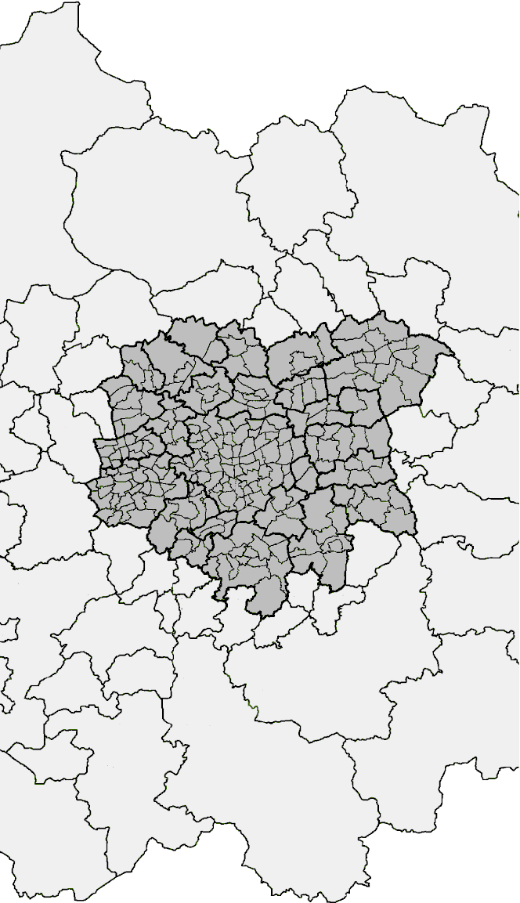
Urban and Regional Models: Integration across Space, Time and Policy Fields
Michael Wegener
Symposium Integration of Land-Use and Transport Models
TUM Science & Study Center, Raitenhaslach, 2-4/11/2016

Slide 2
Objective
2

Slide 3
Objective
Most urban and regional models have been developed for different policy fields at different levels of spatial and temporal resolution.
But it has become apparent that urban policy fields are interdependent and need to be modelled together.
The first urban and regional models were aggregate in space and static in time. More recently new data sources and computer techniques have stimulated a trend towards ever more disaggregation in space and time.
This paper argues for models that are instead multi-level and multi-scale in subsystems, space and time.

Slide 4
Trends in Urban Modelling
4

Slide 5
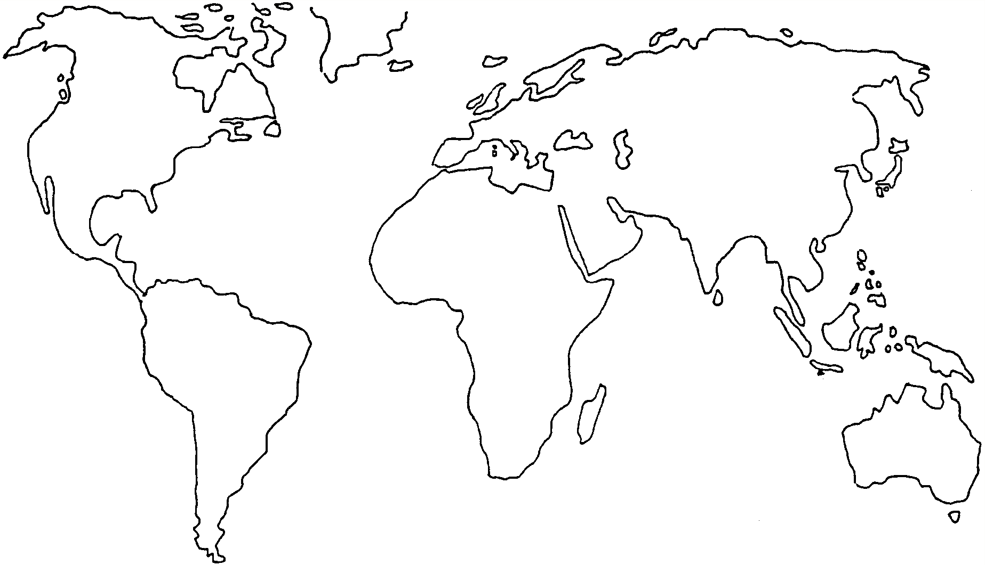
Urban models in the 1980s
Urban models today
SAL
URB
MEP
IMR
PEC
DEL
MEP
TLU
ILU
LIL
ILM
IRP
BOY
HUD
TXL
PUM
IRP
CUF
MET
STA
KIM
ITL
MAR
KIM
CAL
ITL
RUR
POL
POL
OSA
TRA
MUS
TRE
TOP
5
5

Slide 6
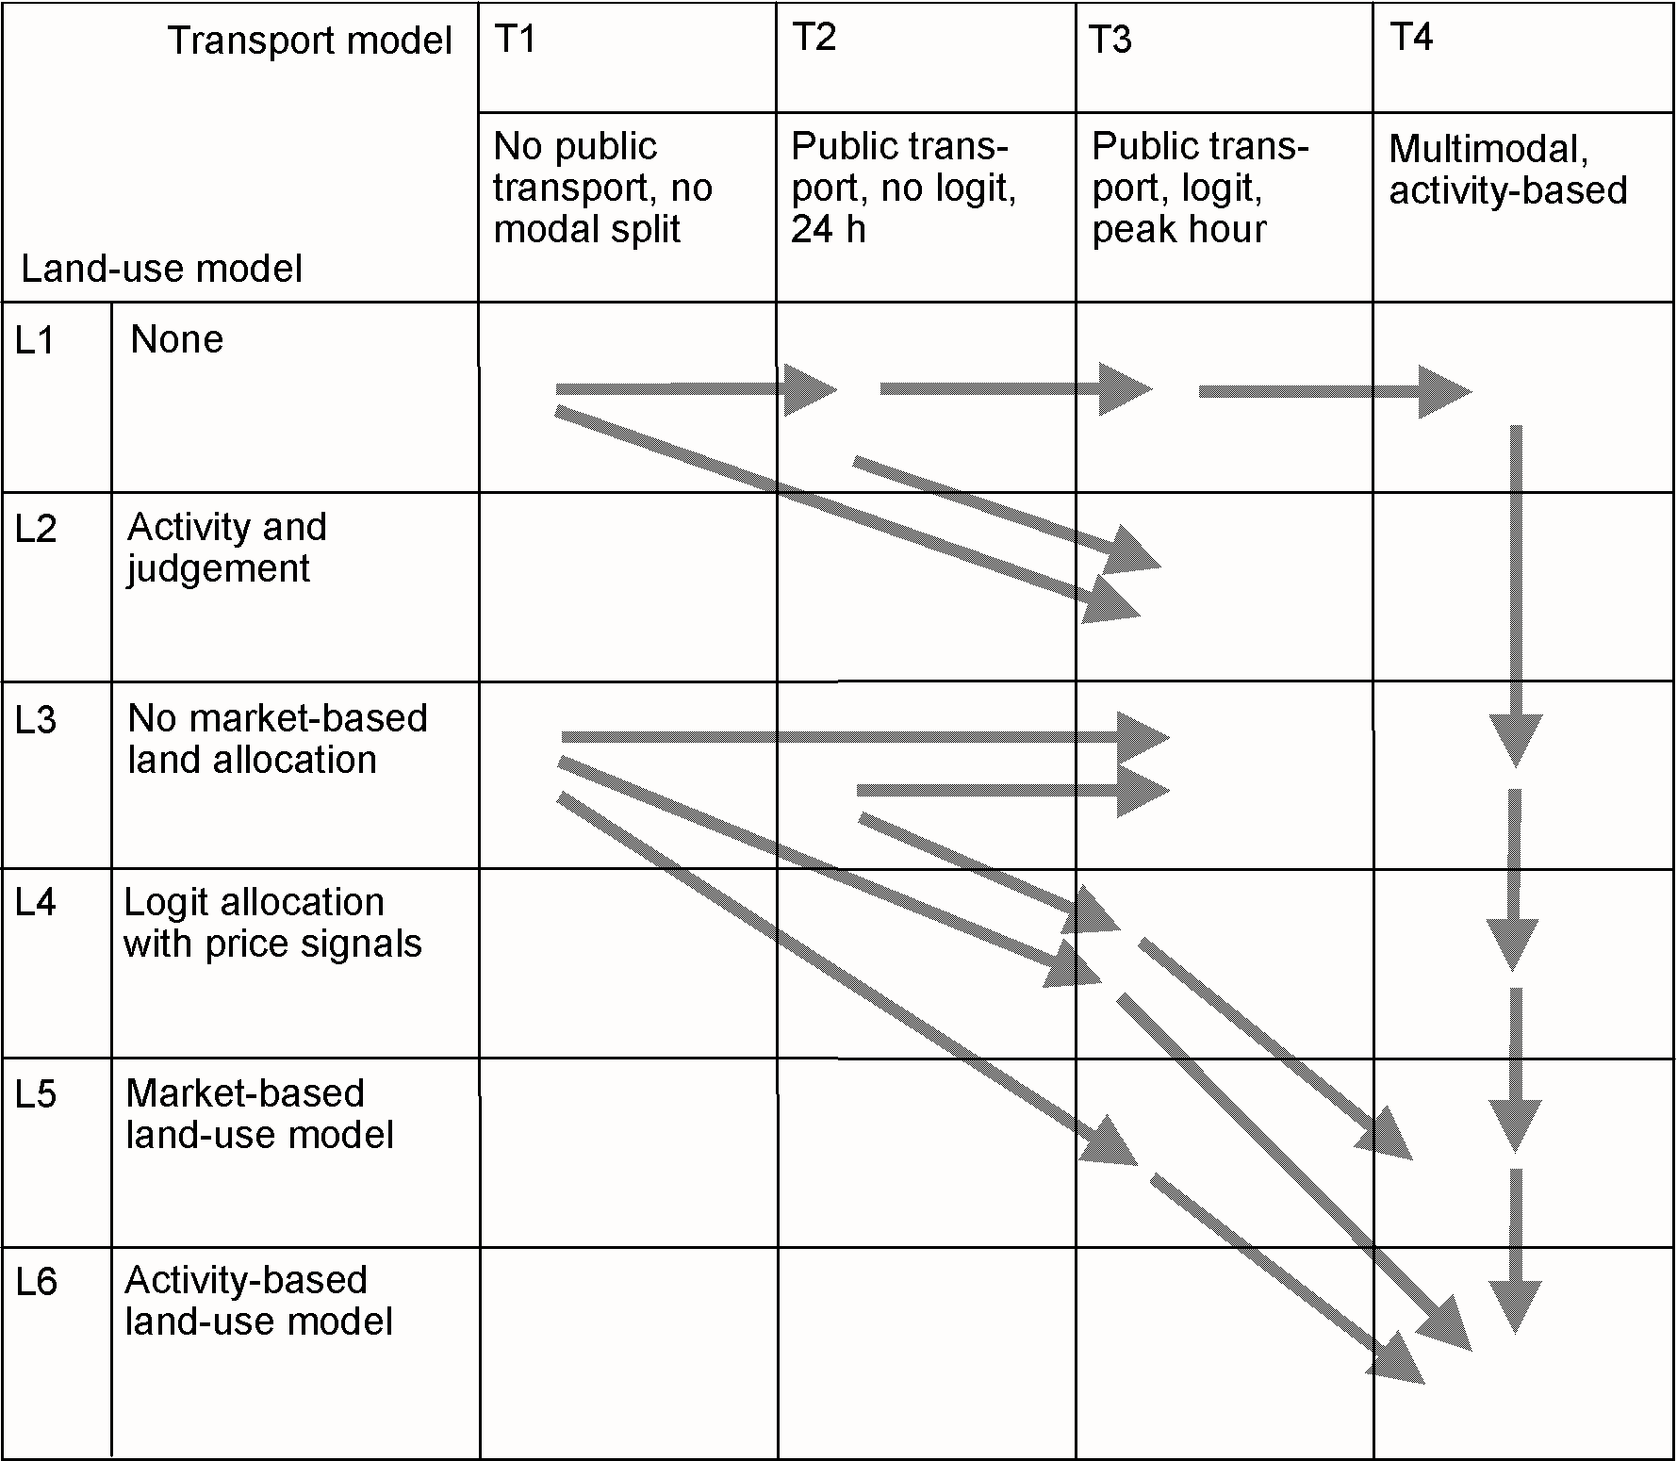
Trends in urban modelling
CUF
KIM
POL
STA
MAR
DEL
IRP
IMR
MPL
MEP
MET
MUS
RUR
PEC
Development path
TRA
TRE
TLU
TXL
(adapted from Miller et al. 1998)
ILT
ILM
URB
PUM

Slide 7
ILUMASS
7

Slide 8
The ILUMASS project (2001-2006)
The project ILUMASS (Integrated Land-Use Modelling and Transport Systems Simulation) combined
a microscopic activity-based simulation model of urban traffic flows
a microscopic agent-based model of household and firm development and the resulting changes of land and housing markets.
a model of environmental impacts.

Slide 9
Land use
ILUMASS
model
Population
- housing
- households
- persons
- cars
Accessibility
- of jobs
- of shops
- of population
- of facilities
Firms
- floorspace
- firms
- jobs
Transport
Person travel
demand
- activities
- week plans
- trips
Dynamic
assignment
- link flows
Goods trans-port demand
- activities
- trips
Environmental impacts
Impacts
- air quality
- traffic noise
at housing
Emissions
- air pollution,
- traffic noise
at sources
Impacts
- air quality,
- traffic noise
at work

Slide 10
ILUMASS model dimensions
1.2 million households
2.6 million persons
1.2 million dwellings
80,000 firms
92,000 industrial sites
8,400 public transport links
848 public transport lines
13,000 road links
246/54 internal/external zones
209,000 raster cells
30 simulation periods (years)
3-5 days computing time)
Conclusions

Slide 11
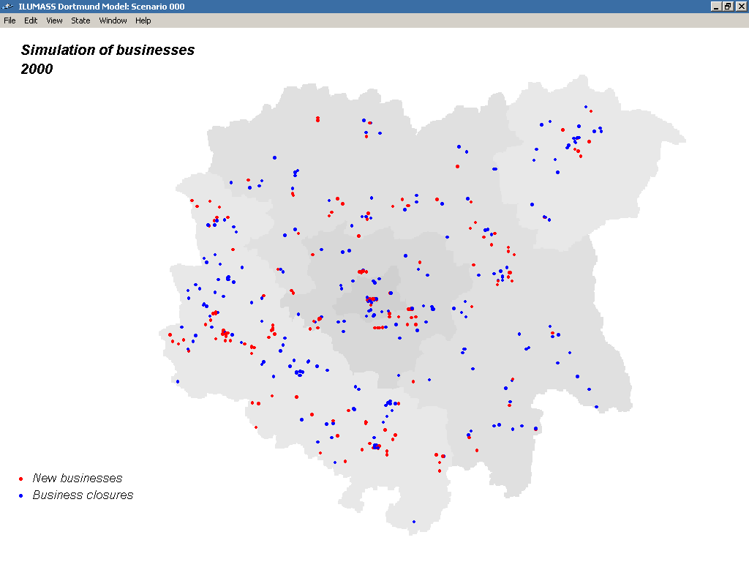
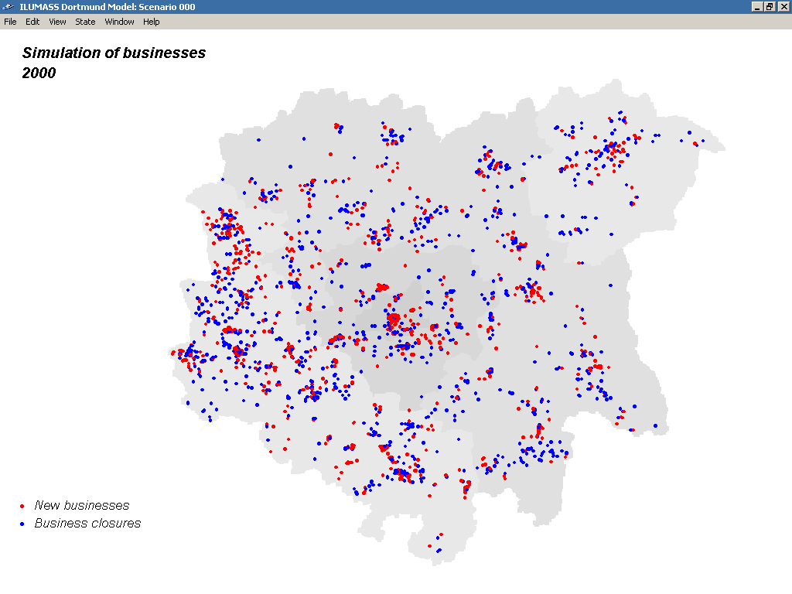
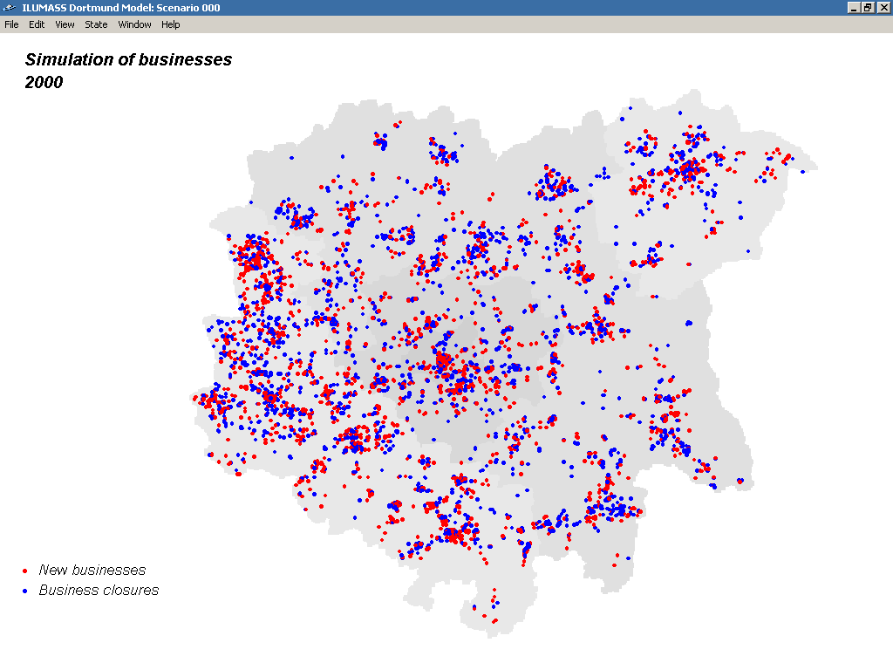
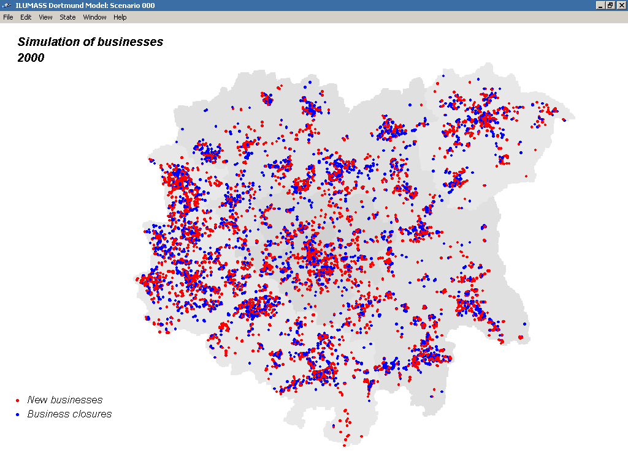
Firms
Firms/households
Firms/households
Firms/households
Firms
Firms/households
New firms
New households
New firms
New households
New firms
New households
New firms
New households
11
11
11
11
Births(Deaths ►

Slide 12
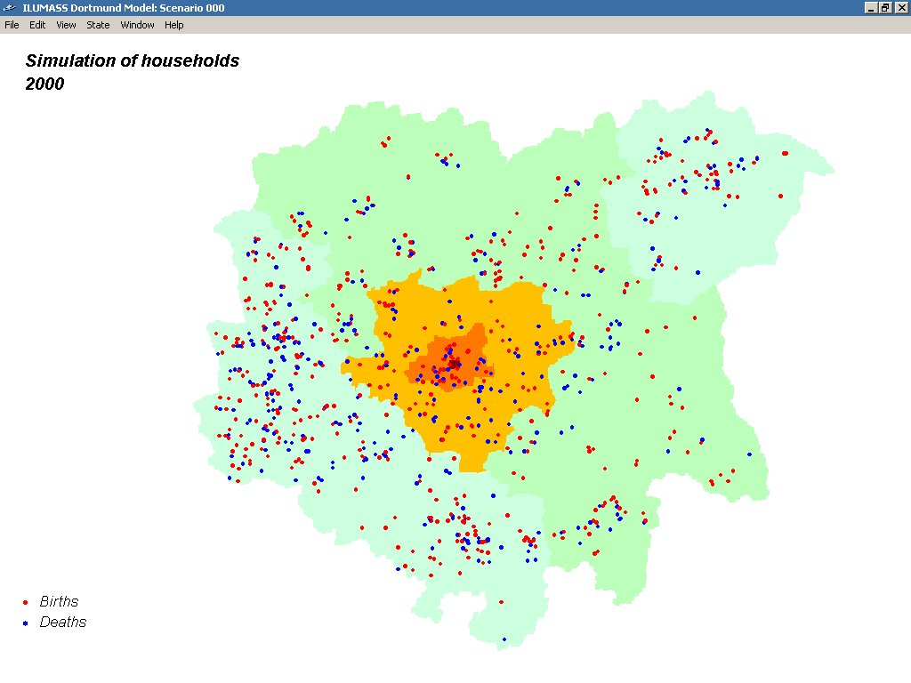
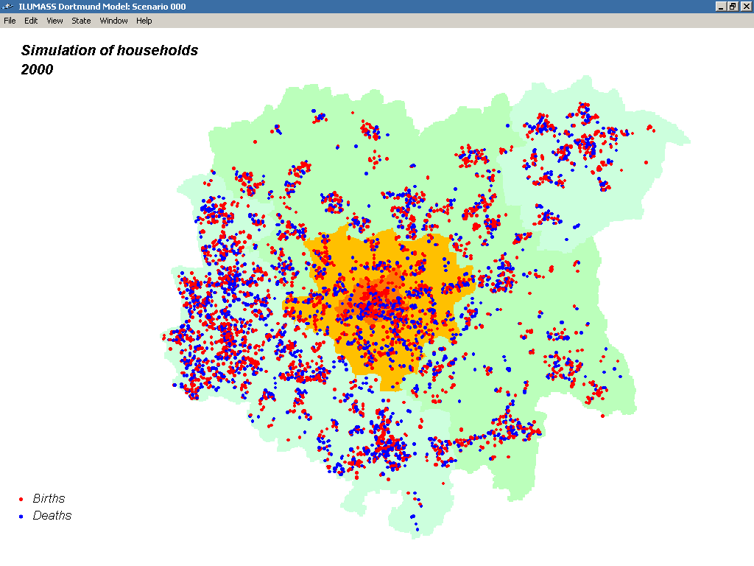
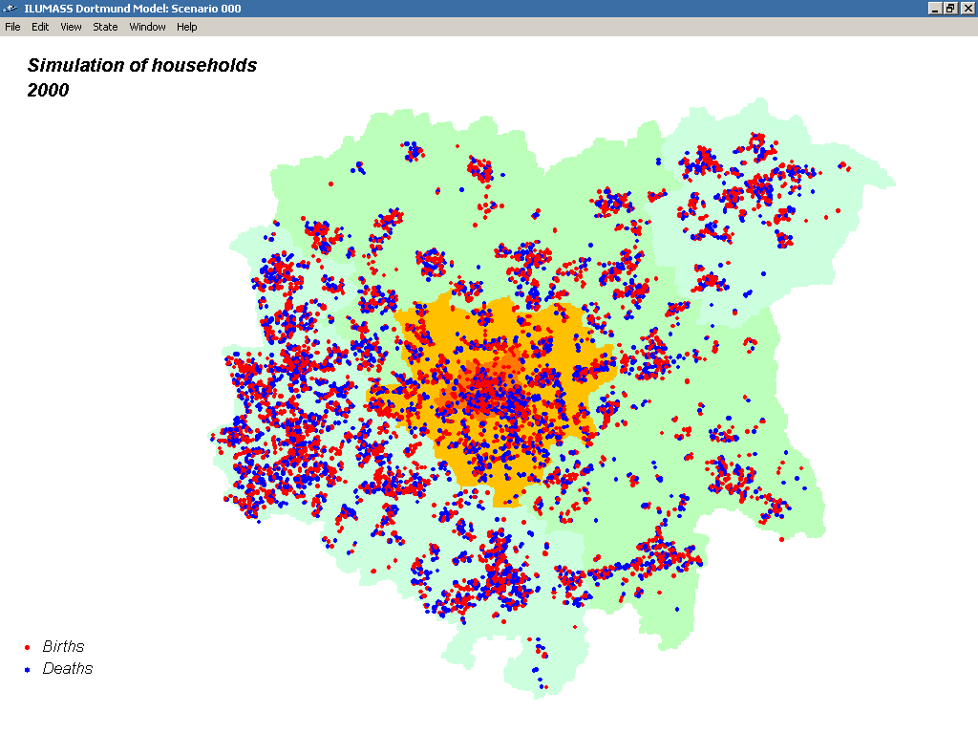
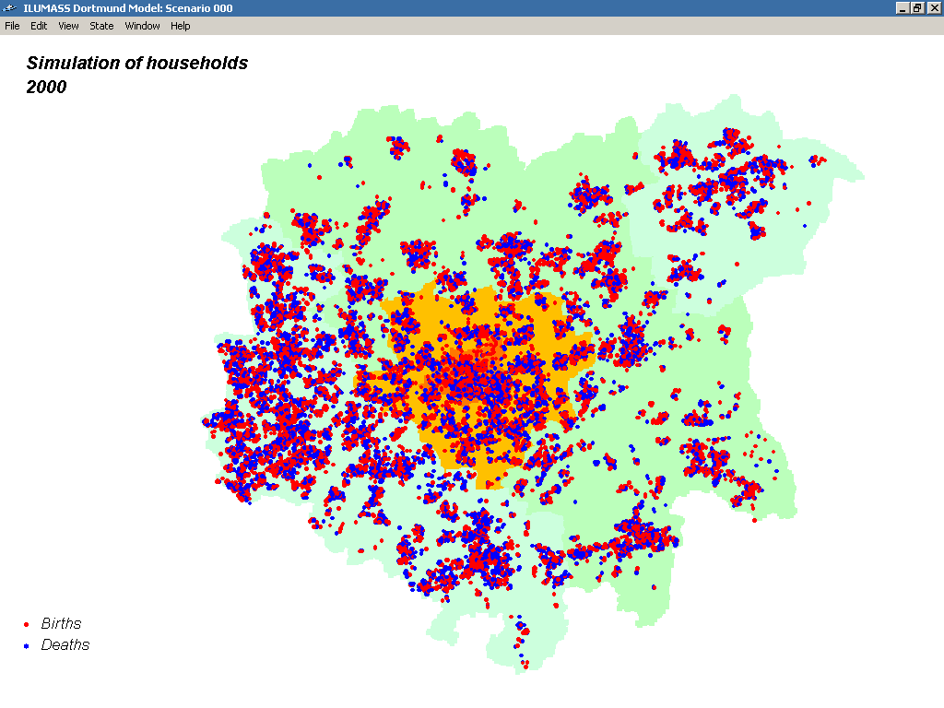
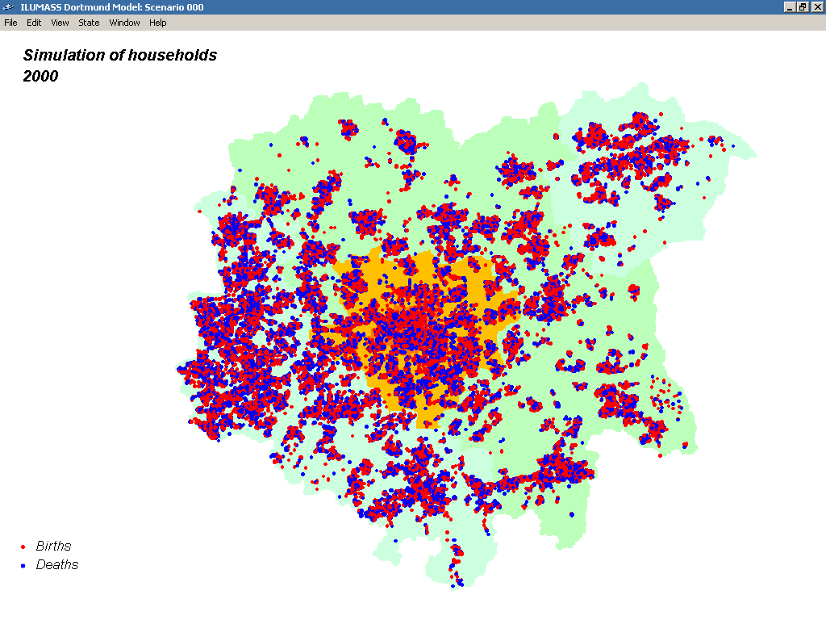
Households
Births/deaths
Households
Births/deaths
Households
Births/deaths
Households
Births/deaths
Households
Births/deaths
Households
Births/deaths
Births
Deaths
Births
Deaths
Births
Deaths
Births
Deaths
Births
Deaths
Births
Deaths
12
12
12
12
12
12
Dwellings ►

Slide 13
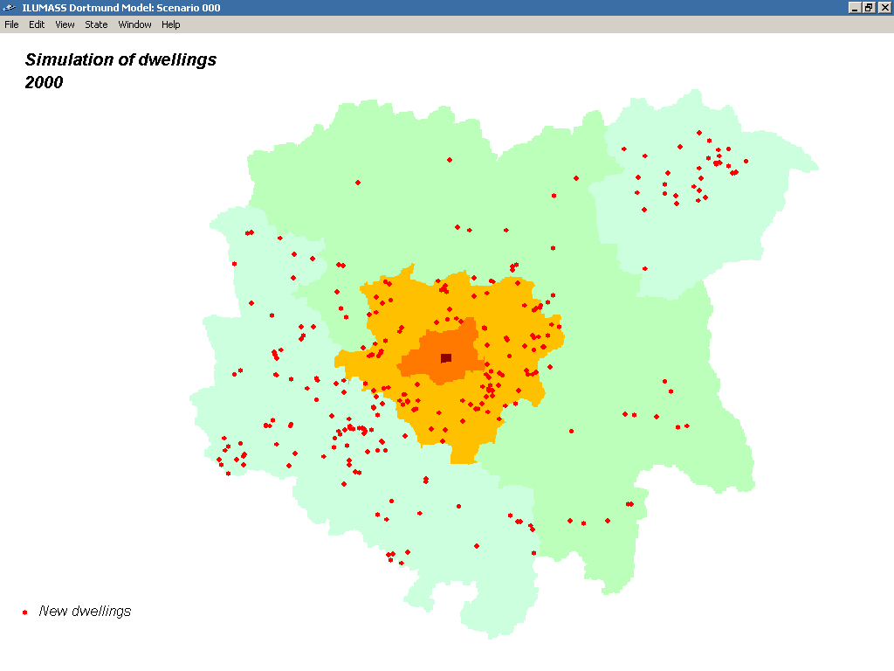
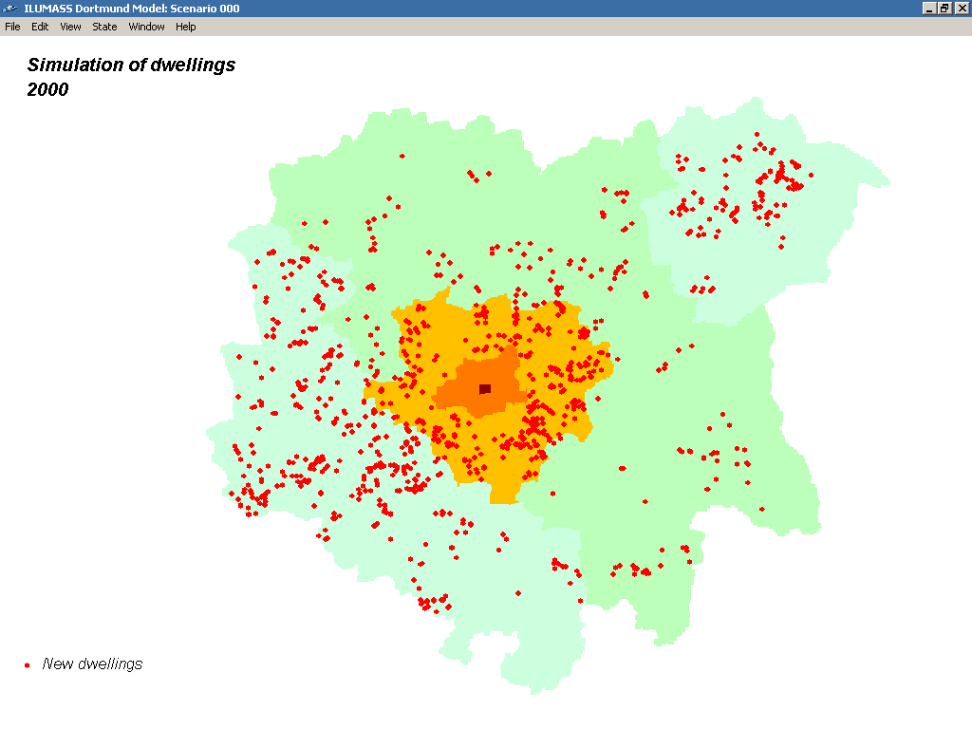
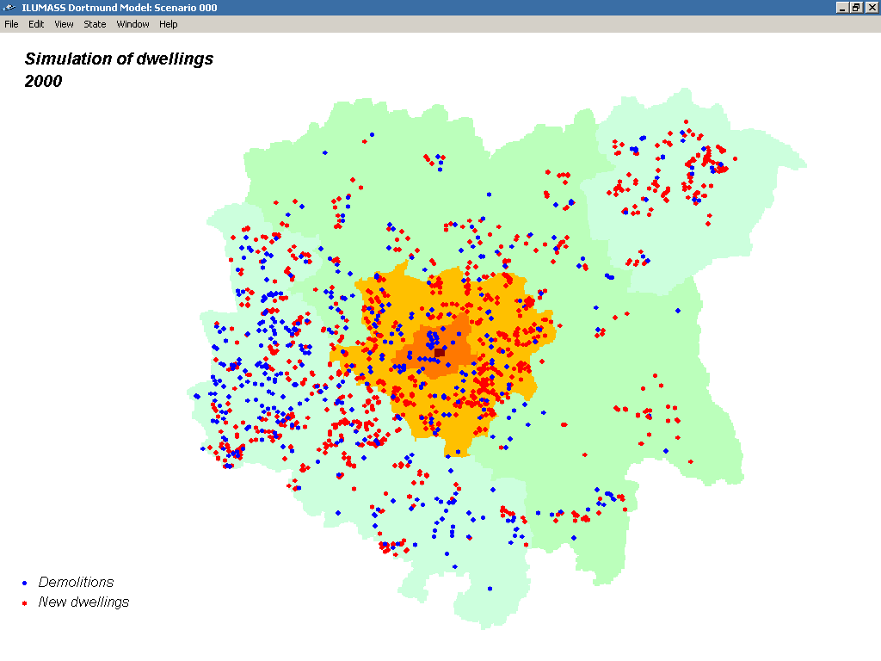
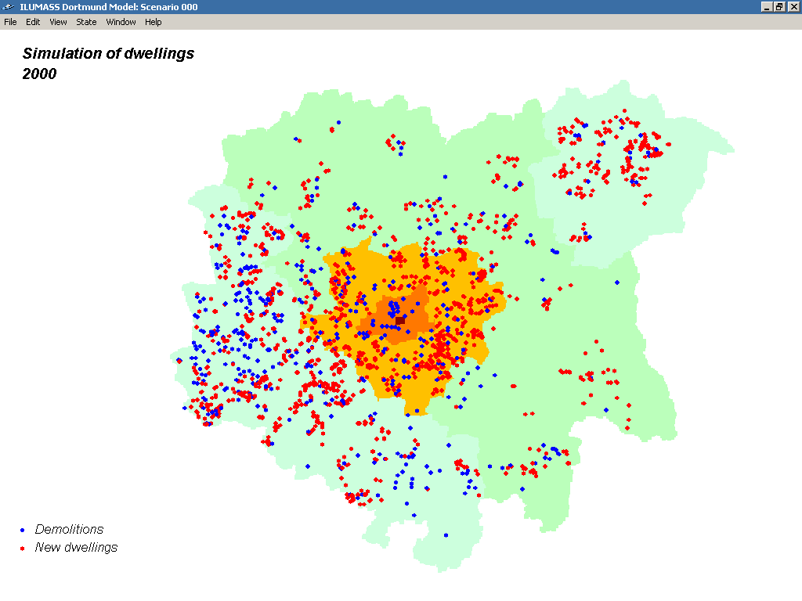
Households
Dwellings
Dwellings
Households
Dwellings
Households
Dwellings
New dwellings
Demolitions
New dwellings
New dwellings
Demolitions
New dwellings
Demolitions
13
13
13
13
13
Moves ►

Slide 14
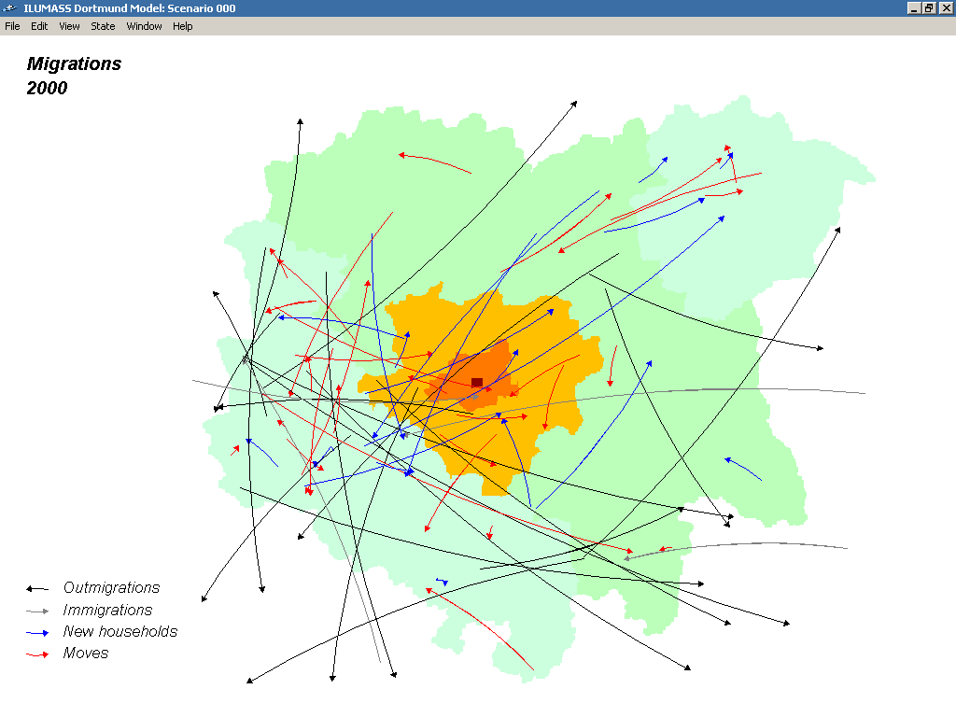
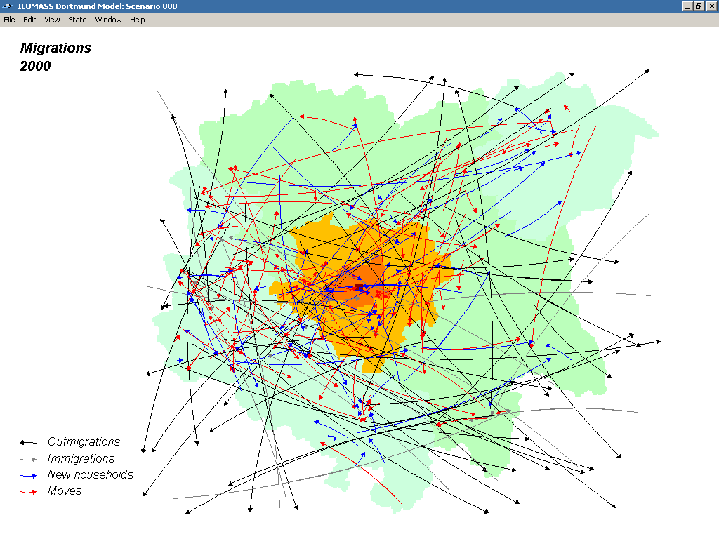
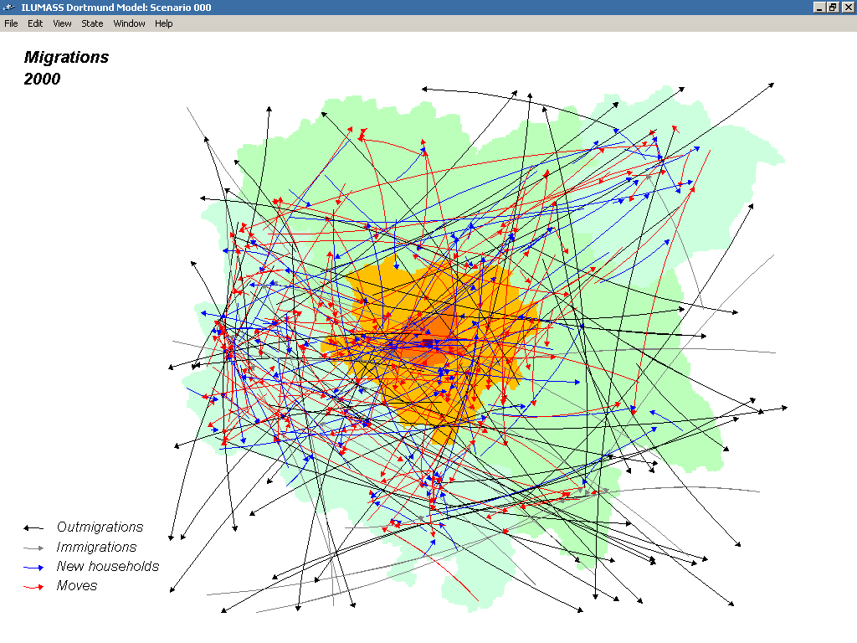
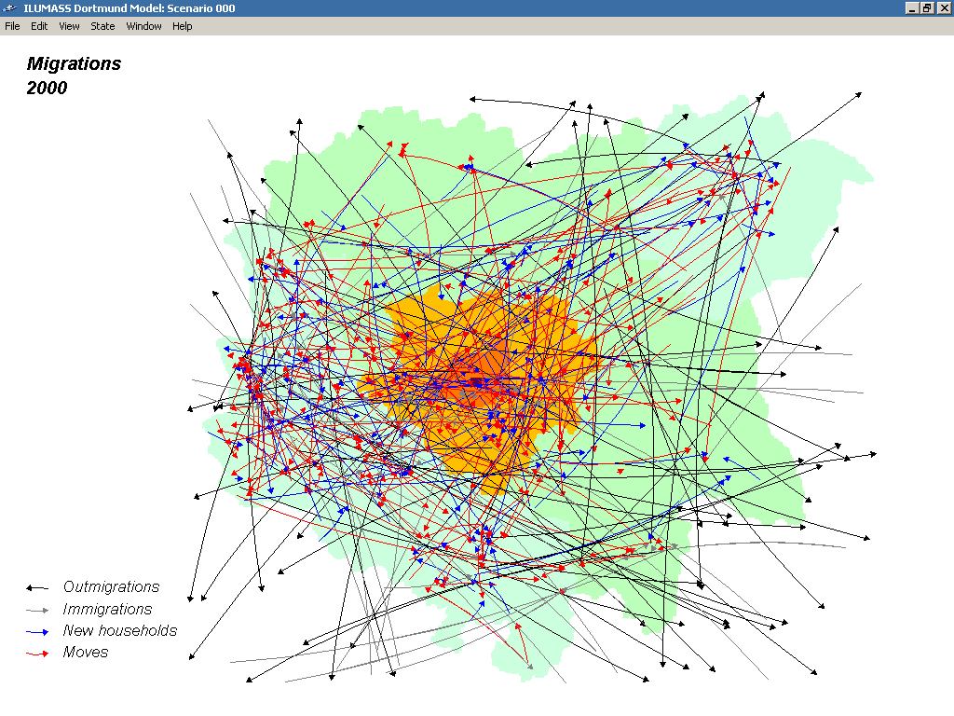
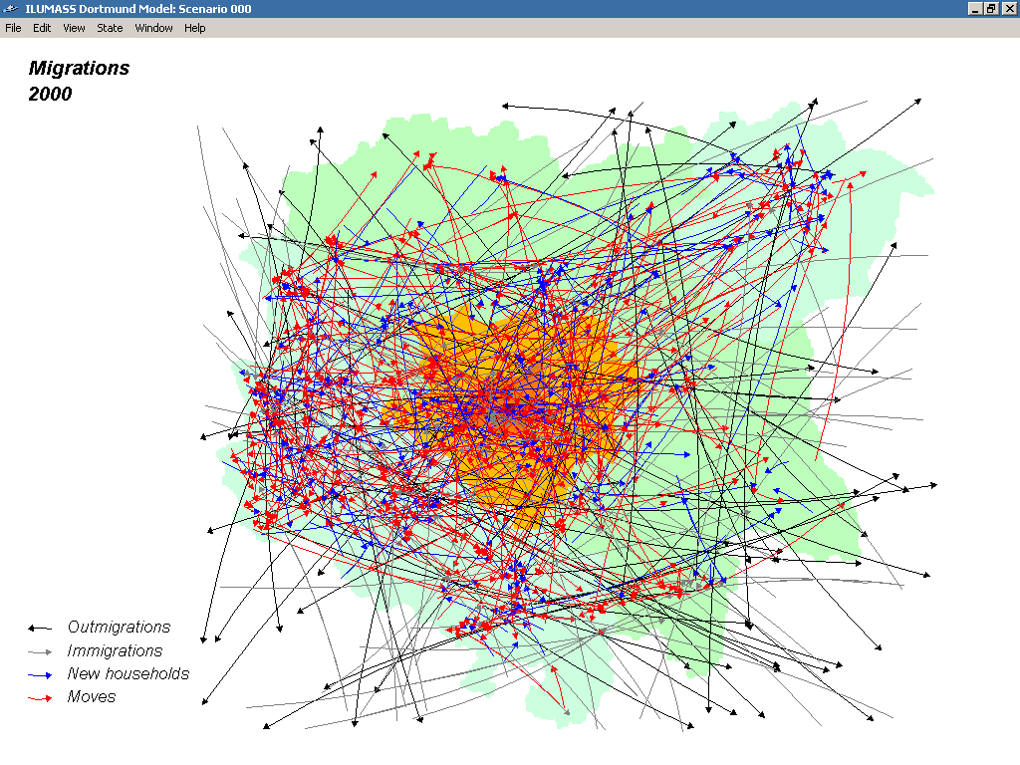
Households
Moves
Moves
Moves
Moves
Moves
Outmigration
Immigration
New household
Move
Outmigration
Immigration
New household
Move
Outmigration
Immigration
New household
Move
Outmigration
Immigration
New household
Move
Outmigration
Immigration
New household
Move
14
14
14
14
14
End of ILUMASS ►

Slide 15
The end of ILUMASS
The ILUMASS project was quite successful.in developing individual submodels..
However, it was not successful in implementing the planned integrated model of land use and transport:
The land use, transport and environment submodels of ILUMASS were independent executables.
The application programming interface (API) connecting submodels via files never worked properly.
Data exchange between submodels was slow.
The computing times of the transport submodels took days for each year.
Conclusions

Slide 16
The "little" ILUMASS
After the end of the project the Dortmund group decided to replace the microscopic transport and environmental sub-models were replaced by the aggregate transport model of the IRPUD model and by simpler environmental impact models.
The resulting "little" ILUMASS model consisted of only two executables and took only 90 minutes for the whole 30-year simulation.
Conclusions

Slide 17
Mircosimulation
17

Slide 18
Microsimulation
New activity-based microsimulation models improve
urban simulation models:
- Lifestyles can be represented, i.e. households and individuals can be disaggregated to the agent level.
- Environmental impacts and feedback can be modelled with the required spatial resolution.
- Population and employment can be represented by their decision making units, i.e. households and firms.
- Microlocations can be represented. Households affected by environmental impacts can be localised.
PROPOLIS & ILUMASS

Slide 19
However ...
To date, no full-scale microsimulation model of urban land use, transport and environment has become operational.
There are still unresolved problems regarding the inter-faces between the submodels.
The feedback between transport and environmental quality and location has not yet been implemented.
The computing time for existing models is calculated in terms of weeks or days, not hours.
Serious problems of calibration, instability and random fluctuations have not yet been solved.
Conclusions

Slide 20
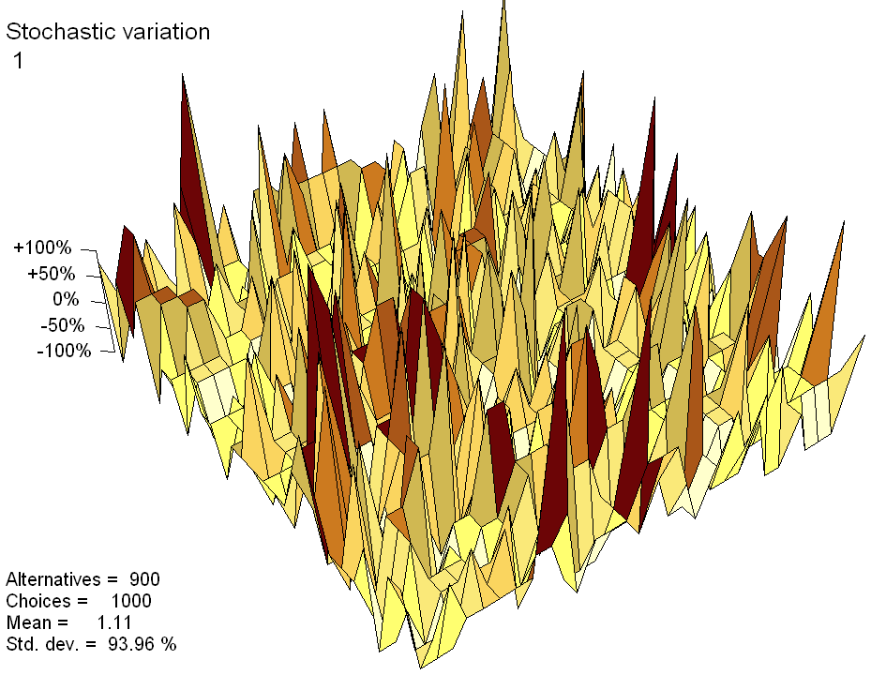
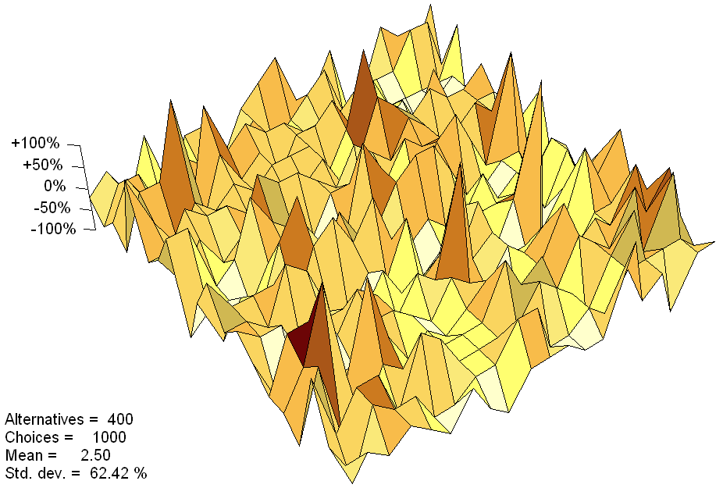
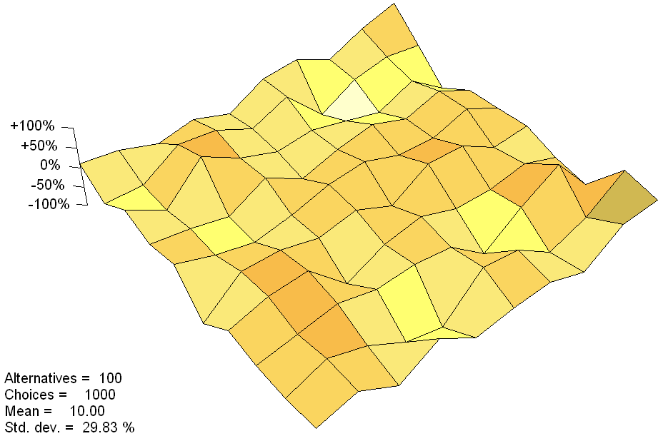
Stochastic variation
Stochastic variation
Stochastic variation
1000 choices
100 alternatives
Wegener (2011)
1000 choices
400 alternatives
Wegener (2011)
1000 choices
900 alternatives
Wegener (2011)
20
20
20

Slide 21
Limits of microsimulation
There are ultimate limits to increasing the substantive,
spatial and temporal resolution of behavioural models:
- There are theoretical limits when the number of pro-cesses simulated is too small to yield reliable results.
- There are empirical limits when the marginal costs of obtaining micro data are larger than their added value.
- There are practical limits when the computing time of the models exceed the duration of the modelled processes.
- There are ethical limits to the collection of data about private lives for purposes of research.
Conclusions

Slide 22
How much micro is enough?
There seems to be little consideration of the benefits and costs of microsimulation:
- Where is microsimulation really needed?
- What is the price for microsimulation?
- Would a more aggregate model do?
For spatial planning models, the answer to these questions depends on the planning task at hand.
Conclusions

Slide 23
Multi-level, Multi-scale Models
23

Slide 24
Model levels
Multi-level
Dortmund City
Dortmund
Dortmund
Multi-scale
Regions
Zones
Raster cells

Slide 25
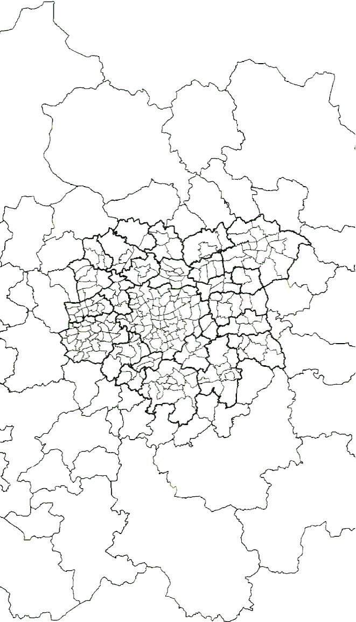
Level 1: regions
Dortmund City
Dortmund
Dortmund
Regions
Zones
Raster cells

Slide 26
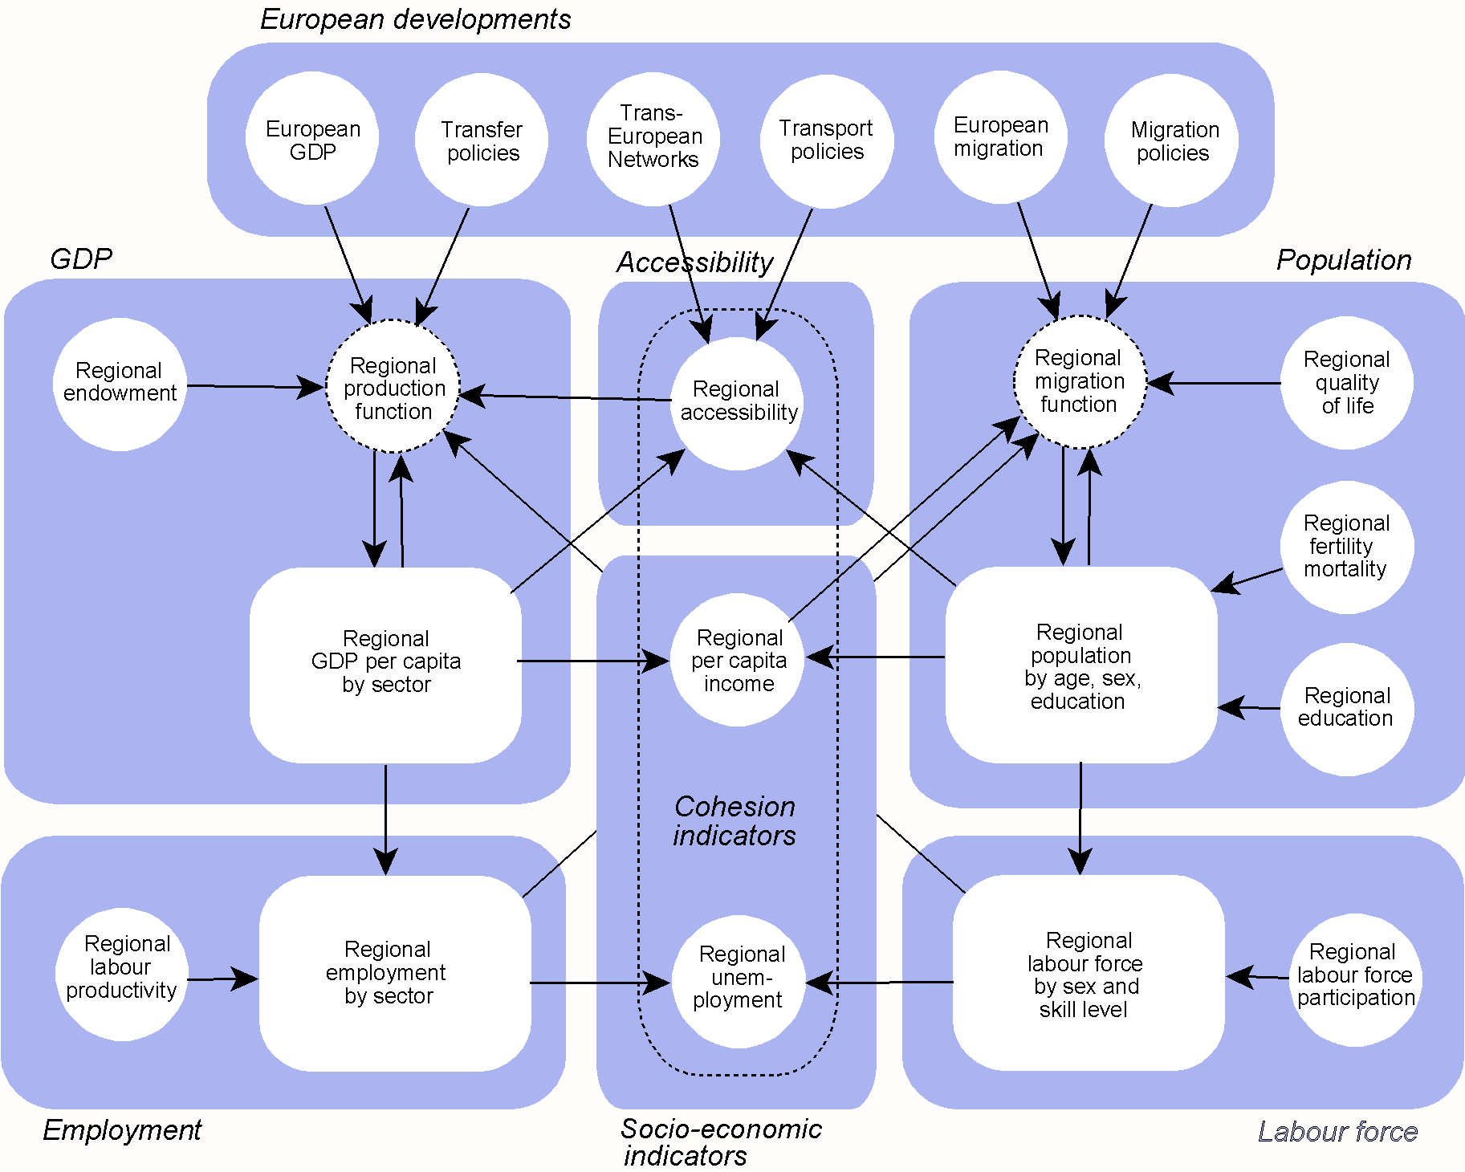
SASI model
Transport
policy
Production
function
Accessibility
Migration
function
GDP
Income
Population
Employment
Unemploy-
ment
Labour
force

Slide 27
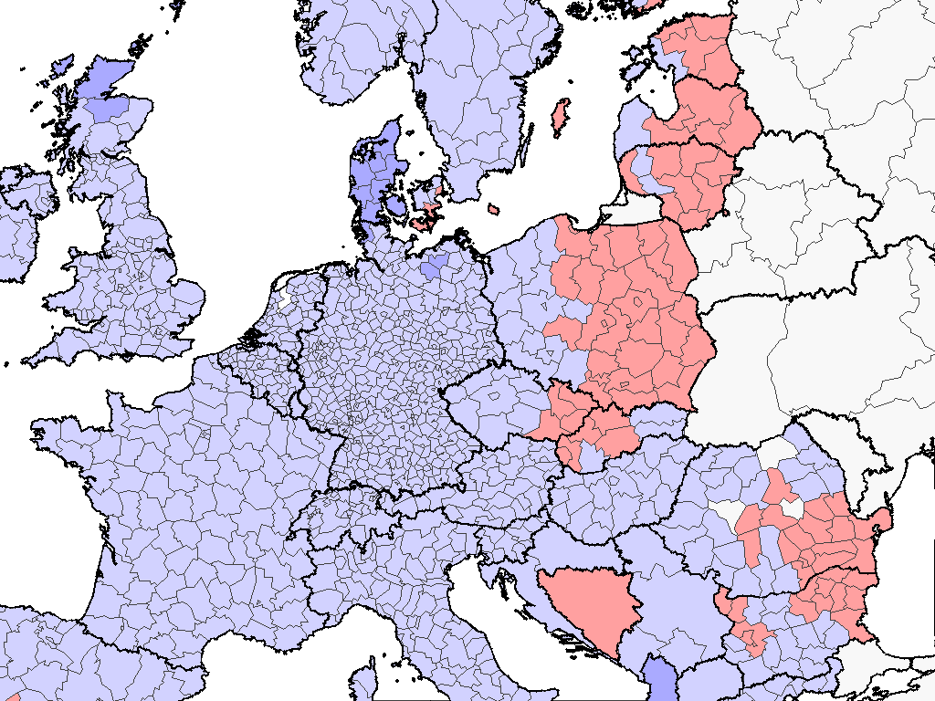
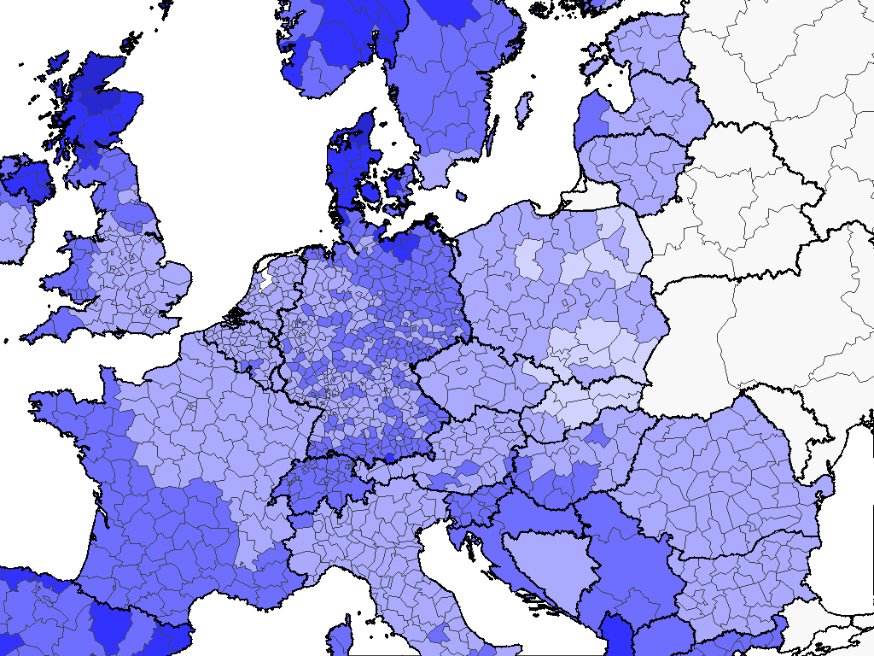
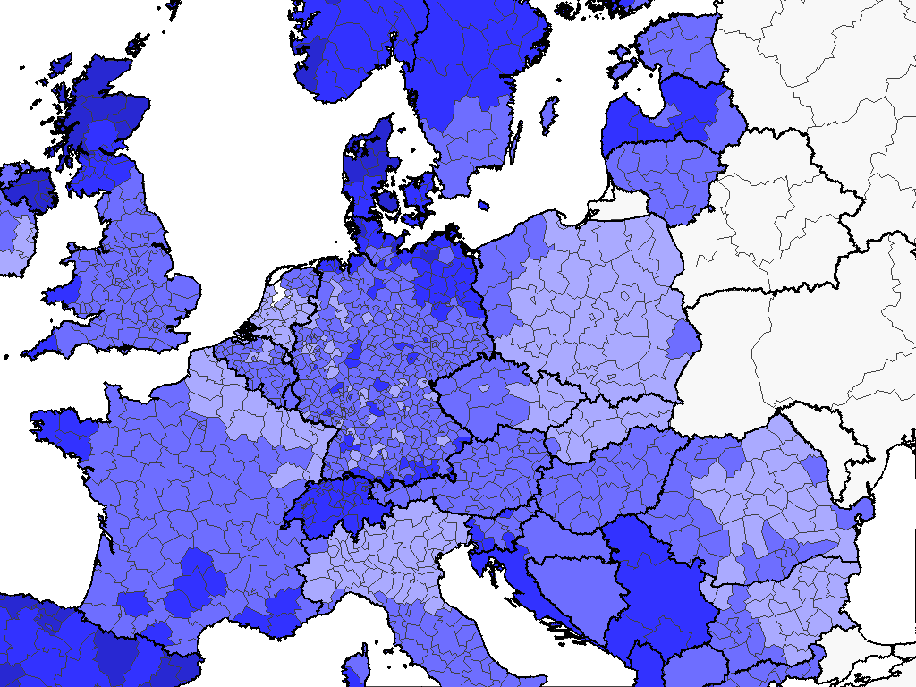
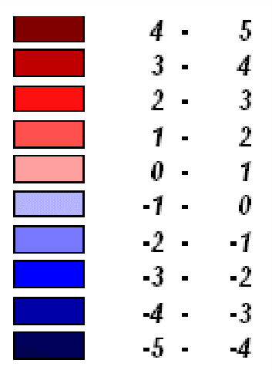
Scenario A1
GDP per capita
Difference from
Scenario A-1
in year 2031
Scenario B1
GDP per capita
Difference from
Scenario A-1
in year 2031
Scenario C1
GDP per capita
Difference from
Scenario A-1
in year 2031
8 - 10
6 - 8
4 - 6
2 - 4
0 - 2
-2 - 0
-4 - -2
-6 - -4
-8 - -6
-10 - -8
8 - 10
6 - 8
4 - 6
2 - 4
0 - 2
-2 - 0
-4 - -2
-6 - -4
-8 - -6
-10 - -8
8 - 10
6 - 8
4 - 6
2 - 4
0 - 2
-2 - 0
-4 - -2
-6 - -4
-8 - -6
-10 - -8
Dortmund
Dortmund
Dortmund
27
27
27

Slide 28
Level 2: zones
Dortmund City
Dortmund
Dortmund
Regions
Zones
Raster cells

Slide 29
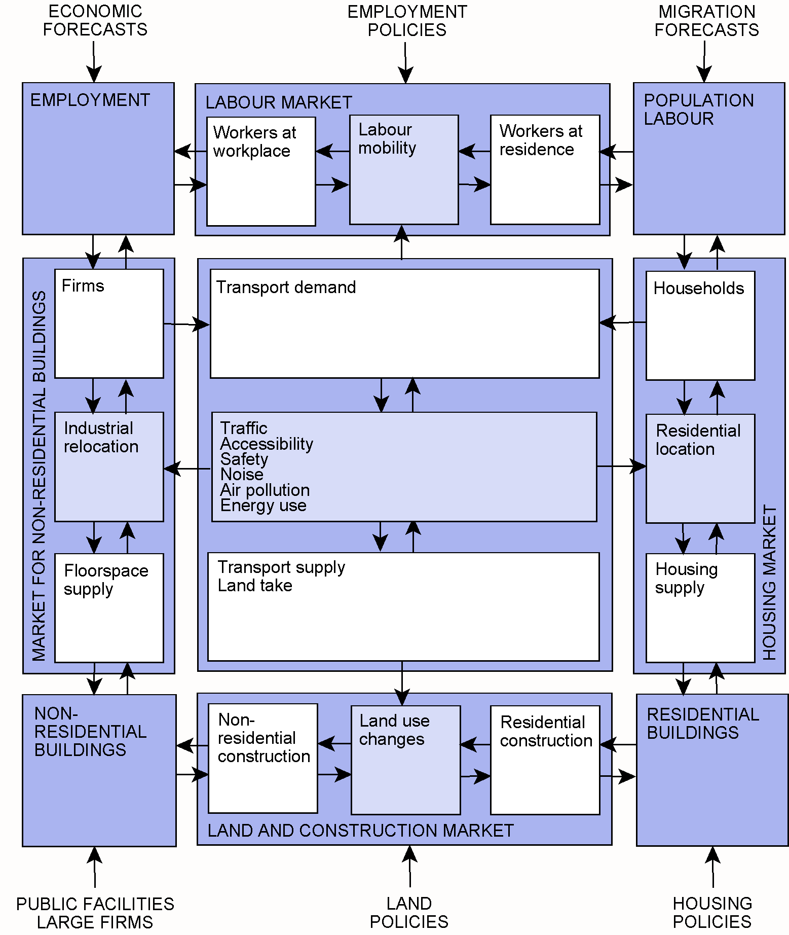
IRPUD model
Employment
Workplaces
Labour
market
Population
households
Market for
nonresidential buildings
Transport
market
Housing
market
from SASI model
Nonresidential
buildings
Land
market
Residential
buildings
Microsimulation

Slide 30
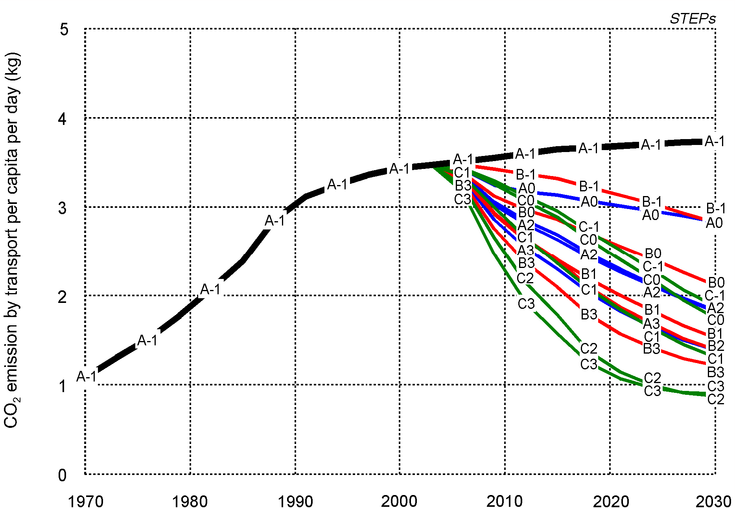
CO₂ emission by transport per capita per day (kg)
CO₂ emission by transport per capita per day (kg)
CO₂ emission by transport per capita per day (kg)
CO₂ emission by transport per capita per day (kg)
CO₂-Emissionen Verkehr je Einwohner je Tag (kg)
CO₂-Emissionen Verkehr je Einwohner je Tag (kg)
CO₂ emission by transport per capita per day (kg)
-20%
-20%
-20%
-20%
CO₂-Emissionen je Einwohner je Tag (kg)
CO₂-Emissionen je Einwohner je Tag (kg)
-30%
CO₂ emission by transport per capita per day (kg)
-30%
CO₂ emission by transport per capita per day (kg)
-40%
30
30
30
30
30
30
30
30
30
30
30
30
30
30
30
30
30
30
30

Slide 31
Level 3: raster cells
Dortmund City
Dortmund
Dortmund
Regions
Zones
Raster cells

Slide 32
Input
Raster model
IRPUD model output
- Population by zone
- Employment by zone
- Floorspace by zone
- Traffic by link
GIS database
- Zones
- Networks
- Land use
Spatial disaggregation
Raster data
- Population
- Employment
- Floorspace
- Traffic
Raster data
- Cars
- Trains
- Busses
- Speeds
Environmental and social impacts
Impacts
- Resource use
Impacts
- Emissions
Impacts
- Air quality
Impacts
- Traffic noise
Impacts
- Environment
Impacts
- Accessibility

Slide 33
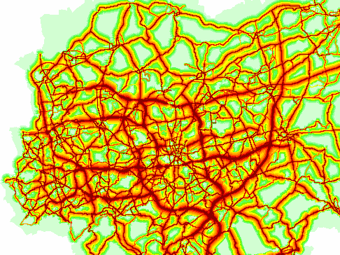
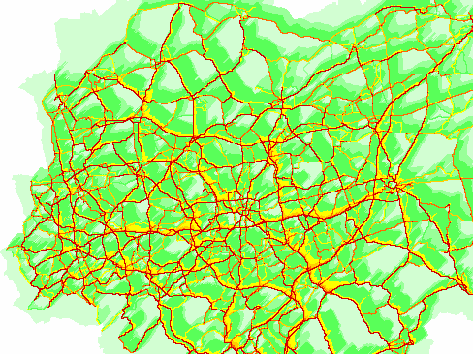
Raster model
Air quality
Raster model
Traffic noise
33
33

Slide 34
New Challenges
34

Slide 35
New challenges for urban models (1)
To cope with the new challenges of energy scarcity and
climate change urban models need to be able to predict
the decision behaviour of households and firms under
fundamentally different conditions:
Climate change: mitigation
- high carbon or fuel taxes
- high road pricing or congestion charges
- heavy use of public transport
- rigorous speed limits, car-free zones
Climate change: adaptation
- flood prevention and management
- rigorous land use controls to prevent development
in floodplains and fresh-air corridors
(continued)

Slide 36
New challenges for urban models (2)
Energy scarcity:
- alternative vehicles/fuels
- decentralised energy (solar, geothermal, photovoltaic)
- heat insulation of buildings
Social conflicts:
- groups/communities most affected by climate change
and energy scarcity
- minimum standards of access to basic services
New technologies:
- car-sharing
- online shopping
- self-driving cars

Slide 37
The Ruhr Model
37

Slide 38
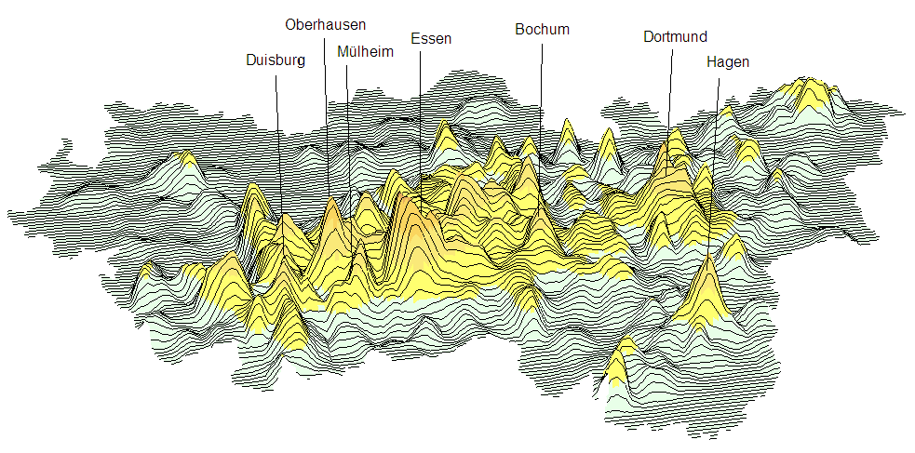
Polycentric Ruhr Area
38

Slide 39
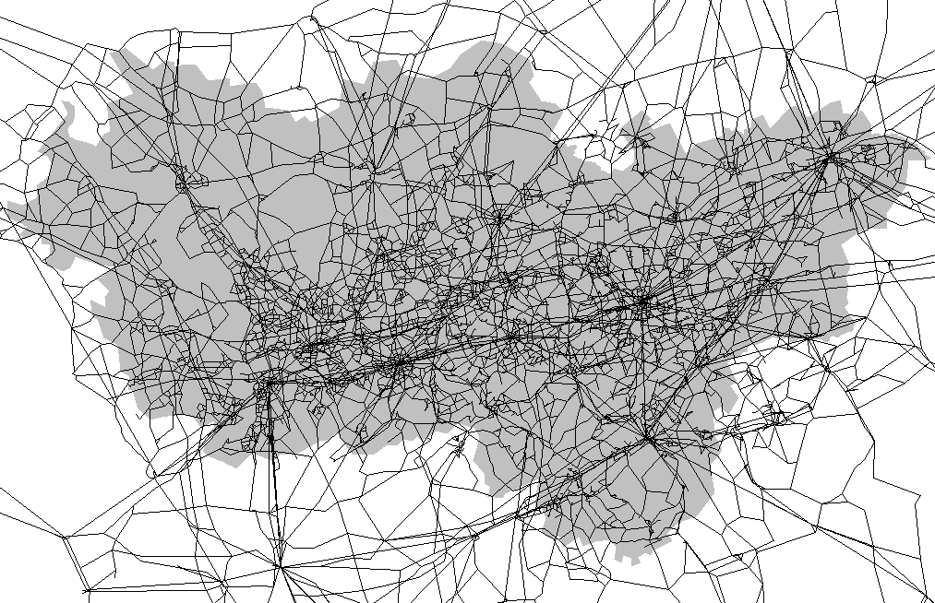
Ruhr model networks
39

Slide 40
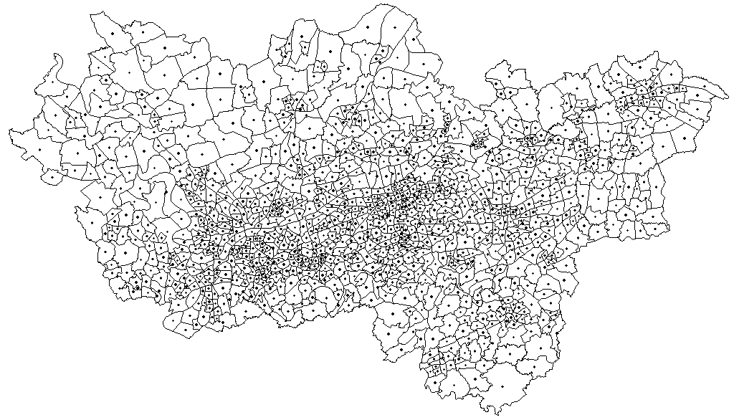
Ruhr model internal zones
40

Slide 41
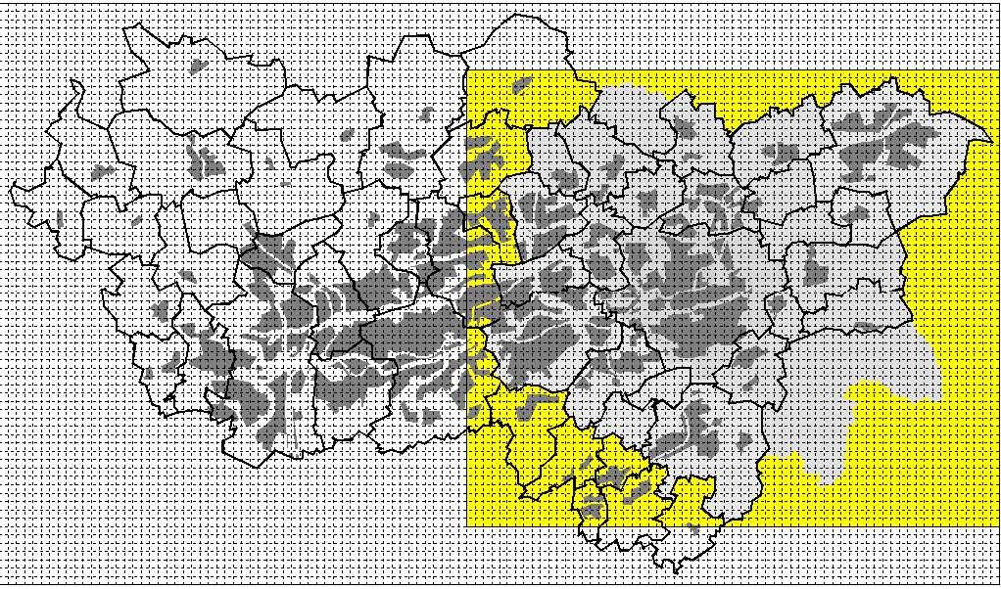
Ruhr model raster cells
70 km
41
120 km

Slide 42
Ruhr model
Employment
Workplaces
Labour
market
Population
households
Energy
CO₂
Energy
CO₂
Market for
nonresidential buildings
Transport
market
Housing
market
Energy
CO₂
Nonresidential
buildings
Land
market
Residential
buildings
Microsimulation
Energy
CO₂
Energy
CO₂

Slide 43
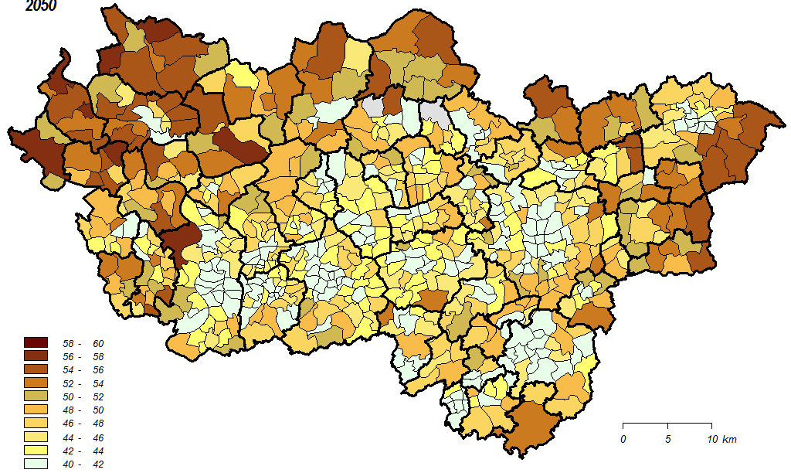
Energy-retrofitted residential buildings 2050 (%)
Scenario A31
43

Slide 44
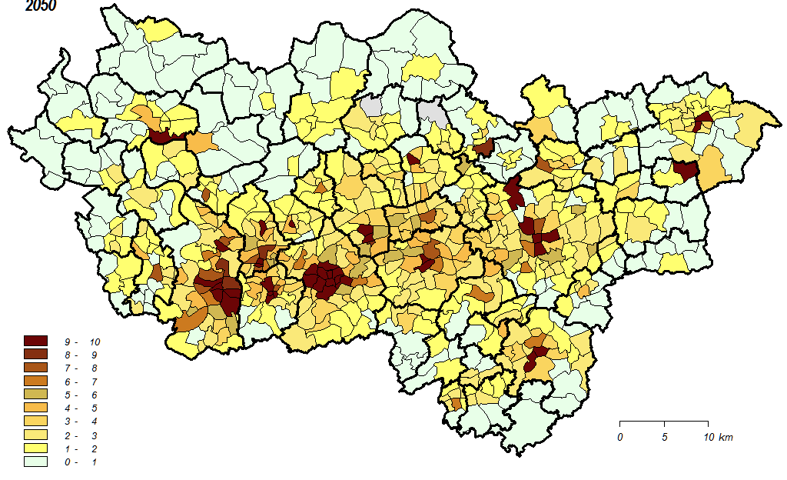
Station-less car-sharing cars 2050 (%)
Scenario A33
44

Slide 45
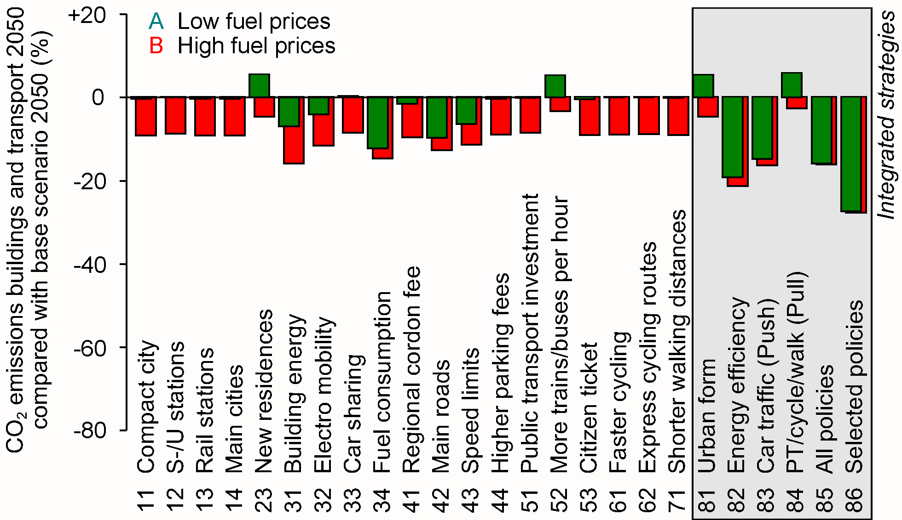
Comparison of scenarios

Slide 46
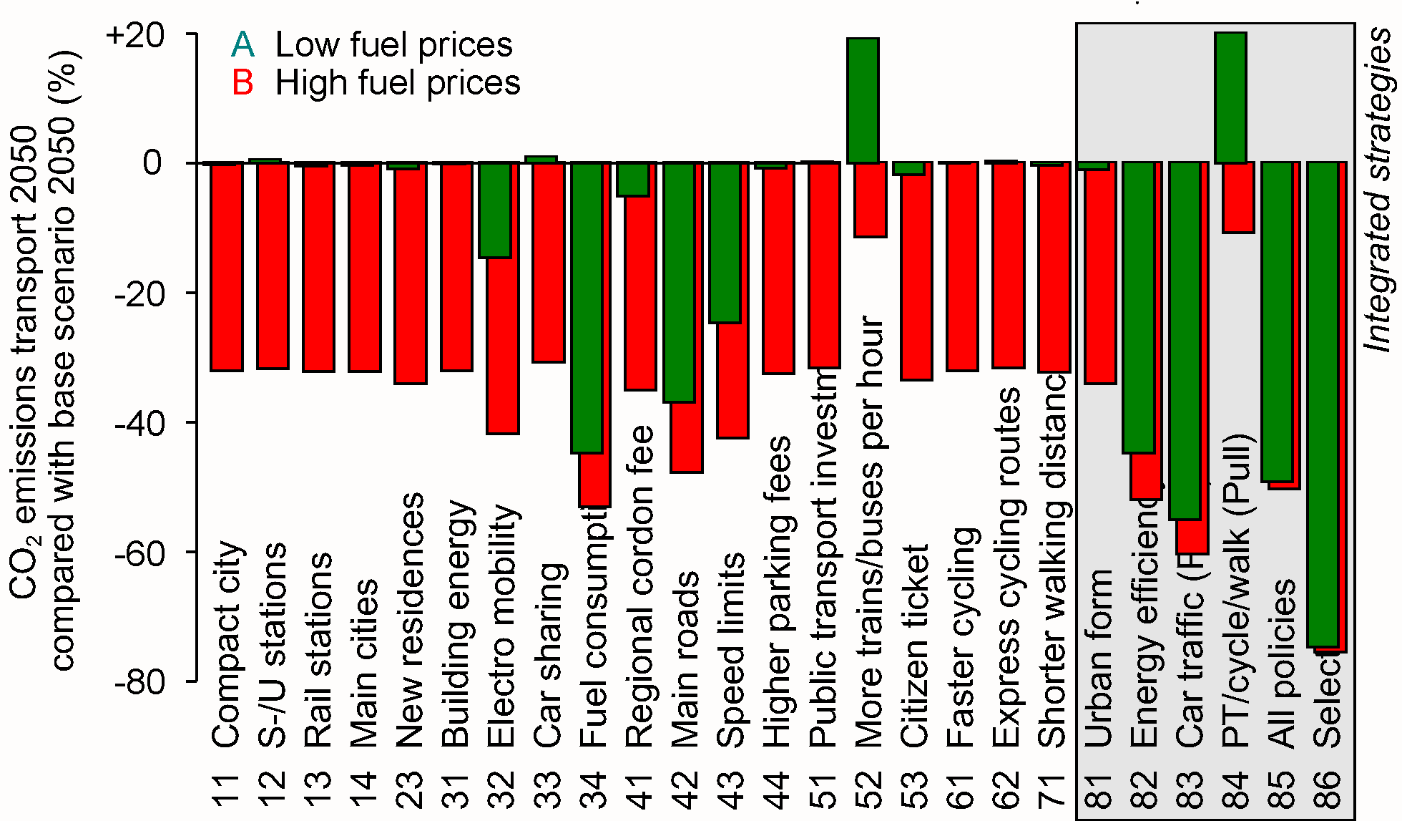
Comparison of scenarios

Slide 47
Conclusions
47

Slide 48
Urban models and fundamental change
The fundamental changes in the problems and priorities
of urban planning will have deep impacts on the philoso-phy and method of urban modelling:
- less detail, more basic essentials
- less extrapolation, more fundamental change
- less equilibrium, more dynamics
- less observed behaviour, more theory on needs
- less preferences and choices, more constraints
- less calibration, more plausibility analysis
- less forecasting, more backcasting (don't ask what
can be done but what needs to be done)

Slide 49
Multi-level, multi-scale models
These considerations lead to a reassessment of the hypo-thesis that in the future all spatial modelling will be micro-scopic and agent-based.
Under constraints of data collection and of computing time, there is for each planning problem an optimum level of conceptual, spatial and temporal resolution.
This suggests to work towards a theory of balanced multi-level models which are as complex as necessary for the planning task at hand and – to quote Albert Einstein – "as simple as possible but no simpler".
Conclusions

Slide 50
More information
Wagner, P., Wegener, M. (2007): Urban land use, transport and environment models: experiences with an integrated microscopic approach. disP 170 (3/2007), 45-56. http://www. spiekermann-wegener.de/pub/pdf/PWMW_ILUMASS.pdf
Wegener, M. (2011): From macro to micro – how much micro is too much? Transport Reviews 31, 2, 161-177.
ILUMASS model:
http://www.spiekermann-wegener.de/mod/ilumassmod.htm
STEPs project:
http://www.spiekermann-wegener.de/pro/steps.htm
Ruhr model:
http://www.energiewende-ruhr.de/
http://www.spiekermann-wegener.de/pro/ruhr2050.htm

