Slide 2
1 Introduction: Artificial Intelligence 18.10.2018 – Johannes Betz | 6 Pathfinding: From British Museum to A* 29.11.2018 – Lennart Adenaw | 11 Reinforcement Learning 17.01.2019 – Christian Dengler
Practice 1 18.10.2018 – Johannes Betz | Practice 6 29.11.2018 – Lennart Adenaw | Practice 11 17.01.2019 – Christian Dengler
2 Perception 25.10.2018 – Johannes Betz | 7 Introduction: Artificial Neural Networks 06.12.2018 – Lennart Adenaw | 12 AI-Development 24.01.2019 – Johannes Betz
Practice 2 25.10.2018 – Johannes Betz | Practice 7 06.12.2018 – Lennart Adenaw | Practice 12 24.01.2019 – Johannes Betz
3 Supervised Learning: Regression 08.11.2018 – Alexander Wischnewski | 8 Deep Neural Networks 13.12.2018 – Jean-Michael Georg | 13 Free Discussion 31.01.2019 – Betz/Adenaw
Practice 3 08.11.2018 – Alexander Wischnewski | Practice 8 13.12.2018 – Jean-Michael Georg
4 Supervised Learning: Classification 15.11.2018 – Jan Cedric Mertens | 9 Convolutional Neural Networks 20.12.2018 – Jean-Michael Georg
Practice 4 15.11.2018 – Jan Cedric Mertens | Practice 9 20.12.2018 – Jean-Michael Georg
5 Unsupervised Learning: Clustering 22.11.2018 – Jan Cedric Mertens | 10 Recurrent Neural Networks 10.01.2019 – Christian Dengler
Practice 5 22.11.2018 – Jan Cedric Mertens | Practice 10 10.01.2019 – Christian Dengler

Slide 3
Feedback from last week

Slide 4
Objectives for Lecture 5: Clustering
Depth of understanding
After the lecture you are able to…
 |  | Remember | Understand | Apply | Analyze | Evaluate | Develop
… understand the concept of clustering and its association to pattern recognition.
… analyze the quality of given clusters regarding to different criteria.
… understand the workflow of unsupervised learning.
… understand the concepts of different clustering methods together with their pro and cons.
… implement, train and use a clustering method with python libraries.
… identify if a problem belongs to regression, classification or clustering.

Slide 5
1. Chapter: Introduction
1.1 Overview
1.2 Training and Validation
2. Chapter: Methods
2.1 Hierarchical Clustering
2.2 k-means
2.3 DBSCAN
3. Chapter: Application
4. Chapter: Summary

Slide 6

Clustering
“Grouping of similar things that are close together,
sometimes surrounding something”
[2]
[1]

Slide 7
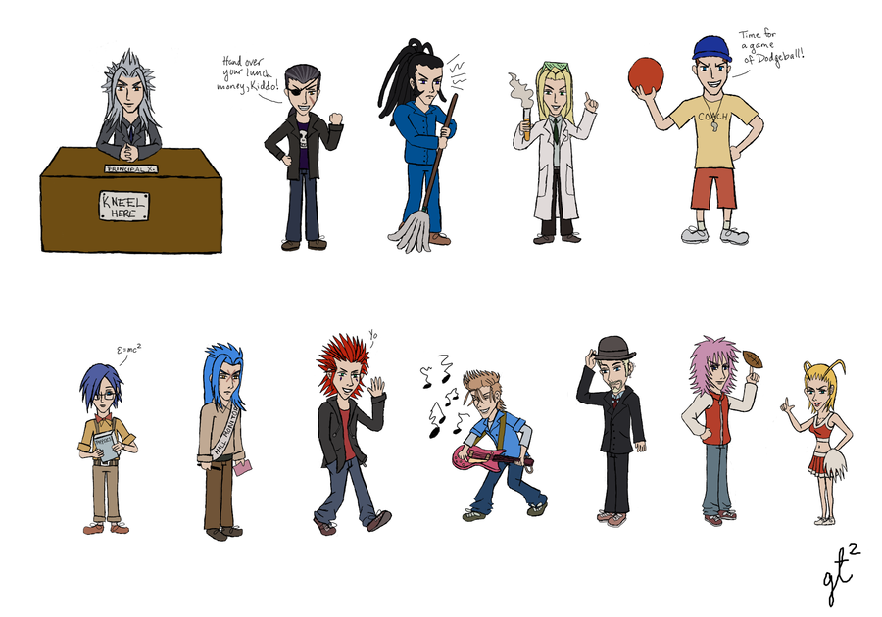
Clustering
“Grouping of similar things that are close together,
sometimes surrounding something”
[2]
[3]

Slide 8
Method Overview
Pattern Recognition
Regression
Predict continuous valued output
Classification
Clustering
Supervised
Predict discrete valued output
Supervised
Predict discrete valued output
Unsupervised
Notes:
Einordnung in die VL
Mensch sehr gut in visueller Mustererkennung

Slide 9
Method Overview
Regression
Classification
Clustering
House pricing
Number of sales
Persons weight
Object detection
Spam detection
Cancer detection
Genome patterns
Google news
Pointcloud (Lidar) processing
Notes:
Einordnung in die VL
Mensch sehr gut in visueller Mustererkennung

Slide 10


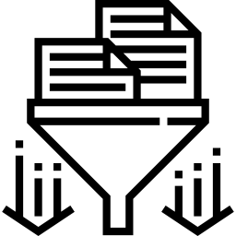
General Approach
Clusters
Dataset
(Features)
Clustering
News (Keywords, …) Similarities? Clusters
Genomes (Size, …) Similarities? Clusters
Points (Position, …) Similarities? Clusters
Notes:
Y€ {0,1}
0 Negative class
1 positive class
Later y€ {0123} Multiclass classification

Slide 11
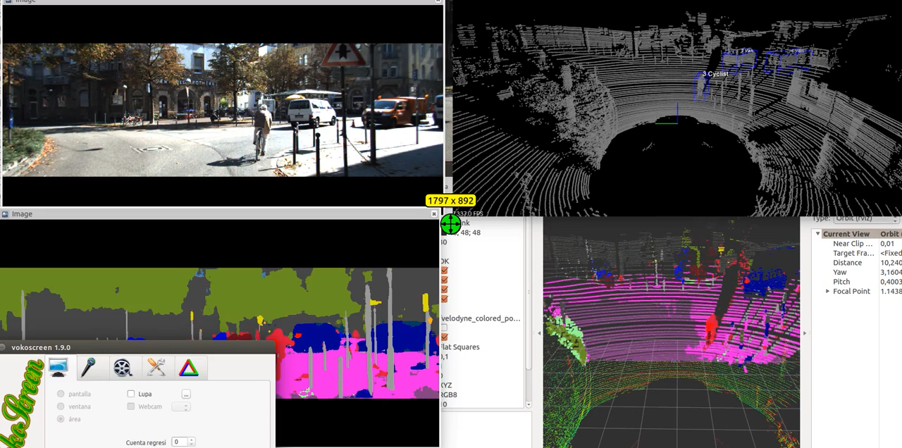
Clustering - Example
Cluster Points
Classifiy subset of cluster
Assign class to cluster
[4]
Notes:
Classification -> Object Detection -> Object Tracking
Keine Classifikation auf der Nebenspur -> Nur Fzg Fronten werden erkannt

Slide 12
Clustering vs. Segmentation
Both terms are interchangable
Statistical background: Clustering
Business background: Segment
Clustering produces segments and vice versa
Notes:
Vorder hintergrund treenung
Segmentation mit klarer tennlinei

Slide 13
1. Chapter: Introduction
1.1 Overview
1.2 Training and Validation
2. Chapter: Methods
2.1 Hierarchical Clustering
2.2 k-means
2.3 DBSCAN
3. Chapter: Application
4. Chapter: Summary

Slide 14
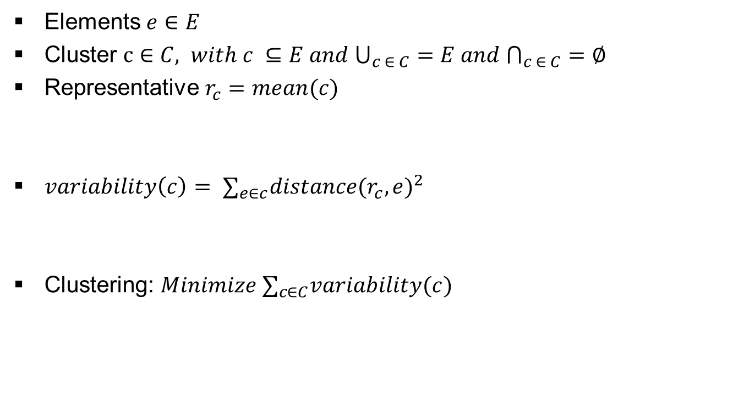
Formal Definition - Clustering
Elements $e∈E$
Cluster $c∈C, with c ⊆E and ⋃_{c ∈ C}=E and ⋂_{c ∈ C}=∅$
Representative $r_{c}=mean(c)$
$variability\left(c\right)= ∑_{e∈c}distance(r_{c},e)^{2}$
Clustering: $Minimize ∑_{c∈C}variability(c)$
Notes:
Menge E zeichnen
Cluster rein das über E raus geht
Zwei Cluster die sich schneiden
Zwei Cluster und es bleibt was von E ohne Cluster
Repräsentaten einzeichnen
Variabilität hoch = wenig Struktur
Variabilität gering = gute Struktur
Optimisierungsproblem

Slide 15


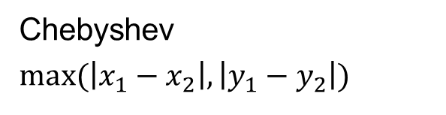
Formal Definition - Distance
Manhattan
$\left|x_{1}−x_{2}\right|+|y_{1}−y_{2}|$
Euclidian
$$\sqrt{(x_{1}−x_{2})^{2}+(y_{1}−y_{2})^{2}}$$
Chebyshev
$max⁡(\left|x_{1}−x_{2}\right|,\left|y_{1}−y_{2}\right|)$
Notes:
Squared Euclidian
Wenn nur abstände gemessen werden

Slide 16
Recap Classification
Classification
  Labeled training data (supervised)
  Given classes
Example: Dart
  Shooting a target
  3 classes for points
Notes:
Class boarders could be generated by hyperplanes in 3d space

Slide 17
Clustering
Grouping a set of data objects into clusters
  Cluster: a collection of elements
  Similar to one another within the same cluster
  Dissimilar to the objects in other clusters
Difference to Classification
  No given clusters/classes
  Unsupervised learning
Application
  Get insights in large datasets
  Preprocessing for other algorithms
Notes:
Draw Cluster boarder
What else does the clusters have in comon?
Thrown with left Hand
One eye closed
Here is data, i dont know what in there or what it means, but can u plz find structure in there?

Slide 18


Supervised Learning - Classification
Adjustment
Training-Set
Classifier
Labeled Data
Quality
Test-Set
(Hidden labels)
Training
Validation
Notes:
Recap supervised learning
Welches Verhältnis zwischen Training und Test?
Was macht der Classifier beim Adjustment?
Was soll hier Validiert werden? Der Classifier

Slide 19
Unsupervised Learning - Clustering
Adjustment
Clustering
Dataset
Quality
Training
Validation
Notes:
Recap supervised learning
Welches Verhältnis zwischen Training und Test?
Was macht der Classifier beim Adjustment?
Was soll hier Validiert werden? Der Classifier

Slide 20
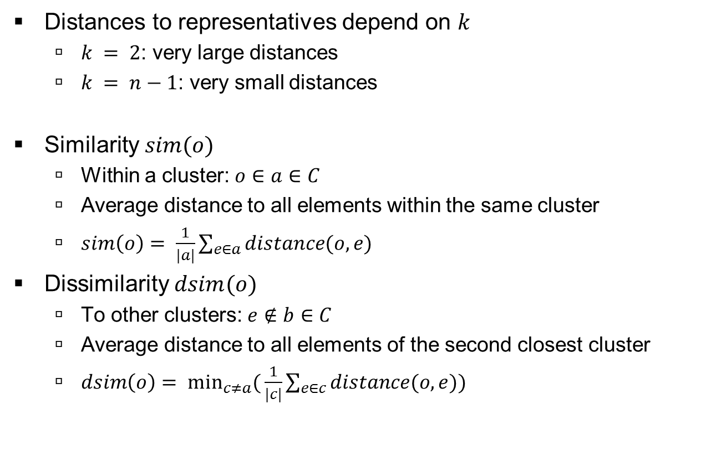
Quality Measure of a Cluster
Distances to representatives depend on $k$
  $k = 2$: very large distances
  $k = n−1$: very small distances
Similarity $sim(o)$
  Within a cluster: $o∈a∈C$
  Average distance to all elements within the same cluster
  $sim\left(o\right)= \frac{1}{|a|}\sum_{e∈a}{distance(o,e)}$
Dissimilarity $dsim(o)$
  To other clusters: $e∉b∈C$
  Average distance to all elements of the second closest cluster
  $dsim\left(o\right)= \min_{c≠a}{(}\frac{1}{|c|}\sum_{e∈c}{distance(o,e)})$
Notes:
Draw distances for a and for b
Distances alone can not be used for quality measurement
b >> a → s = 1 → good cluster
b ~~ a → s = 0 → can be better
b << a → s = -1 → bad cluster
0,7 < silh < 1 : good overall cluster

Slide 21

Quality Measure of a Cluster
Silhouette coefficient
  $s\left(o\right)=\frac{dsim\left(o\right)−sim\left(o\right)}{\max\left\{sim\left(o\right),dsim\left(o\right)\right\}}$
  $if sim\left(o\right)=dsim(o)=0, then s\left(o\right)=0$
  $s(o) ∈[−1, 1]$
  $silh\left(c\right)= \frac{1}{|c|}\sum_{o∈c}{s(o)}$
  $silh\left(E\right)= \frac{1}{|E|}\sum_{o∈E}{s(o)}$
Notes:
dsim >> sim → s = 1 → good cluster
dsim ~~ sim → s = 0 → can be better
dsim << sim → s = -1 → bad cluster
0,7 < silh < 1 : good overall cluster

Slide 22
1. Chapter: Introduction
1.1 Overview
1.2 Training and Validation
2. Chapter: Methods
2.1 Hierarchical Clustering
2.2 k-means
2.3 DBSCAN
3. Chapter: Application
4. Chapter: Summary

Slide 23
Hierarchical Clustering
Start with one cluster per element
Combine the two closest (most similar) clusters
Until all elements are in one cluster
Top down (divisive)/Bottom up (agglomerative)
E
D
B
C
A
A
B
C
D
E
Notes:
Always merge the closest clusters / sperate the most distant ones
Draw Bottom up with 4 steps
Ab
cd
cde
Abced
Draw arrows for dicretion bottom up/top down

Slide 24
Distance between Clusters
Single Link
  Smallest distance between two point of different clusters
Complete Link
  Largerst distance between two points of different clusters
Average Link
  Average distance between all points of one cluster to all points of a different cluster
Notes:
Draw the three link types
Single 1
Complete 1
Average |a|*|b|

Slide 25
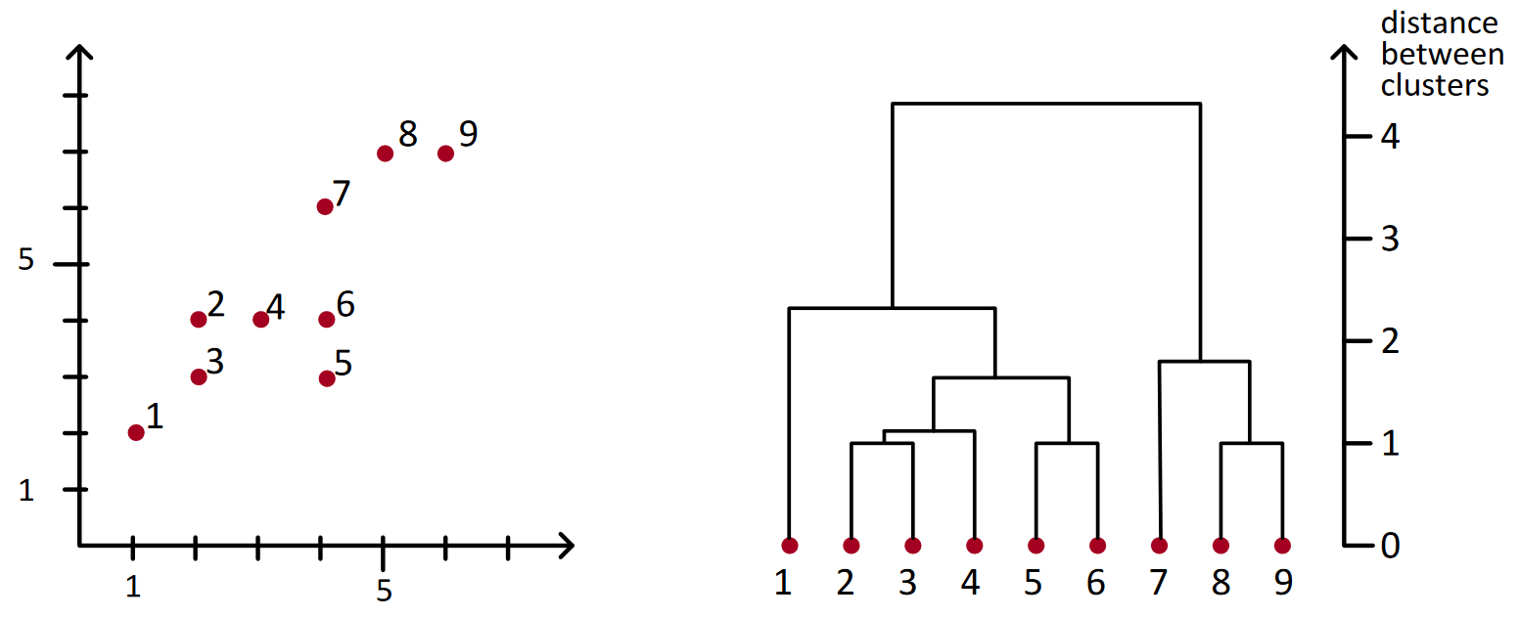
Dendrogram
Root: Cluster with all points
Leaf: Cluster with one point
Edges: Combine two clusters
Depth: Distance between two combined clusters
[5]
Notes:
Draw Bottom up with 4 steps
Ab
cd
cde
Abced
Draw arrows for direction bottom up/top down

Slide 26
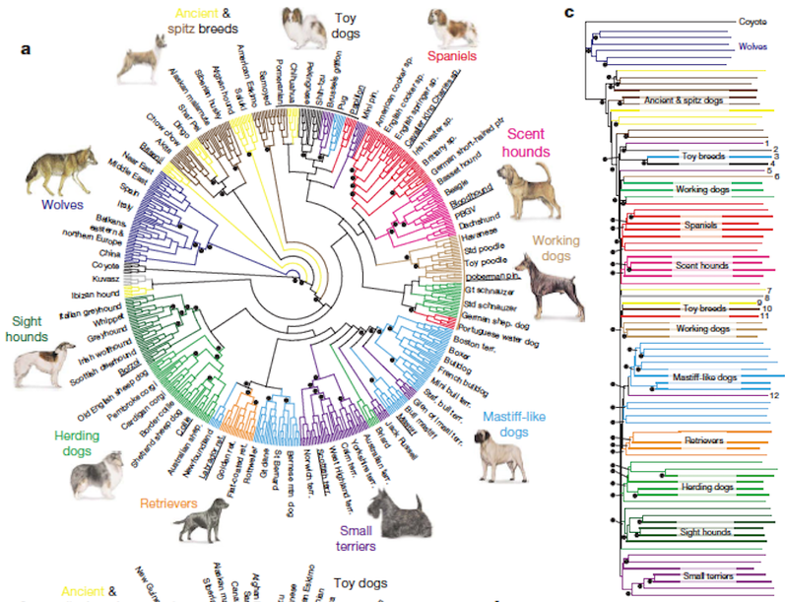
Dendrogram - Example
[6]

Slide 27
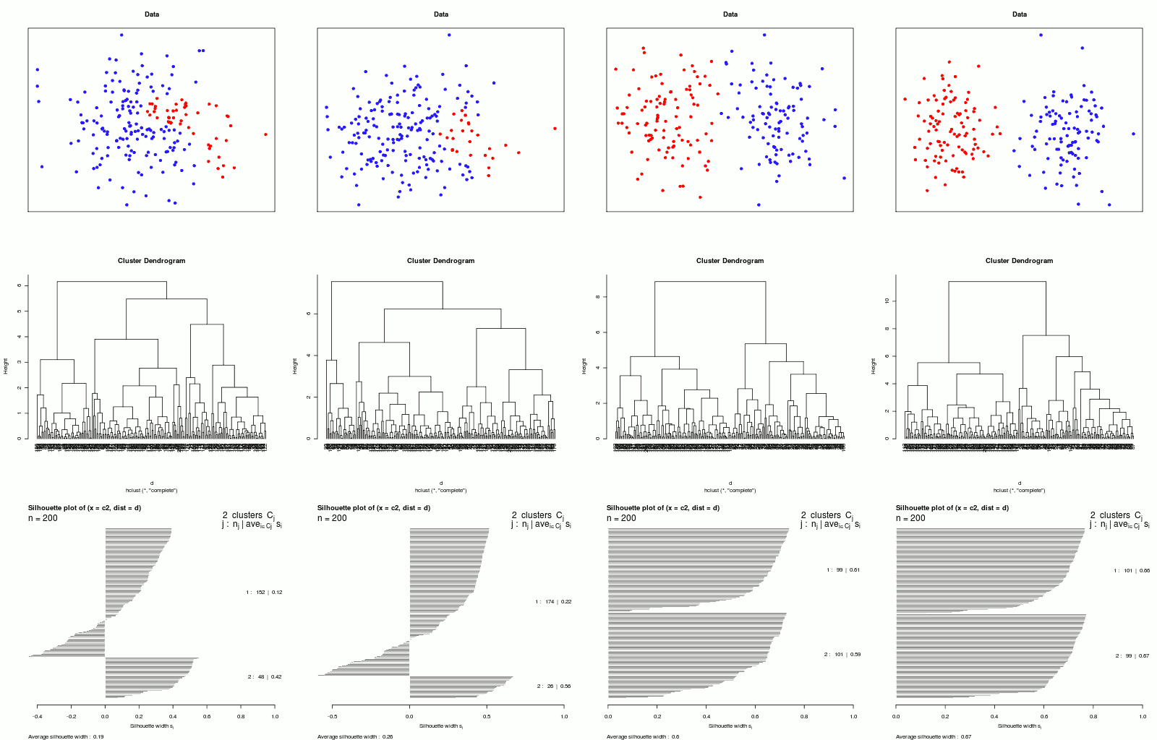
Hierarchical Clustering - Silhouette coefficient
[7]
Notes:
Left Szenario:
Draw two small cluster in the centers
Draw two bigger cluster (top/bottom) containing all points (and the small clusters)
Right Szenario:
Draw 4 clusters

Slide 28
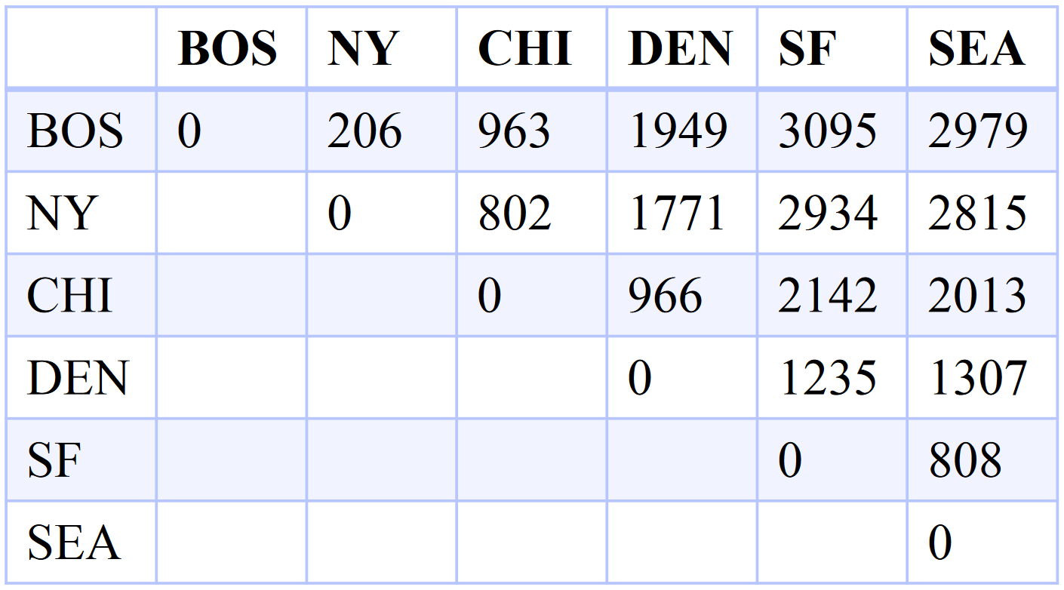
Hierarchical Clustering - Example
[8]
Notes:
Left Szenario:
Draw two small cluster in the centers
Draw two bigger cluster (top/bottom) containing all points (and the small clusters)
Right Szenario:
Draw 4 clusters

Slide 29
Hierarchical Clustering
Problems
  Clusters within clusters
  Different cluster densities in one dataset
Idea: Create a cluster hierarchy
Notes:
Left Szenario:
Draw two small cluster in the centers
Draw two bigger cluster (top/bottom) containing all points (and the small clusters)
Right Szenario:
Draw 4 clusters

Slide 30
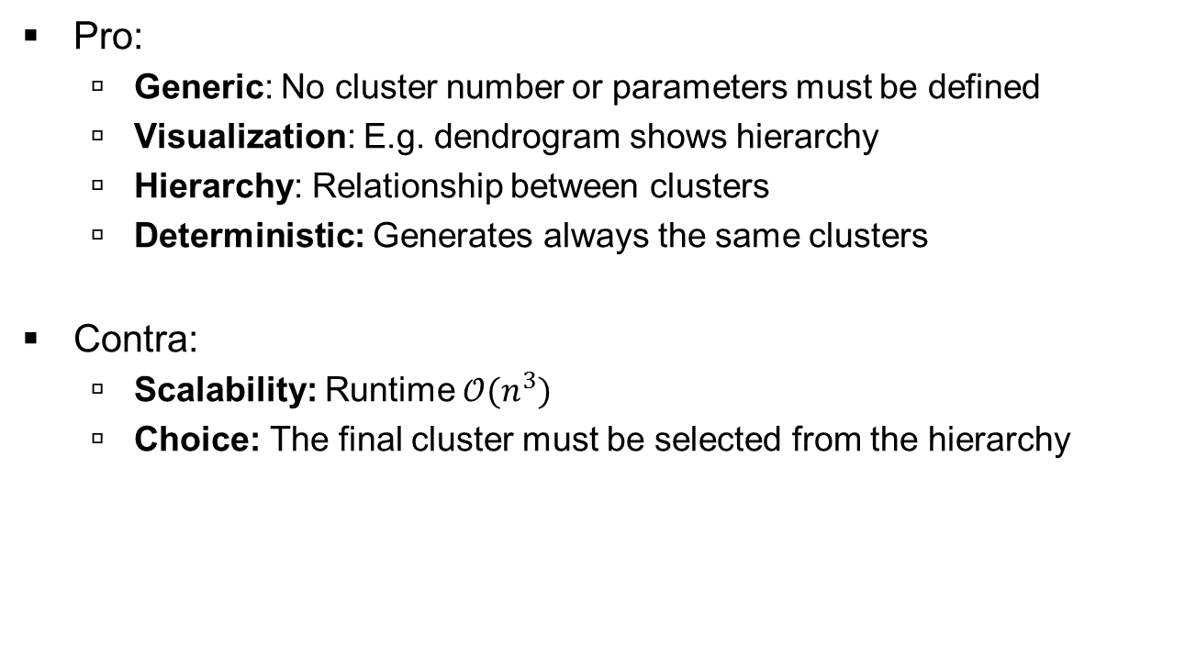
Discussion Hierarchical Clustering
Pro:
  Generic: No cluster number or parameters must be defined
  Visualization: E.g. dendrogram shows hierarchy
  Hierarchy: Relationship between clusters
  Deterministic: Generates always the same clusters
Contra:
  Scalability: Runtime $𝒪(n^{3})$
  Choice: The final cluster must be selected from the hierarchy

Slide 31
1. Chapter: Introduction
1.1 Overview
1.2 Training and Validation
2. Chapter: Methods
2.1 Hierarchical Clustering
2.2 k-means
2.3 DBSCAN
3. Chapter: Application
4. Chapter: Summary

Slide 32
K-Means - Basic Idea
Minimize squared distances to the cluster mean (variability)
Minimize the summed variability of all clusters
  Large Sum → Poor clustering
  Minimal Sum → Optimal clustering
Computationally challenging
  NP-hard
Notes:
Draw Three Poor cluster
Draw mean point
Draw distance vectors to mean
Repaet with optimal cluster
Short explanation of np hard

Slide 33
K-Means Algorithm (Lloyd)
Given:
  Number of desired clusters k
  Dataset
Initialization:
  Choose k arbitrary representatives
Repeat until stable:
  Assign objects to nearest representative
  Compute center of each cluster as new representative
Notes:
K = 2
start lower left and upper right side
Converge after 2 steps

Slide 34
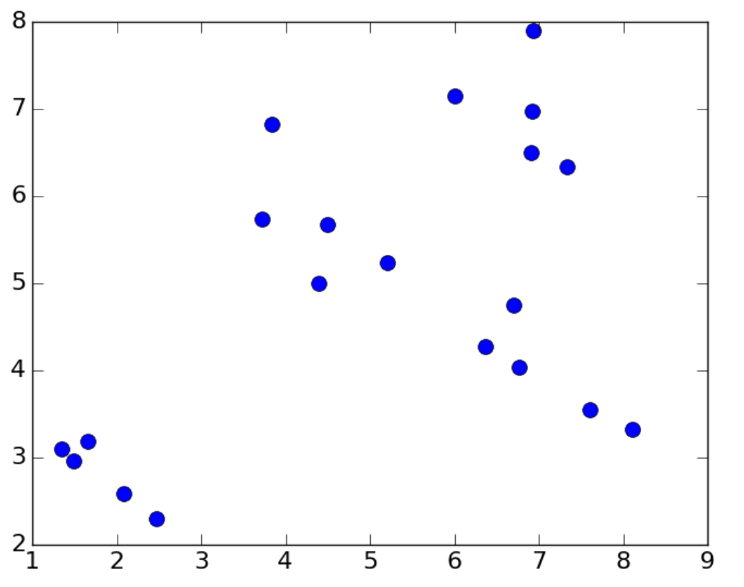
K-Means Algorithm (Lloyd)
[8]
Notes:
K = 2
start lower left and upper right side
Converge after 2 steps

Slide 35
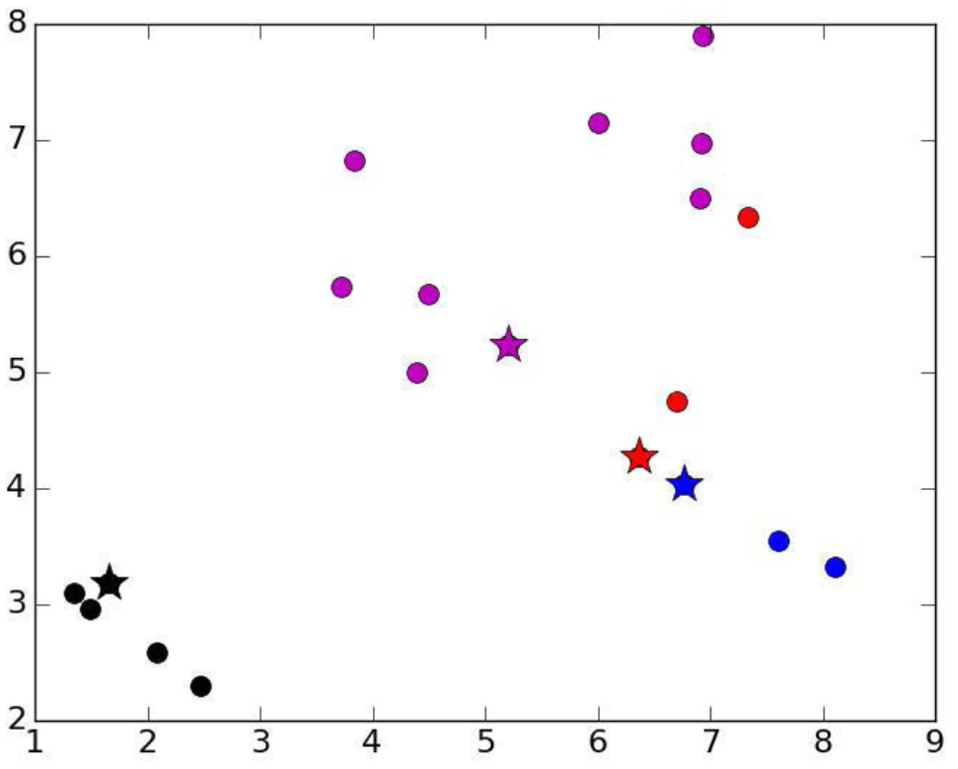
K-Means Algorithm (Lloyd) – Initialisation
[8]
Notes:
K = 2
start lower left and upper right side
Converge after 2 steps

Slide 36
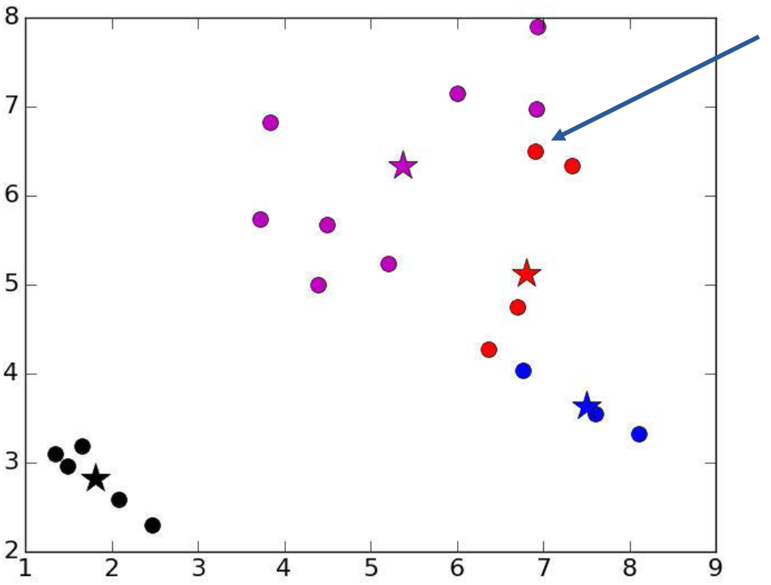
K-Means Algorithm (Lloyd) – Iteration 1
[8]
Notes:
K = 2
start lower left and upper right side
Converge after 2 steps

Slide 37
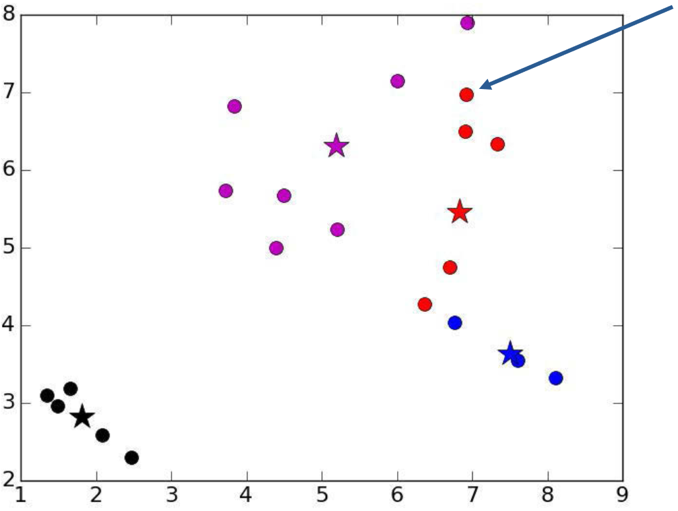
K-Means Algorithm (Lloyd) – Iteration 2
[8]
Notes:
K = 2
start lower left and upper right side
Converge after 2 steps

Slide 38
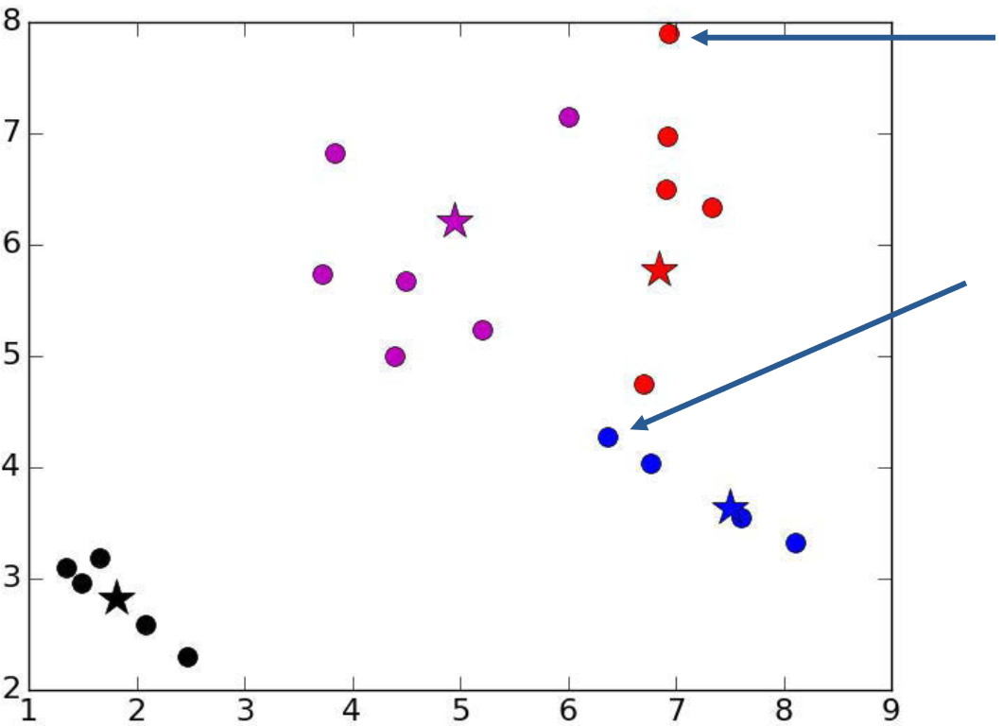
K-Means Algorithm (Lloyd) – Iteration 3
[8]
Notes:
K = 2
start lower left and upper right side
Converge after 2 steps

Slide 39
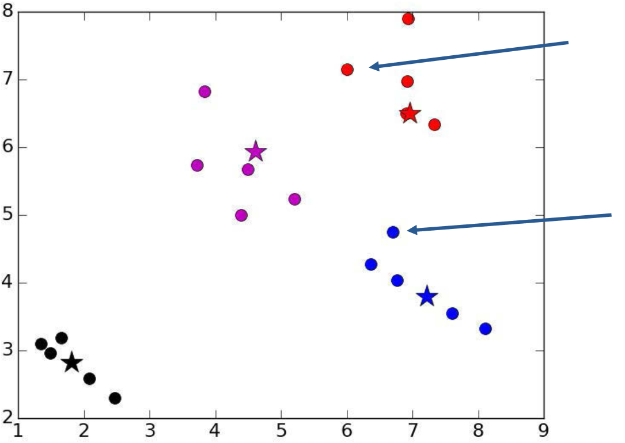
K-Means Algorithm (Lloyd) – Iteration 4
[8]
Notes:
K = 2
start lower left and upper right side
Converge after 2 steps

Slide 40
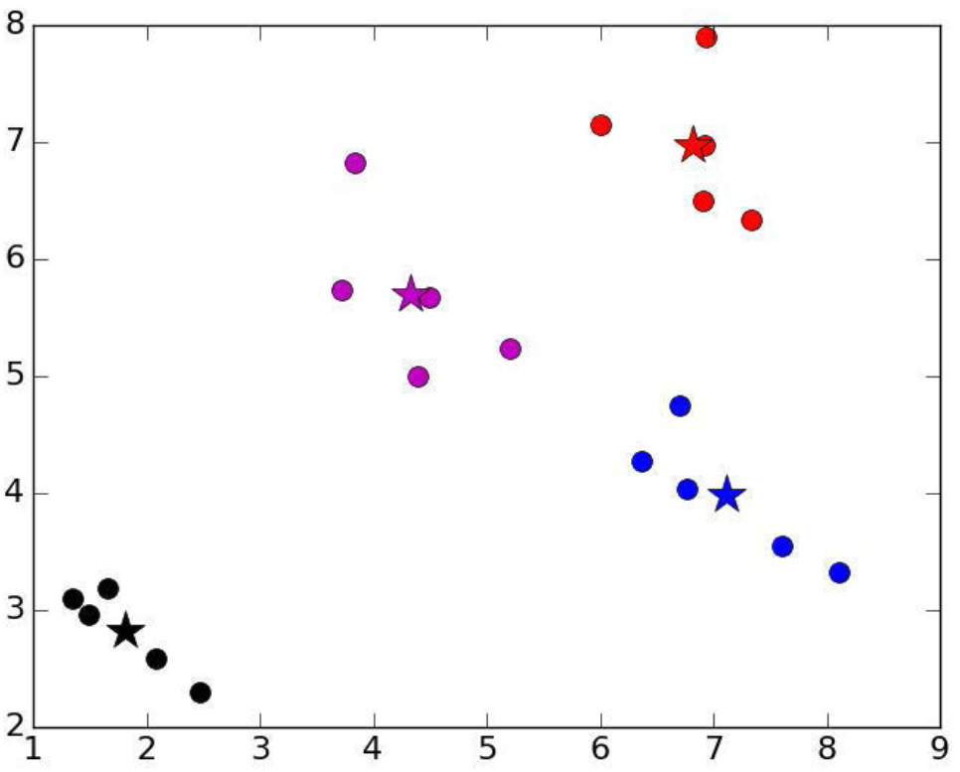
K-Means Algorithm (Lloyd) – Iteration 5
[8]

Slide 41
K-Means Algorithm – How to choose k?
A priori knowledge of an expert
  „There are five different types of bacteria“: k = 5
Search for a good k
  Naïve approach: Brute Force with k = 2 … n-1
  Run hierarchical clustering on subset of data
Notes:
K = 2
start lower left and upper right side
Converge after 2 steps

Slide 42
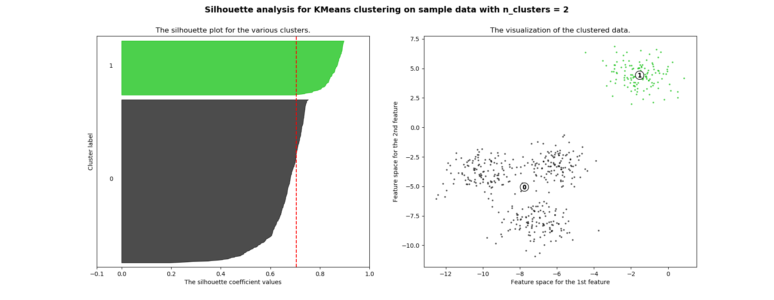
K-Means Algorithm – How to choose k?
[9]
Notes:
K = 2
start lower left and upper right side
Converge after 2 steps

Slide 43
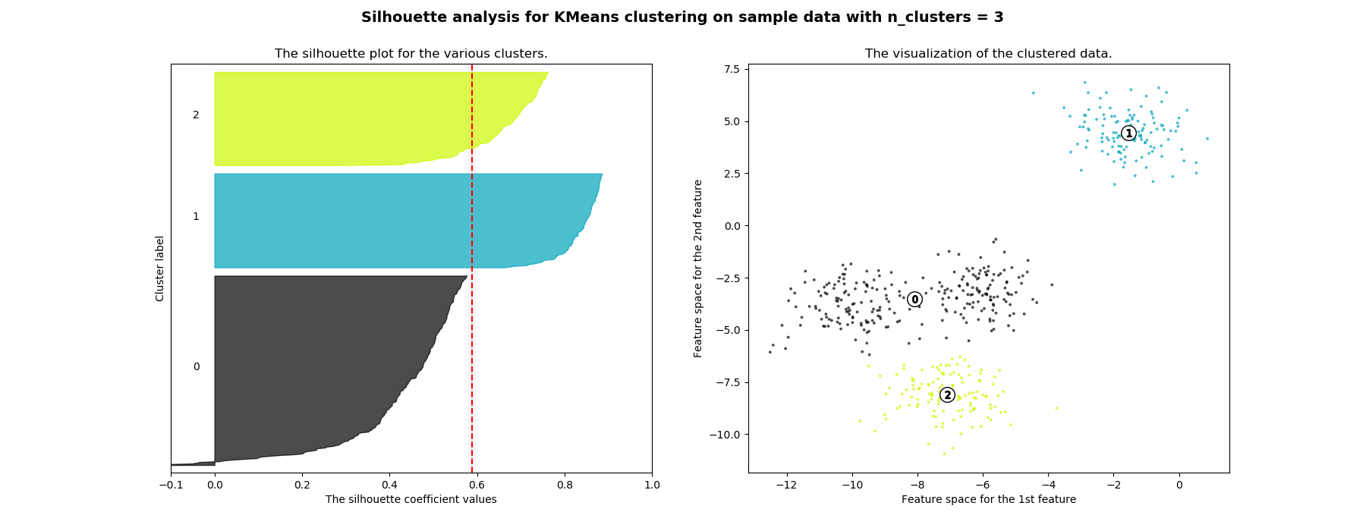
K-Means Algorithm – How to choose k?
[9]
Notes:
K = 2
start lower left and upper right side
Converge after 2 steps

Slide 44
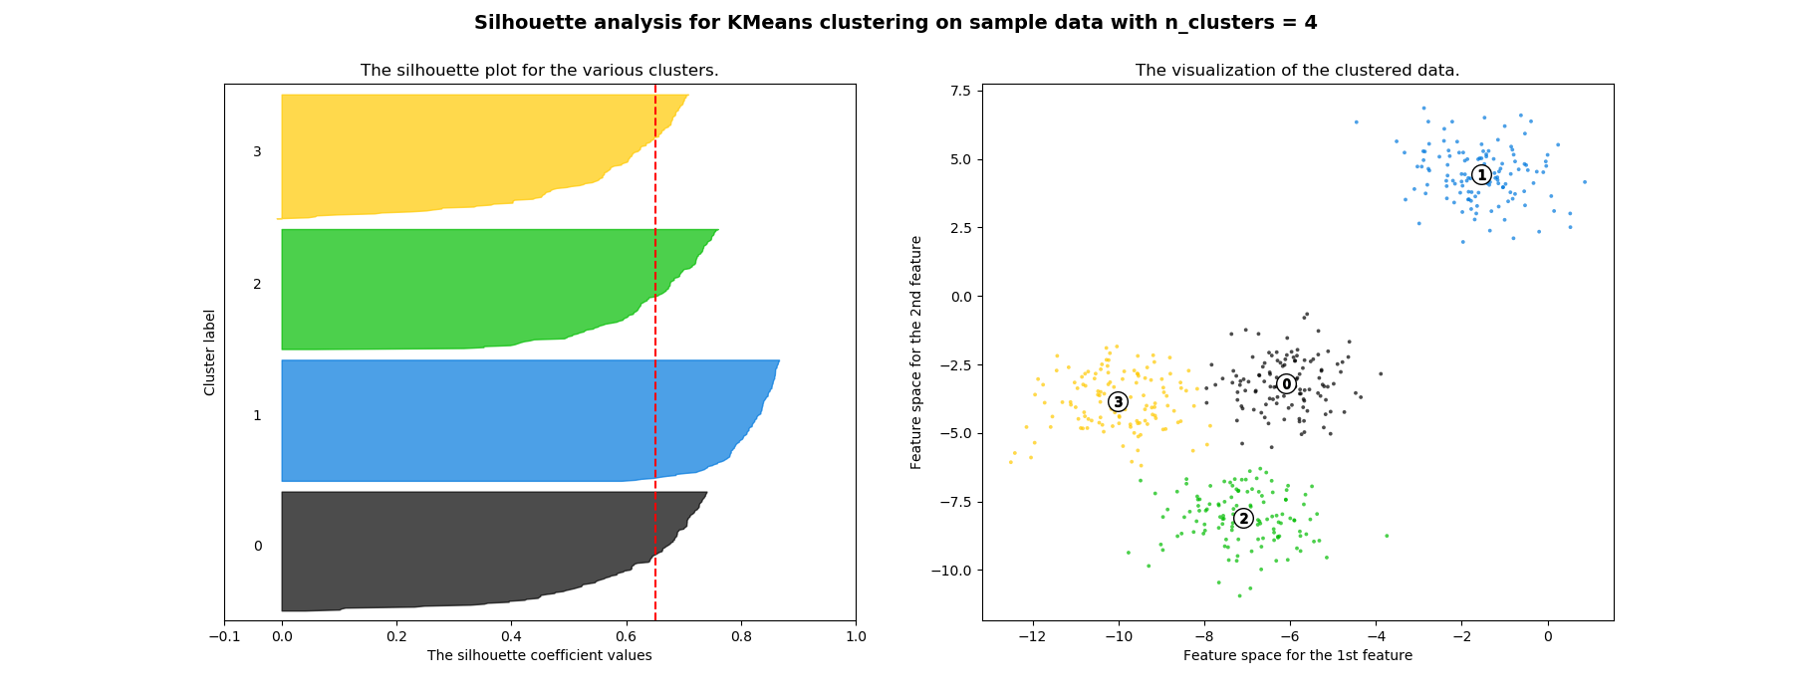
K-Means Algorithm – How to choose k?
[9]
Notes:
K = 2
start lower left and upper right side
Converge after 2 steps

Slide 45
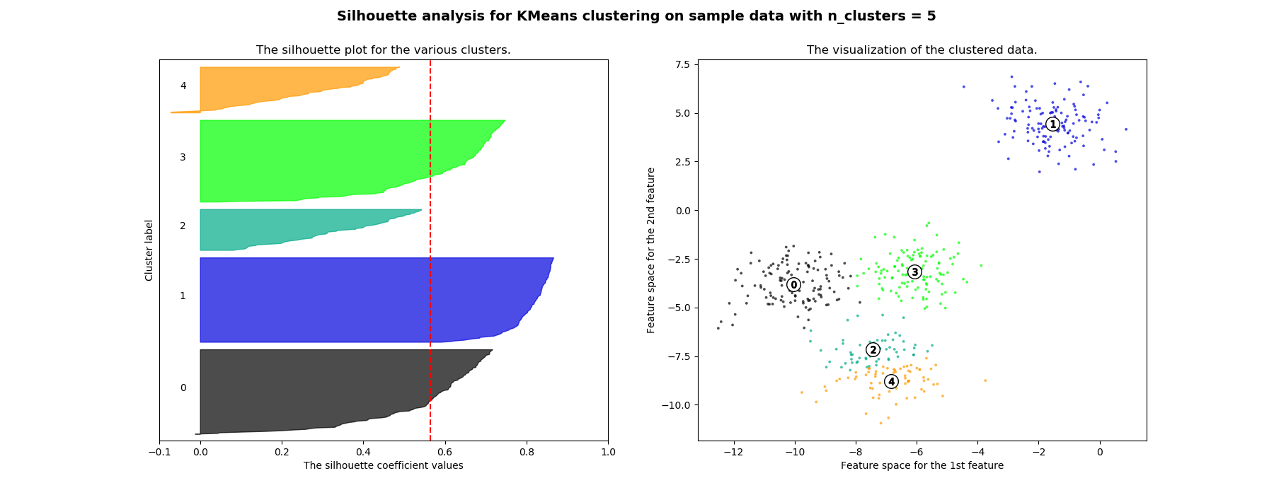
K-Means Algorithm – How to choose k?
[9]
Notes:
K = 2
start lower left and upper right side
Converge after 2 steps

Slide 46
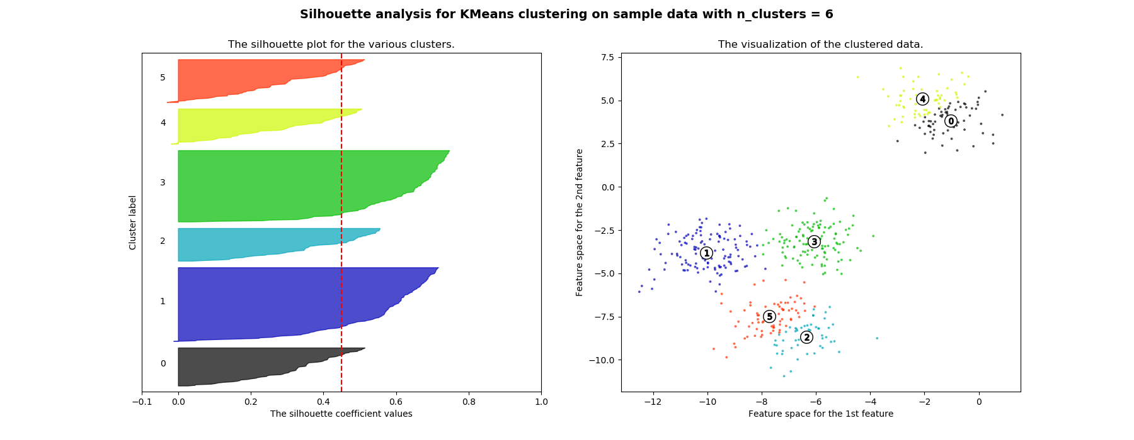
K-Means Algorithm – How to choose k?
[9]
Notes:
K = 2
start lower left and upper right side
Converge after 2 steps

Slide 47
K-Means Algorithm – How to choose k?
k = 2
k = 3
k = 4
k = 5
Notes:
K = 2
start lower left and upper right side
Converge after 2 steps

Slide 48
K-Means Algorithm – How to handle randomness?
[8]
Notes:
K = 2
start lower left and upper right side
Converge after 2 steps

Slide 49
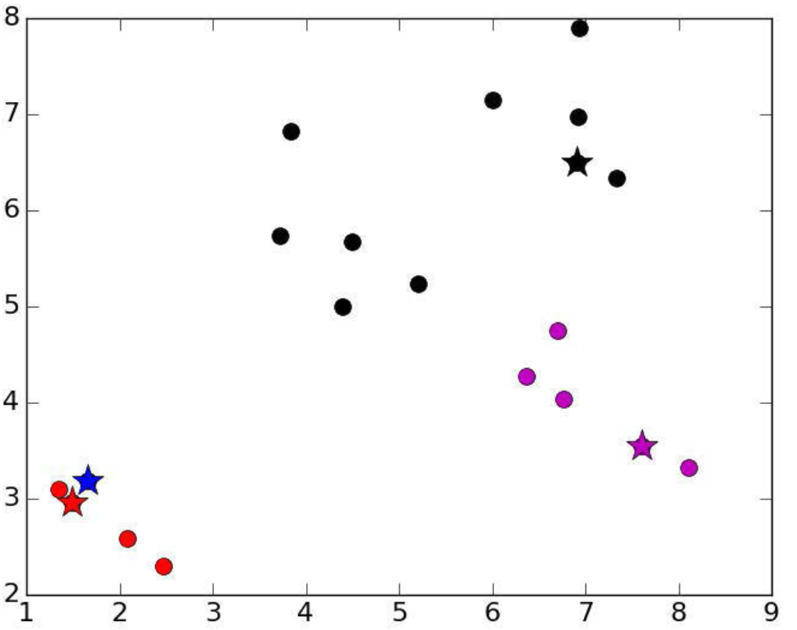
K-Means Algorithm – How to handle randomness?
[8]
Notes:
K = 2
start lower left and upper right side
Converge after 2 steps

Slide 50
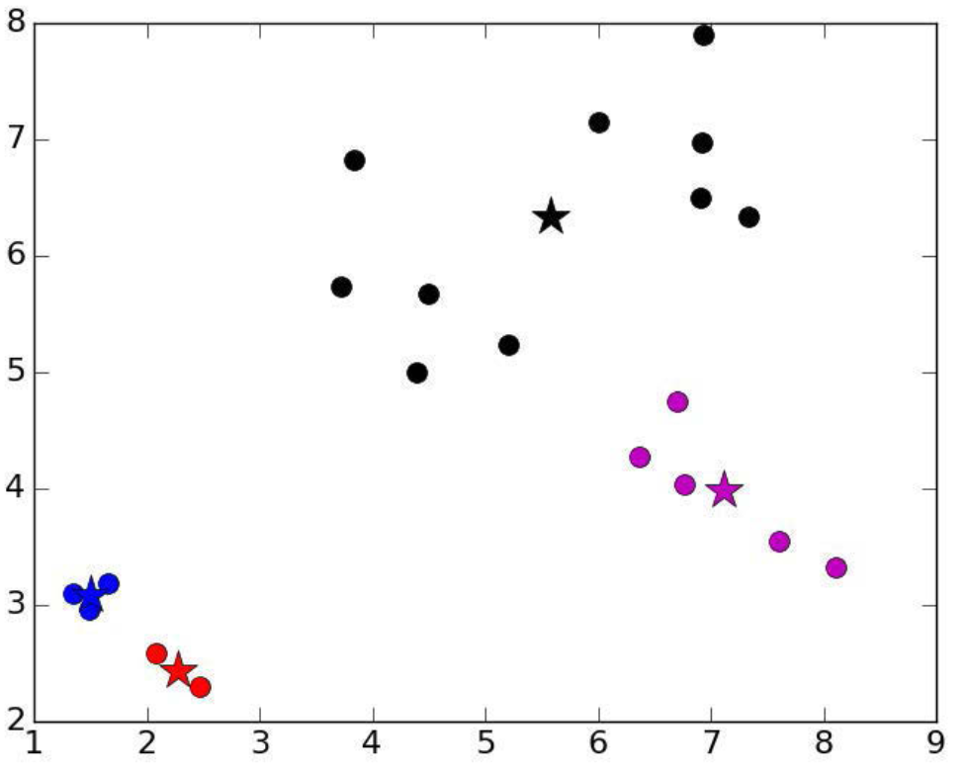
K-Means Algorithm – How to handle randomness?
[8]
Notes:
K = 2
start lower left and upper right side
Converge after 2 steps

Slide 51
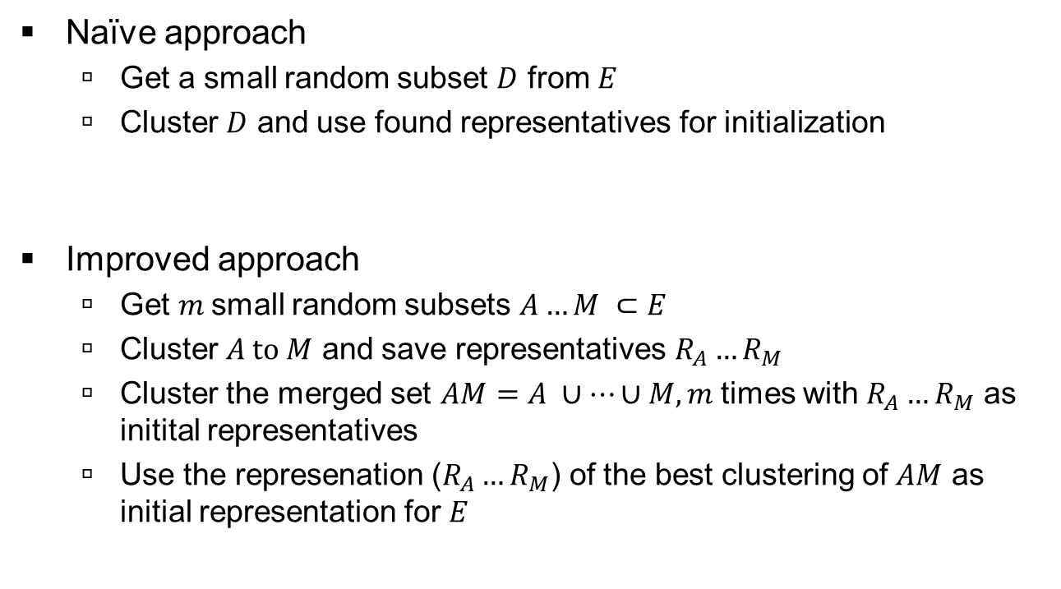
K-Means Algorithm – How to handle randomness?
Naïve approach
  Get a small random subset $D$ from $E$
  Cluster $D$ and use found representatives for initialization
Improved approach
  Get $m$small random subsets $A…M ⊂E$
  Cluster $A to M$ and save representatives $R_{A}…R_{M}$
  Cluster the merged set $AM=A ∪…∪M, m$ times with $R_{A}…R_{M}$ as initital representatives
  Use the represenation ($R_{A}…R_{M}$) of the best clustering of $AM$ as initial representation for $E$
Notes:
K = 2
start lower left and upper right side
Converge after 2 steps

Slide 52
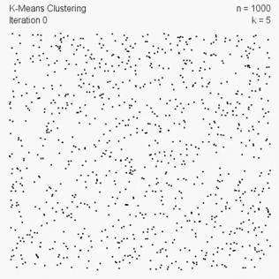
K-Means Example
[10]
Notes:
Draw Convex spaces (Voroni cells)

Slide 53
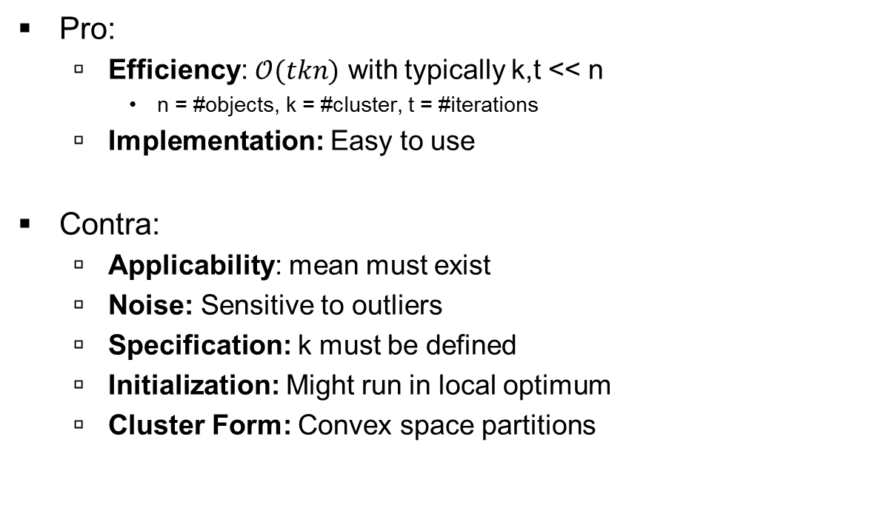
Discussion K-Means
Pro:
  Efficiency: $𝒪(tkn)$ with typically k,t << n
    n = #objects, k = #cluster, t = #iterations
  Implementation: Easy to use
Contra:
  Applicability: mean must exist
  Noise: Sensitive to outliers
  Specification: k must be defined
  Initialization: Might run in local optimum
  Cluster Form: Convex space partitions
Notes:
Draw Convex spaces (Voroni cells)

Slide 54
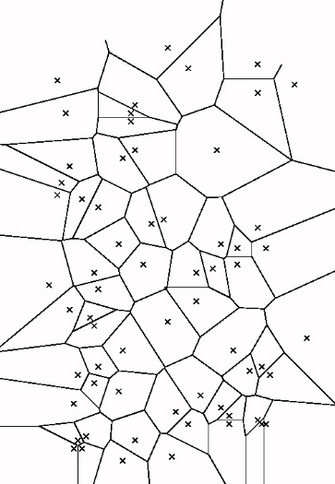
Voronoi Model
The Voroni diagramm partiones the space in Voroni cells for each point p
The Voroni cell for point p covers the area which nearest data point is p
Notes:
Draw how the voroni cells are constructed:
connect two points and draw the mittelsenkrechte

Slide 55
Variants - K-Medoids, K-Median Clustering
Representative: Mean → Object from cluster
  Means do not always exist
Distance: squared distance → normal distance
  Influence of outliers is reduced
Two variants for representative:
  Medoid: Object in the “middle”
  Median: Median of the cluster
Basic idea:
  Minimal distance between the objects of a cluster to its representative
Notes:
Show bad cluster for medoid with three points close together
Show good cluster

Slide 56
Discussion k-Means, k-Medoid & k-Median
 | K-means | K-medoid | K-median
data | Numerical data (mean) | metric | ordered attributed data
efficiency | High O(tkn) | Low O(tk(n-k)^2) | High O(tkn)
Senitivity to outlivers | High | Low | Low
Pro
  Implementation: Easy to use
Contra
  Specification: k must be defined
  Cluster Form: Convex space partitions
  Initialization: Might run in local optimum

Slide 57
1. Chapter: Introduction
1.1 Overview
1.2 Training and Validation
2. Chapter: Methods
2.1 Hierarchical Clustering
2.2 k-means
2.3 DBSCAN
3. Chapter: Application
4. Chapter: Summary

Slide 58
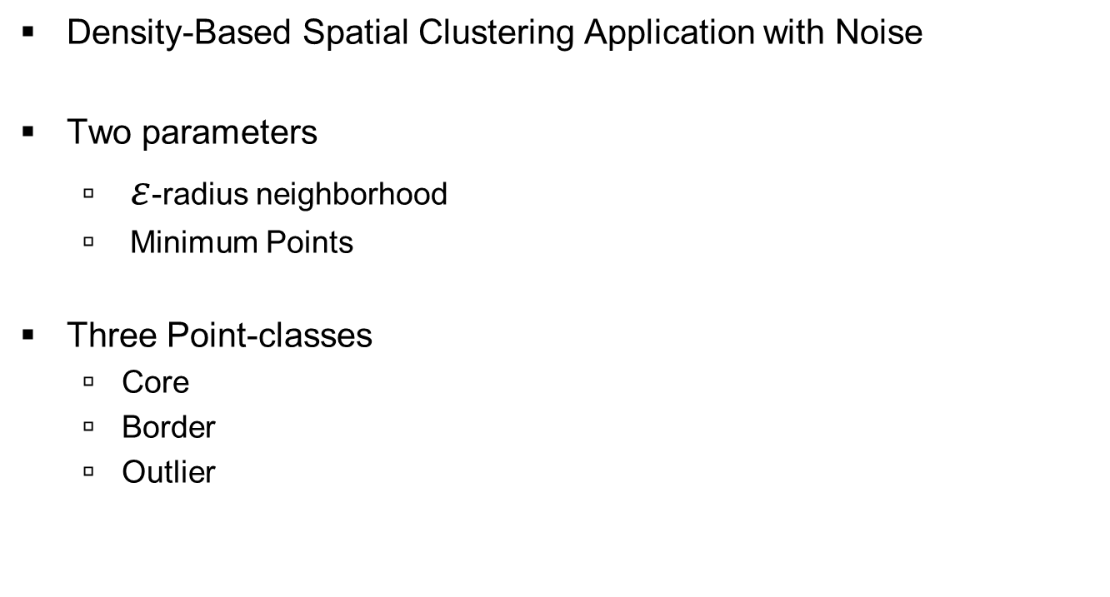
Density Based Clustering - DBSCAN
Density-Based Spatial Clustering Application with Noise
Two parameters
  $ε$-radius neighborhood
  Minimum Points
Three Point-classes
  Core
  Border
  Outlier

Slide 59

DBSCAN – Density Reachability
$p_{n}$ is „reachable“ from $p_{1}$, if there is a path ${p_{1}… p}_{n}$ where each $p_{i}$on the path must be a core point, except for $p_{n}$
Notes:
Epsiolon = 1
MinPts = 4

Slide 60
DBSCAN – Example
Notes:
Epsiolon = 1
MinPts = 4

Slide 61
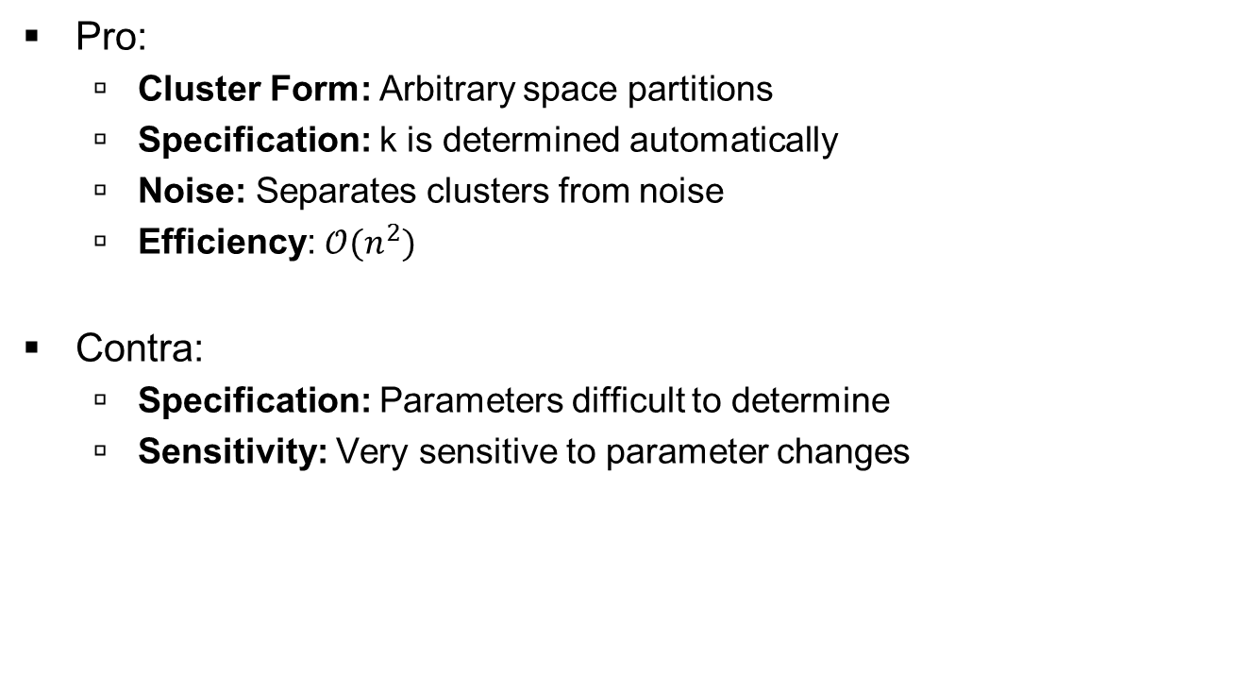
Discussion DBSCAN
Pro:
  Cluster Form: Arbitrary space partitions
  Specification: k is determined automatically
  Noise: Separates clusters from noise
  Efficiency: $𝒪(n^{2})$
Contra:
  Specification: Parameters difficult to determine
  Sensitivity: Very sensitive to parameter changes
Notes:
Draw Convex spaces (Voroni cells)

Slide 62
1. Chapter: Introduction
1.1 Overview
1.2 Training and Validation
2. Chapter: Methods
2.1 Hierarchical Clustering
2.2 k-means
2.3 DBSCAN
3. Chapter: Application
4. Chapter: Summary

Slide 63
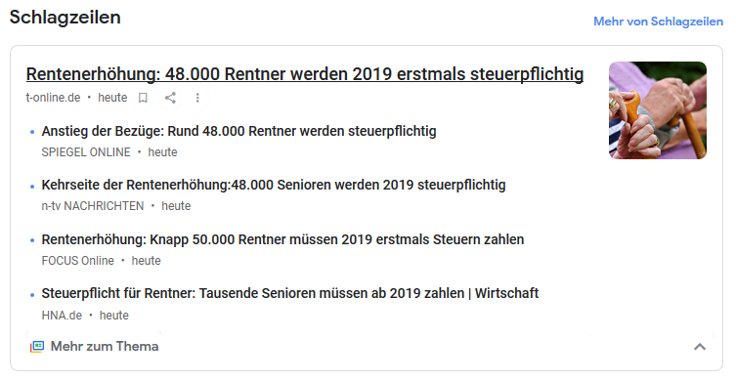
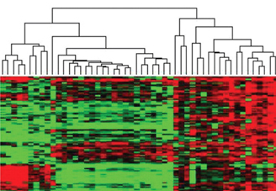
Applications
Google News
Genome Patterns
[14]
Notes:
Google News:
Find News that belongs togther and group it
Medicine:
Find people with similar geneome patterns and group them

Slide 64
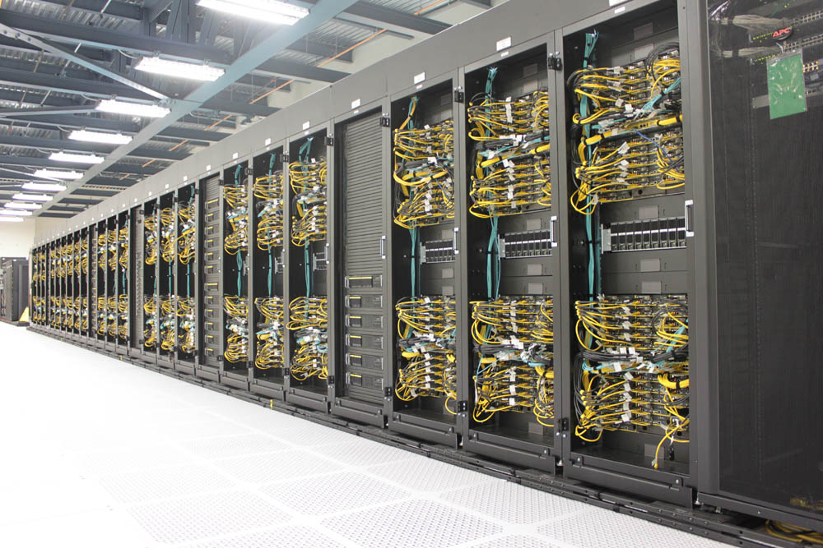
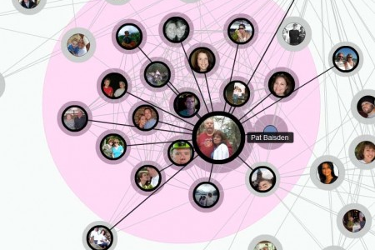
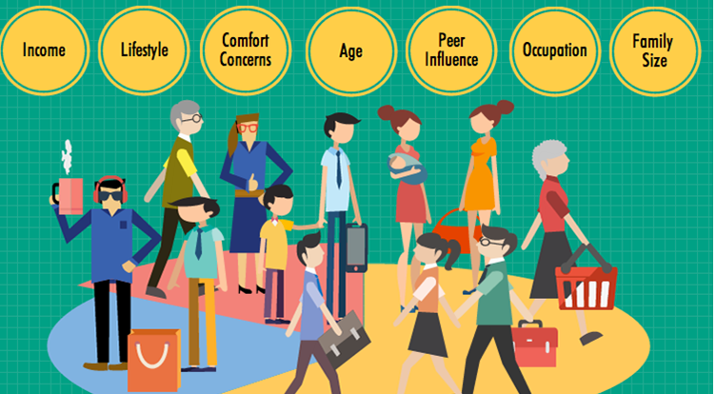
Applications
[11]
[12]
Computing
Cluster
Sozial Network
Market
Segmentation
[13]
Notes:
Reduce Kommunication costs in computing clusters
Find common friends increase information exchange
Find Groups with similar interest and place aimed advertisement

Slide 65
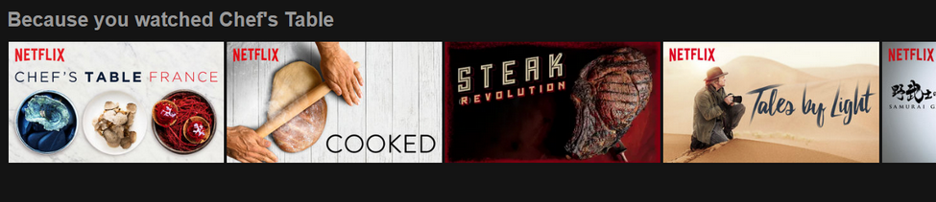
Application
Customer Clustering
  Amazon: Product suggestion (personalised advertisment)
  Netflix: Movie suggestion
  Netflix 1,000,000 $ challenge from 2006
Notes:
Amazon extrem large database, so many products and so many customers→ no chance to get overview
Clusterisation to form customer groups
Draw: cross out the class titles
Clustering gives the class rules but not the meaning behind a class. That has to labled by a human or classified in a further proessing step, eg with a SVM
Amazon does not need a titel for the cluster → Someone who bought trainers and sunglasses is likely to by a beltbag → Ad → Money
anecdote with pregnant girl in walmart (payback points)

Slide 66
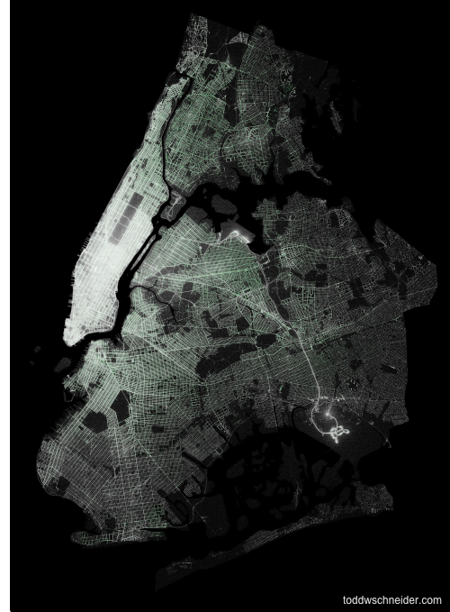
Clustering for automotive technology
Traffic analysis
  Collect mobility data of cars
  or density of certain regions
  Use cluster algorithm to identify different groups
    e.g. commuter, points of interest
  Extract generalisation of trajectories and traffic flow
  Use knowledge for city planing and to identify bottlenecks
Notes:
Points of interest

Slide 67
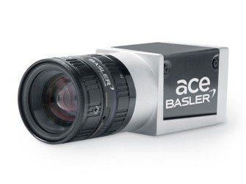
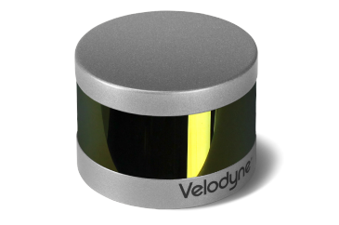
Clustering for automotive technology
High Level Object-Fusion
  Object-Detection based on limited data (only from one sensor)
  Object-Fusion based on processed Object-List (already information loss)
Lidar
(Velodyne)
Camera
(Basler)
Object-List
(Position, Velocity)
Object-List
(Classification)
Object-Fusion
Object-List
(Position, Velocity
Classification)
Notes:
Todo:
raw Data→ Object detection

Slide 68
Clustering for automotive technology
Low Level Object-Fusion
  Overlay Lidar point-cloud with camera image
  Find cluster in augmented pointcloud
  Object Detection based on fused raw-data
Lidar
(Velodyne)
Camera
(Basler)
Point-Cloud
RGB Image
Sensor-Fusion
Augmented Point-Cloud
Clustering
Object Detection
Notes:
Easy to identify a car in an image,
But hard to find separation between two oberlapping cars
Easy to finde separation between two objects in a pointcloud (depth information=
Draw top down view of lidar data for two cars in a line

Slide 69
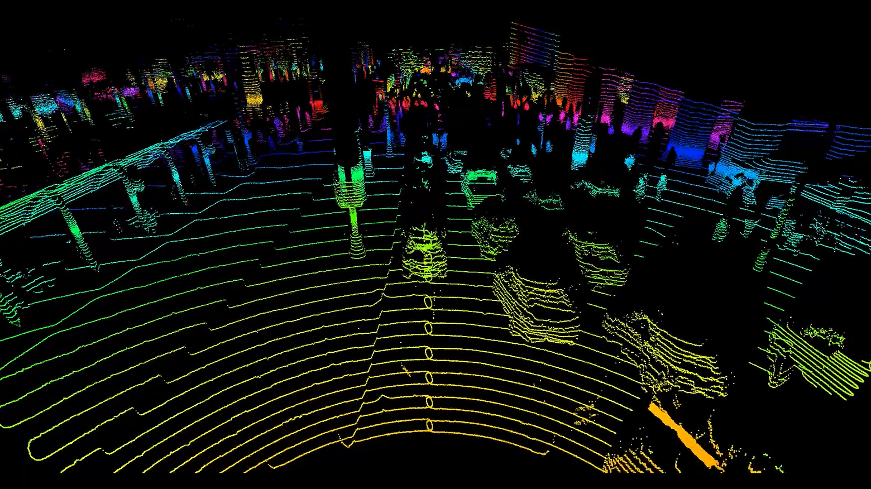
Clustering for automotive technology
[15]

Slide 70
Clustering for automotive technology
[4]
Notes:
Bottom Left: Sematic pixel labeling → Segmentation

Slide 71
1. Chapter: Introduction
1.1 Overview
1.2 Training and Validation
2. Chapter: Methods
2.1 Hierarchical Clustering
2.2 k-means
2.3 DBSCAN
3. Chapter: Application
4. Chapter: Summary

Slide 72
Summary
Pattern Recognition
Regression
Predict continuous valued output
Classification
Clustering
Supervised
Predict discrete valued output
Supervised
Predict discrete valued output
Unsupervised

Slide 73
Summary
What did we learn today:
Clustering is about finding groups in a dataset.
Clustering is an optimisation problem.
Elements within a cluster are similar.
Elements form different clusters are dissimilar.
The distance can be used to express similarity.
Clustering is an unsupervised method, no labels are required.
The silhouette can be used to express the quality of a cluster.
Segmentation and Clustering are interchangeable terms.
The concepts of hierarchical clustering, k-means and DBSCAN.
Hierarchical clustering builds a dendrogram.
The number of desired clusters can be selected afterwards.

Slide 74
Summary
What did we learn today:
K-means is a fast but greedy and non determninistic algorithm.
The number of clusters must be selected beforehand.
Only convex space partitions can be generated.
DBSCAN is a density based method and can deal with noise.
Elements are classified as core, border or outlier.
Complex forms can be grouped as clusters.
Clustering is applied as preprocessing or to find coherences.
Wide range of clustering applications, but rarely as stand alone.
Experts or classification methods give clusters afterwards meaning.

Slide 75
Sources
[1] https://dailyillini.com/news/2017/09/28/students-reflect-race-affects-classroom-participation/
[2] https://dictionary.cambridge.org/dictionary/english/cluster
[3] https://www.deviantart.com/gttorres/art/Not-Another-High-School-Story-256629151
[4] https://www.youtube.com/watch?v=xXWLXfMugkM
[5] http://www.dbs.ifi.lmu.de/Lehre/KDD/WS1718/04_Clustering-3.pdf
[6] http://www.instituteofcaninebiology.org/how-to-read-a-dendrogram.html
[7] https://de.wikipedia.org/wiki/Silhouettenkoeffizient
[8] https://ocw.mit.edu/courses/electrical-engineering-and-computer-science/6-0002-introduction-to-computational-thinking-and-data-science-fall-2016/lecture-slides-and-files/MIT6_0002F16_lec12.pdf
[9] http://docs.w3cub.com/scikit_learn/auto_examples/cluster/plot_kmeans_silhouette_analysis/
[10] https://www.youtube.com/watch?v=BVFG7fd1H30
[11] https://computing.llnl.gov/tutorials/linux_clusters/
[12] http://www.messersmith.name/wordpress/2009/10/12/visualizing-your-facebook-network-of-friends/
[13] http://www.businessstudynotes.com/marketing/principle-of-marketing/discuss-market-segmentation-and-market-targetting/
[14] http://www.discoveryandinnovation.com/BIOL202/notes/images/cluster_analysis.jpg
[15] https://www.nytimes.com/2017/05/25/automobiles/wheels/lidar-self-driving-cars.html
Notes:
Mean shift clusztering als moderne methode

Slide 76
Acknowledgment
Machine Learning (Stanford/Coursera)
  Andrew Ng
  https://www.coursera.org/learn/machine-learning
Knowledge Discovery in Databases I (LMU)
  Prof. Dr. Peer Kröger
  http://www.dbs.ifi.lmu.de/cms/studium_lehre/lehre_master/kdd1718/index.html
Introduction to Computational Thinking and Data Science (MIT)
  Prof. Eric Grimson
  https://ocw.mit.edu/courses/electrical-engineering-and-computer-science/6-0002-introduction-to-computational-thinking-and-data-science-fall-2016

