Slide 2
Feedback from last week
Too much slides / Too much information in too little time
→ AI is a complex topic with different subjects
→ Overall lecture is not enough time (1.5h + Practice)
→ Use the summary and the learning results: Each slide is just for you to understand everything in total, but the focus of what you need to learn is clear based on learning results
→ Trust us: First lecture of his kind – We will combine learning results with exam questions
Live Coding/ Practice Coding: the code could not be read on the beamer:
→ Uploading practice code and live code before the lecture
→ Use jupyter notebook for better explanation

Slide 3
Overall Introduction for the Lecture 18.10.2018 – Betz Johannes | 6 Pathfinding: From British Museum to A* 29.11.2018 – Lennart Adenaw | 11 Reinforcement Learning 17.01.2019 – Christian Dengler
1 Introduction: Artificial Intelligence 18.10.2018 – Betz Johannes | P6: 29.11.2018 – Lennart Adenaw | P11 17.01.2019 – Christian Dengler
P1: 18.10.2018 – Betz Johannes | 7 Introduction: Artificial Neural Networks 06.12.2018 – Lennart Adenaw | 12 AI-Development 24.01.2019 – Johannes Betz
2 Perception 25.10.2018 – Betz Johannes | P7 06.12.2018 – Lennart Adenaw | P12 24.01.2019 – Johannes Betz
P2: 25.10.2018 – Betz Johannes | 8 Deep Neural Networks 13.12.2018 – Jean-Michael Georg | 13 Free Discussion 31.01.2019 – Betz/Adenaw
3 Supervised Learning: Regression 08.11.2018 – Alexander Wischnewski | P8 13.12.2018 – Jean-Michael Georg
P3: 08.11.2018 – Alexander Wischnewski | 9 Convolutional Neural Networks 20.12.2018 – Jean-Michael Georg
4 Supervised Learning: Classification 15.11.2018 – Jan-Cedric Mertens | P9 20.12.2018 – Jean-Michael Georg
P4: 15.11.2018 – Jan-Cedric Mertens | 10 Recurrent Neural Networks 10.01.2019 – Christian Dengler
5 Unsupervised Learning: Clustering 22.11.2018 – Jan-Cedric Mertens | P10 10.01.2019 – Christian Dengler

Slide 4
Objectives for Lecture 3: Regression
Depth of understanding
After the lecture you are able to…
 |  | Remember | Understand | Apply | Analyze | Evaluate | Develop
… understand the definition of a Regression problem and know the relevant vocabulary.
…. understand in which areas of Automotive Technology Regression can be applied.
… know the strengths and weaknesses of different basis functions for applying a regression model
… choose the right loss function for training your model based on your dataset
…. analyze the result of the training process
…. apply and evaluate the usefulness of regularization techniques to control model complexity
…. analyze potential problems arising from real world datasets used in regression
…. understand the basic mathematical principles behind regression

Slide 5
Chapter: Motivation
Chapter: Linear Models
Chapter: Loss functions
Chapter: Regularization & Validation
Chapter: Practical considerations
Chapter: Summary

Slide 6
Motivation – Regression Example
Data points
Output variable
or Labels
Weight in kg
Regression
result
Size in m
Input variables

Slide 7
Motivation – Algorithms in Machine Learning
Pattern Recognition
Regression
Predict continuous valued output
Classification
Clustering
Supervised
Predict discrete valued output
Supervised
Predict discrete valued output
Unsupervised
Notes:
Einordnung in die VL
Mensch sehr gut in visueller Mustererkennung

Slide 8
Motivation – Algorithms in Machine Learning
Regression
Classification
Clustering
House pricing
Sales
Persons weight
Object detection
Spam detection
Cancer detection
Genome patterns
Google news
Pointcloud (Lidar) processing
Notes:
Einordnung in die VL
Mensch sehr gut in visueller Mustererkennung

Slide 9
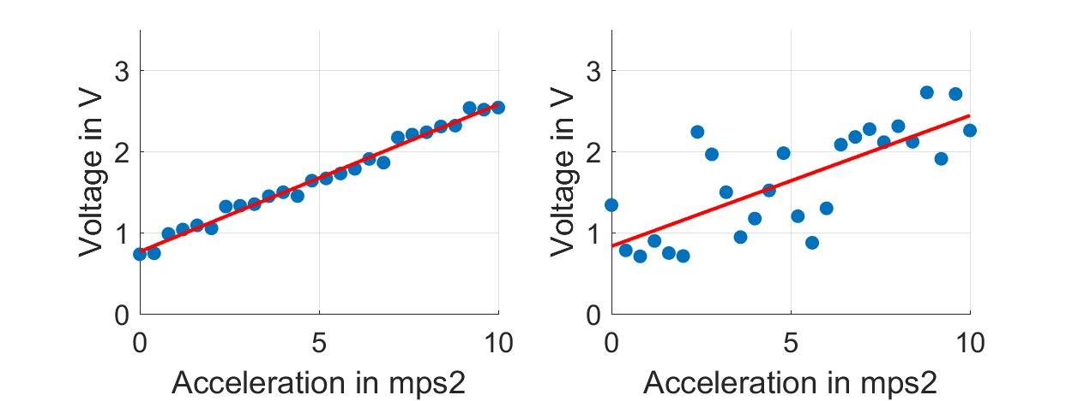
Motivation – Regression in Automotive Technology
Sensor calibration
Usually electric quantities are measured
Necessary to convert them to physical quantities
Examples:
Accelerometers
Gyroscopes
Displacement sensors

Slide 10
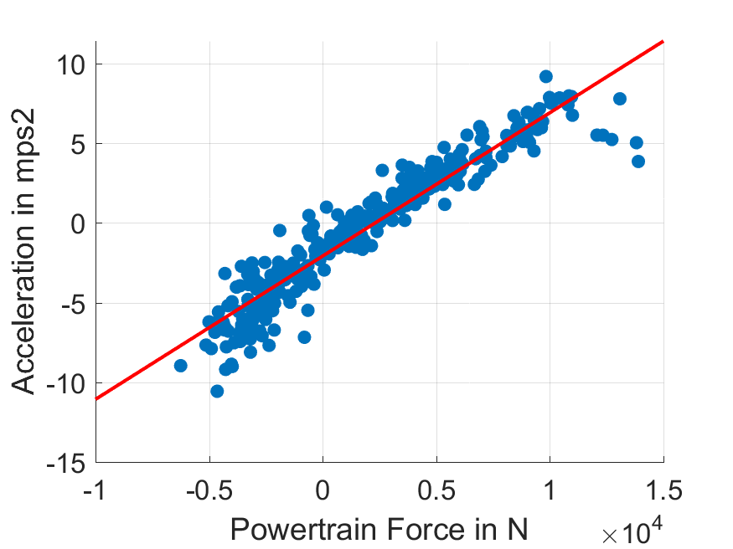
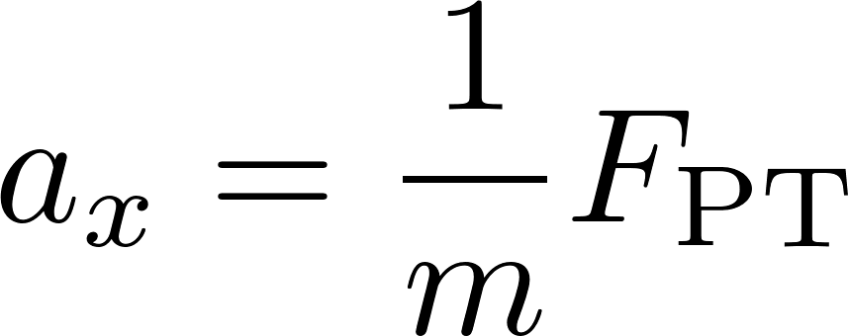
Motivation – Regression in Automotive Technology
Parameter estimation
Vehicle parameters like are often only roughly known
Estimation via regression techniques

Slide 11
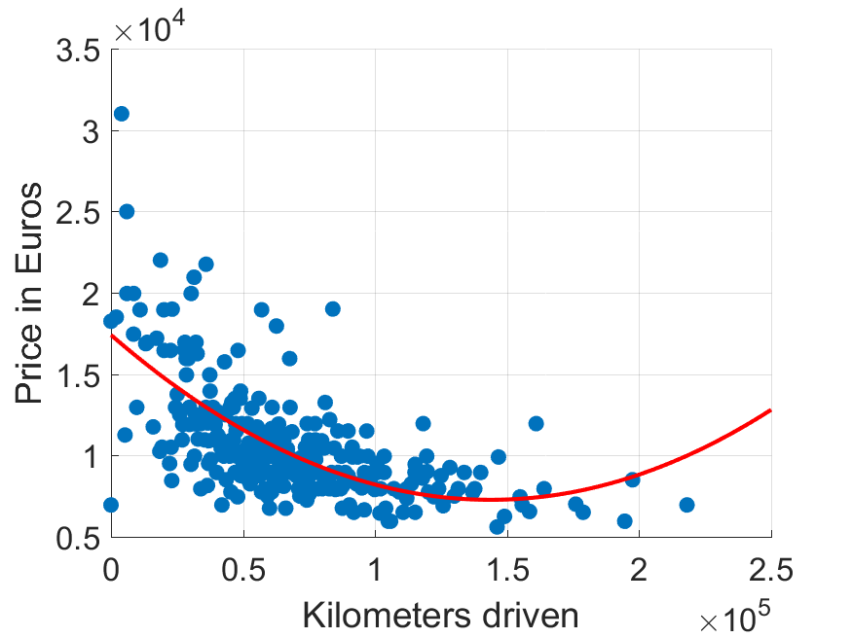
Motivation – Regression in Automotive Technology
Vehicle pricing
Regression is widely used for financial relations
Allows to compress data into a simple model and evaluate derivatives

Slide 12
Motivation – Why should you use Regression?
Based on the combination of data and model structure, it is possible to predict the outcome of a process or system
Training data set is usually only a representation at sparse points and contains lots of noise
Allows usage of information in simulation, optimization, etc.
Model
structure
Training
Data
Previously unseen sets of
input variables
Predictions about output variables
Predictive
Model

Slide 13
Relation of statistics and machine learning
How can we extract information from data and use them to reason and predict in beforehand unseen cases? (learning)
Nearly all classic machine learning methods can be reinterpreted in terms of statistics
Focus in machine learning is mainly on prediction
Statistics often focusses on relation analysis
Lots of advanced regression techniques build upon a statistical interpretation of regression

Slide 14
Definition according to Wikipedia:
In statistical modeling, regression analysis is a set of statistical processes for estimating the relationships among variables. It includes many techniques for modeling and analyzing several variables, when the focus is on the relationship between a dependent variable and one or more independent variables (or 'predictors'). More specifically, regression analysis helps one understand how the typical value of the dependent variable (or 'criterion variable') changes when any one of the independent variables is varied, while the other independent variables are held fixed.
Definition according to a Machine Learning Blog:
Regression is a method of modelling a target value based on independent predictors. This method is mostly used for forecasting and finding out cause and effect relationship between variables. Regression techniques mostly differ based on the number of independent variables and the type of relationship between the independent and dependent variables.
Source: https://en.wikipedia.org/wiki/Regression_analysis
Source: https://towardsdatascience.com/introduction-to-machine-learning-algorithms-linear-regression-14c4e325882a

Slide 15
Chapter: Motivation
Chapter: Linear Models
Chapter: Loss functions
Chapter: Regularization & Validation
Chapter: Practical considerations
Chapter: Summary

Slide 16
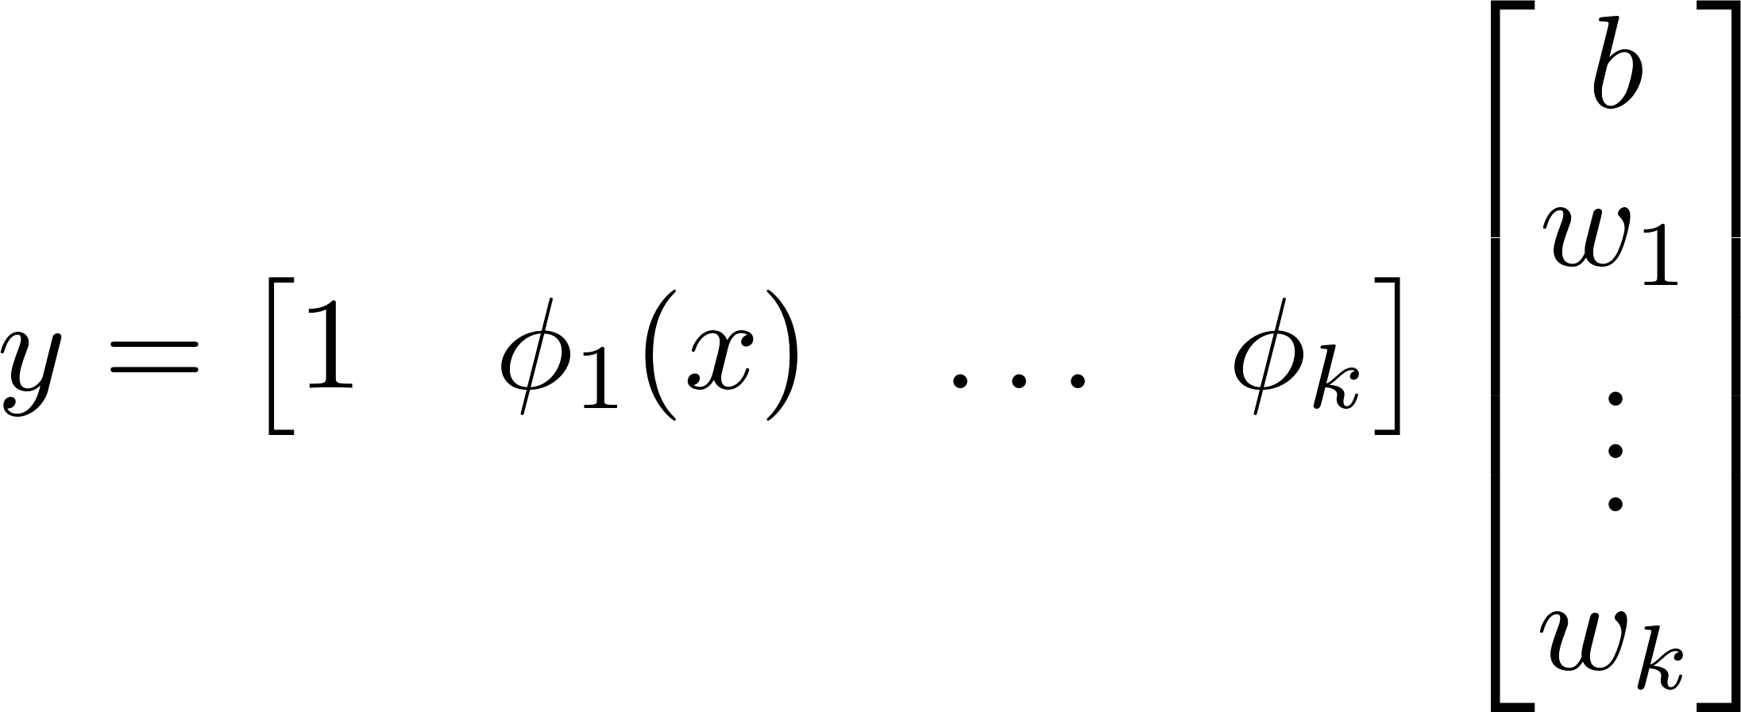
Linear Basis Function Model
Bias Term
Input Variables
Output Variables
Weight
Parameters
Basis Functions
Weight
Parameters
Basis Functions

Slide 17
Representing the dataset as a matrix
Output vector
Weight vector
Design Matrix

Slide 18
Nonlinear regression
Nonlinear optimization
Specify set of parameters
Gaussian Processes
Support Vector Machines
Uses kernel methods
Bayesian interpretation
Solve nonlinear optimization problem
No parameters
Uses kernel methods
No parameters
Mostly used for classification

Slide 19
Workflow – How do we obtain model parameters?
1. Choose model
2. Find Parameters
3. Validate Model
Type of basis functions
Number of basis functions
Specify a loss function which measures „how good the model fits the data“
Use explicit solution or iterative algorithms to obtain parameters
Specify constraints on the parameters
Use a second dataset which was not used for training to evaluate the performance of your model
This ensures the ability to generalize to unseen data

Slide 20
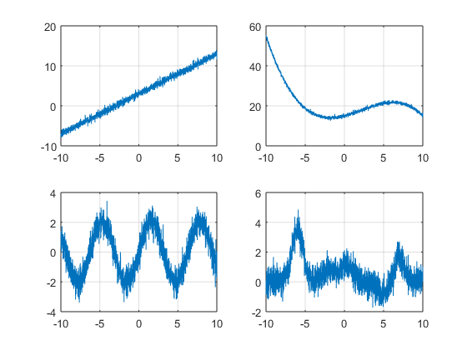
Basis functions – examples
Linear function
Polynomial function
Sinusoidal function
Gaussian basis function

Slide 21
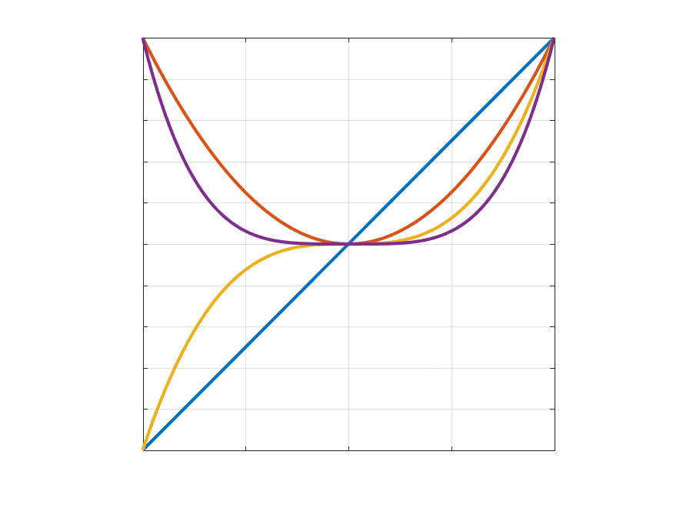
Basis functions – Polynomials
Globally defined on the independent variable domain
Design matrix becomes ill-conditioned for large input domain variables for standard polynomials
Hyperparameter:
Polynomial degree
$$φ_{0}\left(x\right)=1$$
$$φ_{1}\left(x\right)=x$$
$$φ_{2}\left(x\right)=x^{2}$$
$$φ_{3}\left(x\right)=x^{3}$$
$…$
$$φ_{i}\left(x\right)=x^{i}$$

Slide 22
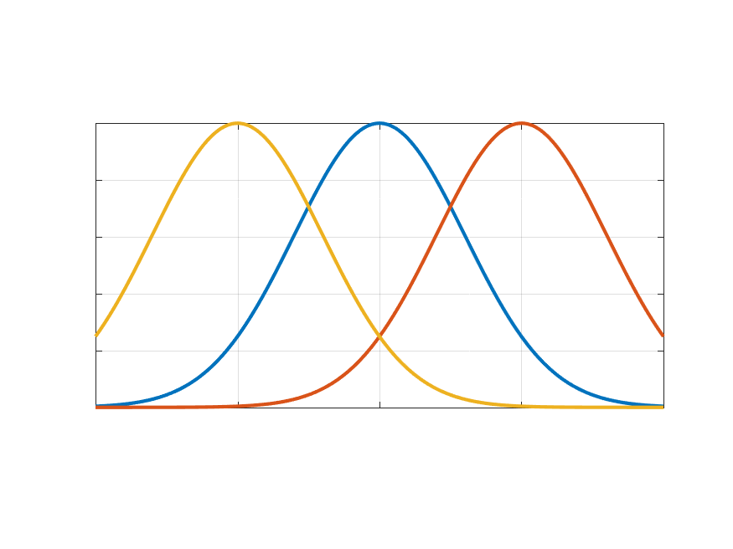
Basis functions – Gaussians
Locally defined on the independent variable domain
Sparse design matrix
Infinitly differentiable
Hyperparameter:
Number of Gaussian functions
Width $s$ of each basis function
Mean $μ$ of each basis function
$$\exp{(\frac{−{\left(x−μ\right)}^{2}}{2s^{2}})}$$

Slide 23
Basis functions – comparison of local and global
Global basis function
Local basis function
Spread parameter: 0.3

Slide 24
The previous slide compares the reaction of the regression to outliers if different basis functions are used. All examples are calculated using a quadratic loss function. Details on other possibilities follow in the upcoming slides.
The upper plots are constructed based on slightly noisy observations of a quadratic polynomial function. The ground truth is $y=3x^{2}−2x+3$. The upper left plot uses a quadratic polynomial as regression model. Since this exactly matches the underlying generation model, the coefficients are estimated to 2.99, -1.96 and 2.96. The estimation quality is really good which is also reflected in the plot. The upper right plot uses seven gaussian basis function equally spaced along the relevant interval of independent variables. The prediction quality is only slightly worse than that of the polynomial model. However, note the little oscillations which are induced by the fact that the regression model does not perfectly fit the underlying model. This leads to local overfitting.
The lower plots contain four outliers. This heavily influences the polynomial model (right). Its characteristic does not fit the rest of the data at all. This is also reflected in the coefficients, which are estimated to -0.38, 5.55 and 0.97. Note that not even the coefficient signs are estimated correctly. As a consequence of the global nature of the basis functions, the model does not match the data over the complete interval. The gaussian model performs way better. It is only affected locally by the outliers and performs well on the rest of the intervall.

Slide 25
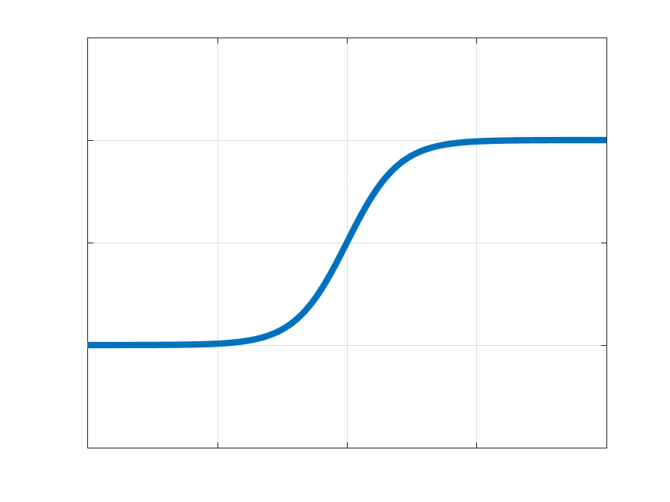
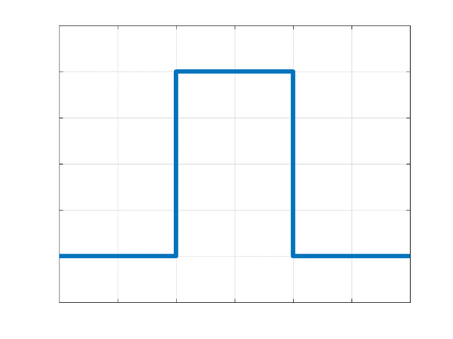
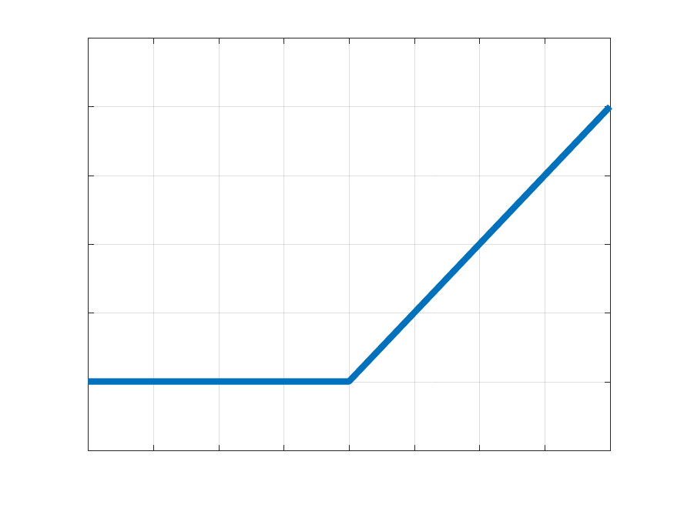
Basis functions – other
Sigmoid Functions
Bounded
Bin functions
Piecewise linear
Bounded
Not bounded
Globally defined
Locally defined
No continuity
Globally defined

Slide 26
Background details on different basis functions:
http://madrury.github.io/jekyll/update/statistics/2017/08/04/basis-expansions.html

Slide 27
Chapter: Motivation
Chapter: Linear Models
Chapter: Loss functions
Chapter: Regularization & Validation
Chapter: Practical considerations
Chapter: Summary

Slide 28
Loss functions
The loss functions measures the accuracy of the model based on the training dataset
The best model we can obtain, is the minimum loss model
Choice of a loss function is fundamental in the regression problem
Minimize the loss function $L$ for the training dataset consisting of independent variables $\vec{x}$ and target variables $\vec{y}$ by variation of the basis function weights $\vec{w}$.

Slide 29
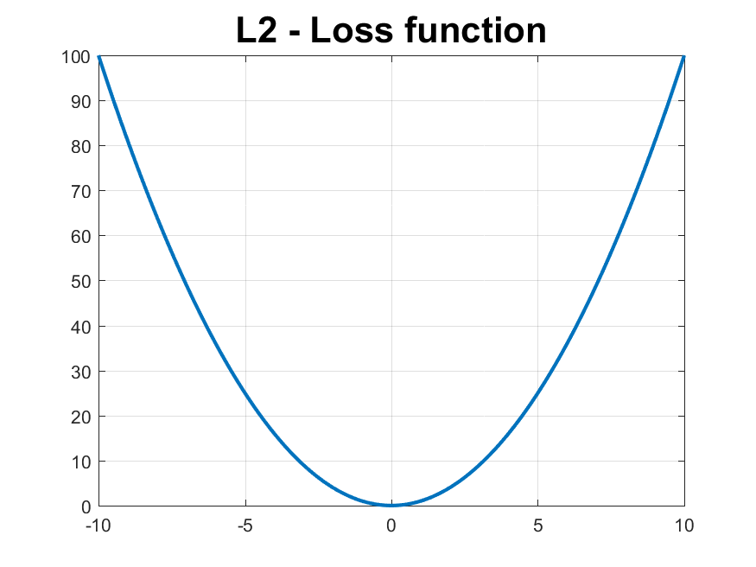
Loss functions – Mean Squared Error (MSE or L2)
Pro‘s:
Very important in practical applications
Solution can be easily obtained analytically
Con‘s:
Not robust to outliers
Examples:
Basic regression
Energy optimization
Control applications

Slide 30
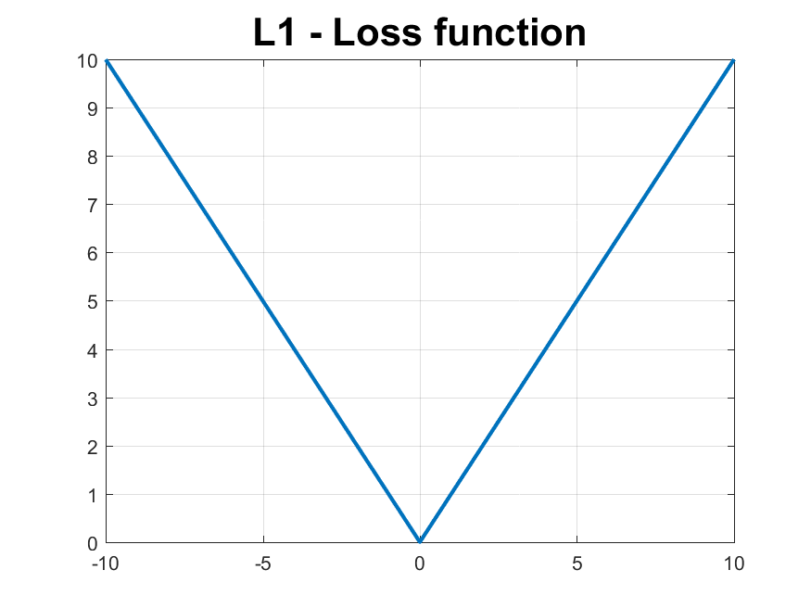
Loss functions – Mean Absolute Error (MAE or L1)
Pro‘s:
Robust to outliers
Con‘s:
No analytical solution
Non-differentiable in the origin
Examples:
Financial applications

Slide 31
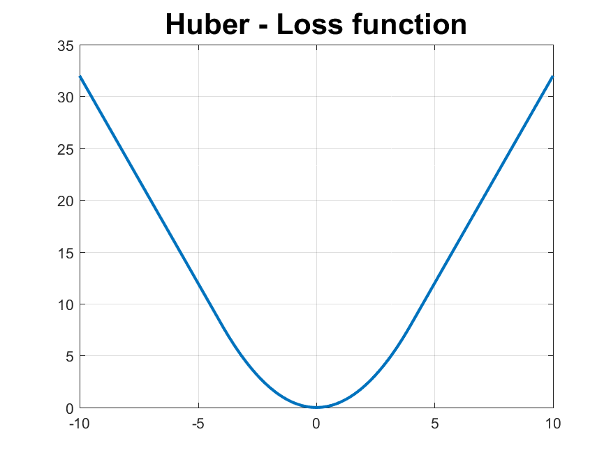
Loss functions – Huber Loss
Pro‘s:
Combines strengths and weaknesses of L1 and L2 loss functions
Robust + differentiable
Con‘s:
More hyperparameters
No analytical solution

Slide 32
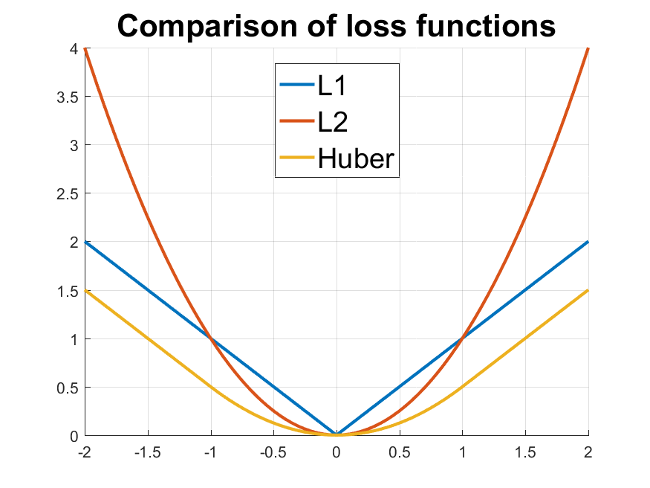
Loss functions – Comparison
L2 loss is differentiable
L1 loss is more intuitive
Huber Loss combines theoretical strengths of both
Practical hints:
Start with L2 loss whenever possible
Think about physical insights and your intent!

Slide 33
Additional material on loss functions:
Good overview and basic discussion of pro‘s and con‘s of different loss functions
https://heartbeat.fritz.ai/5-regression-loss-functions-all-machine-learners-should-know-4fb140e9d4b0
In detail comparison of MSE and MAE loss functions and their robustness
http://rishy.github.io/ml/2015/07/28/l1-vs-l2-loss/

Slide 34
Analytic Solution – Low dimensional example
Solve the optimization problem
with the model
Insert the model and data points
In general, optimal solutions are obtained at the points where the gradient vanishes to zero.

Slide 35
Analytic Solution – Low dimensional example
Calculate the gradient
and set it equal to zero

Slide 36
Analytic Solution – Low dimensional example
Solve the resulting equation (also called normal equation):

Slide 37
Analytic Solution – General form
Minimizing MSE loss function can be rewritten in matrix form
Optimum value for $w$ is equal to setting the gradient to zero and solve for
The importance of this loss function is tightly related to the fact that the analytical solution is available and can be calculated explicitly for low- to medium sized datasets!

Slide 38
Detailed derivation of least squares solution
Taking the gradient with respect to $w$
From the necessary condition for a minimum, it follows that
The term is also called the Moore-Penrose pseudo-inverse. It is also the MSE solution of an overdetermined system of equations of the form $\vec{b}=A\vec{x}$ with A being a tall, full-rank matrix. Note the equivalence of the problem formulation using the Data Matrix before.

Slide 39
Sequential Analytic Solution - Motivation
Consider the following cases:
Apply regression during operation of the product
There is not enough memory to store all data points
A possible solution is given by Recursive Least Squares (RLS)
Actual best estimate
RLS Update rule
New data point

Slide 40
Sequential Analytic Solution – The algorithm
New data point: $\left\{\overline{x},\overline{y}\right\}$
Update the parameters
And the memory matrix $P$
with $I$ being the identity matrix of appropriate dimension
Prediction based on old parameters
Old parameter estimate
Correction gain
Residual

Slide 41
Please note the following facts:
The initialization of this algorithm is a crucial part in its application. There are two major possibilities:
Initialize by using the first datapoints available
Initialize using values which you assume to be right, e.g. obtained from first principles
The first technique leads to the solution of the ordinate least squares problem. The second technique however, is tighly related to the regularization techniques already discussed. If one initializes the parameters as follows
$$P\left(0\right)=λ^{−1}I$$
$$w\left(0\right)=0$$
the resulting solution $w\left(k\right)$ is equivalent to the solution of the L2 regularized least squares problem. Moreover, you have the possibility to set a starting value. This can be helpful if a first principles model is available which should be refined online.
Moreover, the presented algorithm is tightly connected to the Kalman Filter algorithm. In this case, $P$ takes the role of the estimation covariance matrix and $w$ is the corresponding state estimate. More details on this correspondence can be understood from the carefuly comparison of the update equations of both algorithms. This constitutes the fact, that the Kalman Filter delivers the least squares state estimate.

Slide 42
Sequential Analytic Solution – Forgetting factor
Some applications show slowly varying conditions in the long term, but can be considered stationary on short to medium time periods
Aging of products leads to slight parameter changes
Vehicle mass is usually constant over a significant period of time
The RLS algorithm can deal with this by introduction of a forgetting factor $γ$. This leads to a reduction of weight for old samples.

Slide 43
Numerical Iterative Solutions
Regression can be solved numerically
Important for large-scale problems and for non-quadratic loss functions
Popular methods:
Gradient descent
Gauss-Newton
Levenberg-Marquardt
Pro‘s:
Very generic
Con‘s:
Knowledge about numeric optimization necessary
Optimum
Cost function
Parameter

Slide 44
Constraints on the weights
Weights can be interpreted as physical quantities
Temperature (non-negative)
Spring constants (non-negative)
Mass (non-negative)
A valid range is known for the weights
Tire and other friction models
Efficiency ( 0 – 100 % )
Improves robustness
More difficult to solve

Slide 45
How to solve the regression problem?
Is the cost function quadratic?
yes
no
Are there parameter constraints?
no
yes
Is the dataset very large?
no
yes
Is all data available instantanously?
yes
no
Analytic Solution
Sequential Analytic Solution
Numeric Iterative Solution

Slide 46
Chapter: Motivation
Chapter: Linear Models
Chapter: Loss functions
Chapter: Regularization & Validation
Chapter: Practical considerations
Chapter: Summary

Slide 47
How to choose the model?
Underfitted
Well done
Overfitted
Not enough features
Wrong structure
Too many features
Unrelevant features

Slide 48
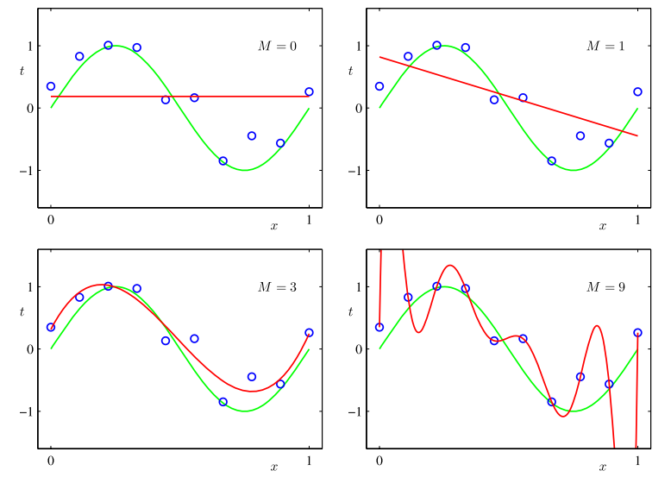
Overfitting – Choice of hyperparameters
Overfitting is the failure to generalize properly between the data points
Cost function decreases with increased model complexity
Noise and unrelevant effects become too important
Figure source: Bishop – Pattern Recognition and Machine Learning

Slide 49
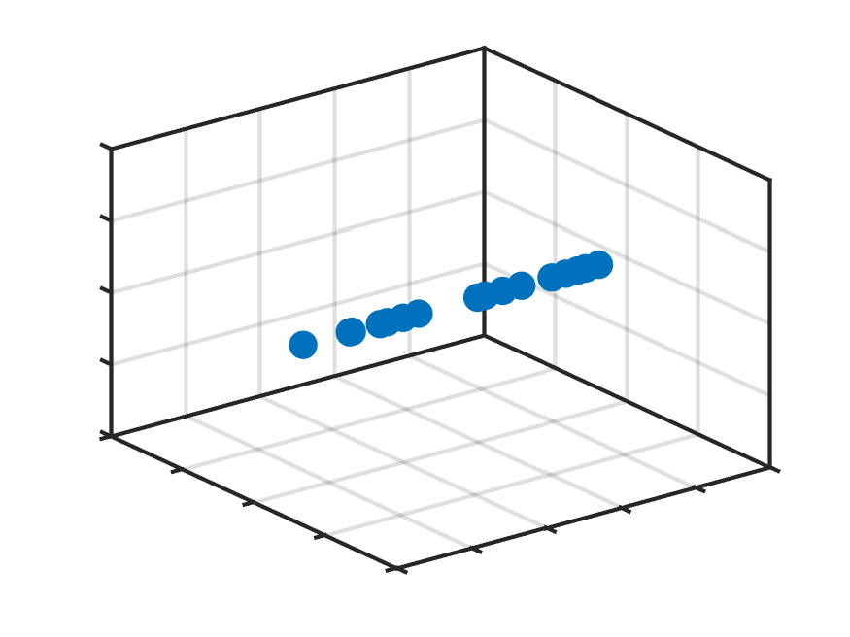
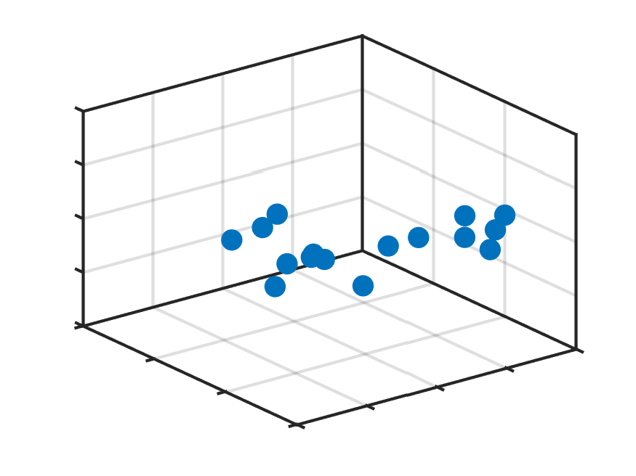
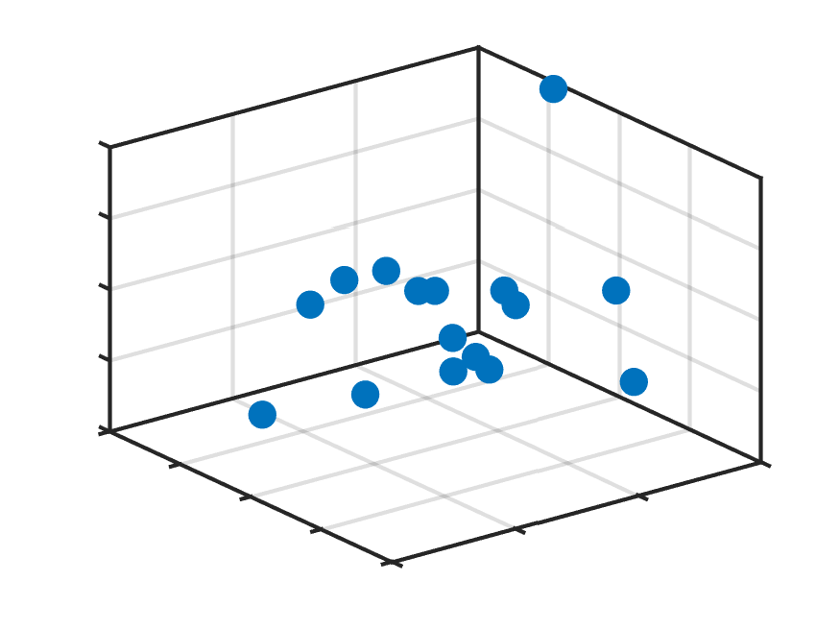
Overfitting – Curse of dimensionality
Overfitting occurs if
data points are sparse
Model complexity is high
Sparsity of data points is difficult to grasp
Sparsity increases fast with increased input dimension
16 samples
in one, two and three dimensional space

Slide 50
The curse of dimensionality is a widespread problem along all data based algorithms. The most intuitive is the combinatorical aspect mentioned on the slide before. It affects the required sample size as well as the computational effort needed. Beside the mathematical implications, it is therefore of big impact regarding feasible implementations in a descent time and can be considered critical for the application of systems with real time constraints.
Despite the raw number of samples, it is helpful in regression if the samples are „nicely“ located in the sample space. This usually transforms to well-spread along the domain of interest. It is often possible to design the sample points in advance to the experiment carried out. In this case, techniques like Design of Experiment can help to optimize the location of sample points. This helps increasing the model quality with a limited sample size. (Further details can be found here: https://en.wikipedia.org/wiki/Design_of_experiments)
There are other effects related to the dimensionality of the spaces as well. A fundamental one which is more difficult to grasp is the fact, that distances become less meaningful in high dimensional space. (Details can be found here: https://en.wikipedia.org/wiki/Curse_of_dimensionality)

Slide 51
Validation datasets
Difficult to judge overfitting in high-dimensional domains and autonomous systems
A standard technique is to separate the data into training and validation data
Validation Data
Train model A
Evaluate
Training Data
Available Data
Train model on complete Dataset
Train model B
Evaluate
Train model C
Evaluate
Best model

Slide 52
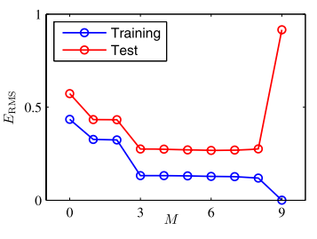
Validation datasets
Different hyperparameters can be used to tune the model
Validation technique works for all of them
Figure source: Bishop – Pattern Recognition and Machine Learning
Increased Model Complexity

Slide 53
Common pitfalls with validation datasets
Be aware that your validation dataset must reflect the future properties of the underlying physical relationship.
Do not reuse validation datasets. If the same validation set is used again and again for testing the model performance it is somehow incorporated into the modelling process and does not give the expected results anymore!
Split the data before fitting the model is therefore essential. Taking 2/3 of the data as training data is a good starting value.
Visualize your data as much as possible!

Slide 54
k-Fold Cross-validation
In case of limited data size sets, one may not want to remove a substantial part of the data for the fitting process
One can use smaller validations sets to estimate the true prediction error by splitting the data into multiple ‚folds‘
Variance of the estimation error is an indicator for model stability
Training Data
Validation Data
Validation Data
Validation Data
Validation Data
fold

Slide 55
Regularization
From a design point of view, we want to choose model structure based on underlying physical principles and not on the characteristics of the dataset
Polynomial basis functions tend to have large coefficients for sparse datasets
Gaussian basis functions tend to overfit locally, which leads to single, large coefficients
A technique to circumvent this is regularization
Penalize high coefficients in the optimization prevents these effects
Weighting of penalty term gives an intuitive hyperparameter to control model complexity

Slide 56
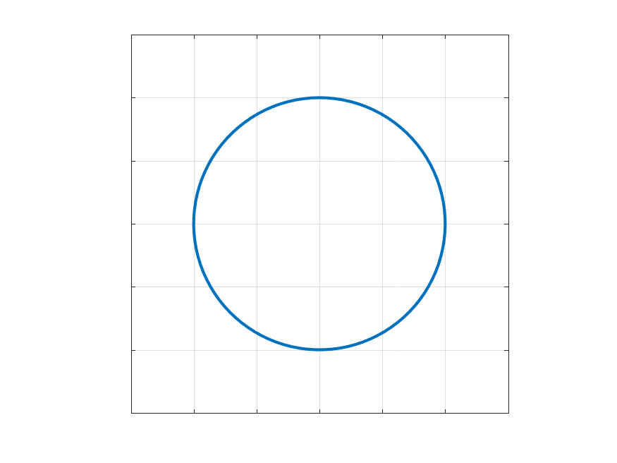
Typical Regularization – Ridge Regression
Other names: L2 regularization, Thikonov regularization
Prevents overfitting well
Analytic solution is available as an extension to the MSE problem
Difficult to apply and tune in high-dimensional feature spaces
Regularization Term

Slide 57
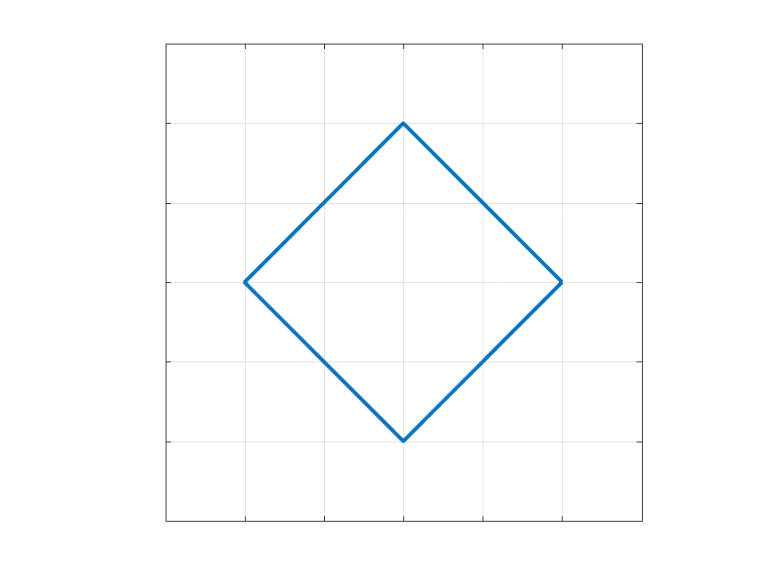
Typical Regularization – Lasso Regression
Other names: L1 regularization
Tends to produce sparse solutions and can therefore be applied for feature selection
Sparse solution means, that several coefficients go to zero:
Regularization Term

Slide 58
Comparison between ridge and lasso regularization:
https://www.analyticsvidhya.com/blog/2016/01/complete-tutorial-ridge-lasso-regression-python/
https://codingstartups.com/practical-machine-learning-ridge-regression-vs-lasso/

Slide 59
Application of regularization
Use high dimensional input space for test model
Ridge regression is applied
Regularized solutions perform far better at interpolation
Note: You must evaluate at points BETWEEN your sample points

Slide 60
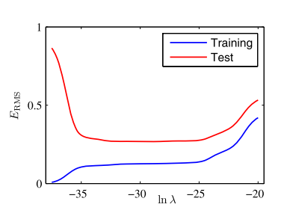
Tuning regularization with validation data
Figure source: Bishop – Pattern Recognition and Machine Learning
Increased Model Complexity

Slide 61
Bias Variance Trade Off
The issue of over- and underfitting can be formalized
Study the predictor performance on a previously unseen data set
Assume that the observations are corrupted by noise
The variance of the test data is then written as
Bias
Variance
Noise

Slide 62
Derivation of the Bias-Variance decomposition following
https://towardsdatascience.com/mse-and-bias-variance-decomposition-77449dd2ff55
Using the fact that holds for the first and the second term we obtain
Since we evaluate on previously unseen data, the last term vanishes ( The noise of new measurements is independent of the fitted model and zero mean).

Slide 63
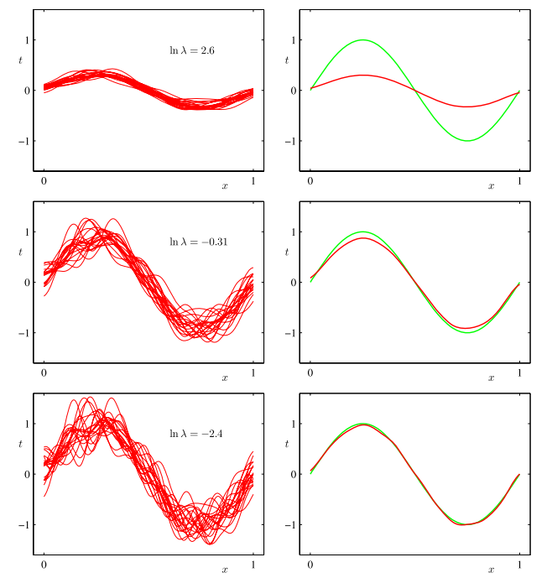
Regularization in context of Bias-Variance Trade-Off
Imagine you can repeat the fitting process lots of times
This renders the fitting process a random experiment
Model Bias: The mean error over all possible fits of the model
Model Variance: The variance of all possible fits of the model
High Variance
High Bias
Figure source: Bishop – Pattern Recognition and Machine Learning

Slide 64
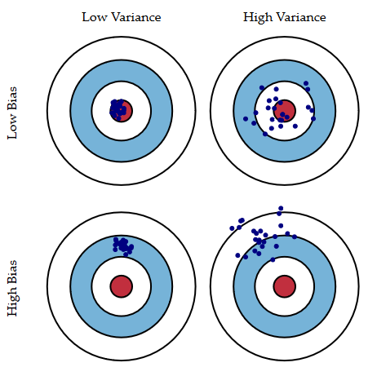
Regularization in context of Bias-Variance Trade-Off
Bulls-Eye: True model
Each hit is a realization of prediction model
In general, we cannot ensure to reach low bias and low variance at the same time
We have to balance bias and variance according to our objective
Low bias and low variance require large, high quality datasets
Source: Scott Fortmann-Roe

Slide 65
Chapter: Motivation
Chapter: Linear Models
Chapter: Loss functions
Chapter: Regularization & Validation
Chapter: Practical considerations
Chapter: Summary

Slide 66
Comparison regression and intuitive solution
Regression: Minimize the error in output domain
Independent Variables are assumed noise free
Often not true in engineering applications
Total least squares
Principal component analysis
Standard linear regression

Slide 67
Normalization – Input data
Regression implies inversion of design matrix
Numerically expensive and can get unstable
In general, all matrix entries variables should lie within the same order of magnitude!
Examples for scaling and mean value normalization
Multiple length measures should be transformed to the same unit
Variables which do not have any physical relation should be transformed based on their min/max values
Temperatures are likely to be far away from zero, they should be normalized by a mean temperature

Slide 68
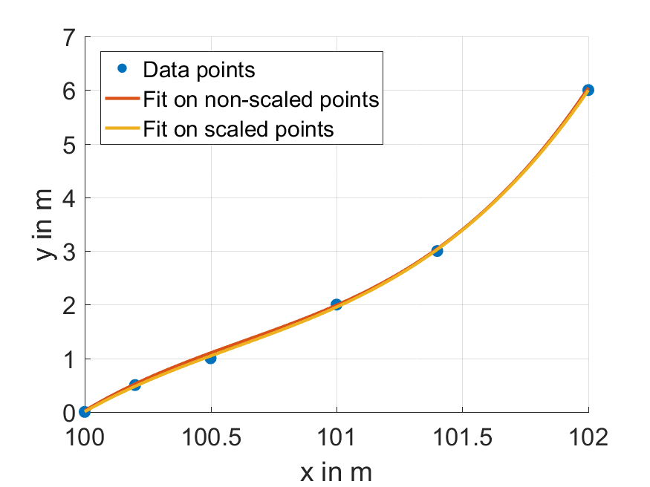
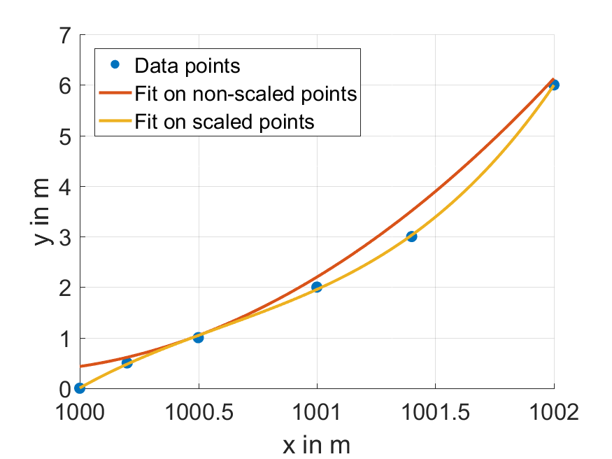
Normalization – Input data

Slide 69
The plots in the slide before were obtained by fitting a regression based on the simple polynomial basis to the data points. The basis functions in this example are
$$\begin{matrix}1 & x & x & x^{2}\end{matrix}$$
This leads to the fact, that the design matrix becomes ill-conditioned very fast for large input data. It results from the polynomials which lead to a design matrix (depicted for x = 1000 and 1001) of
$$\left[\begin{matrix}1 & 1000 & 1000000 & 1000000000 \\ 1 & 1001 & 1002001 & 1003003001 \\ … & … & … & …\end{matrix}\right]$$
Instead of (depicted for x = 0 and x = 1)
$$\left[\begin{matrix}1 & 0 & 0 & 0 \\ 1 & 1 & 1 & 1\end{matrix}\right]$$
The latter matrix is far easier to solve by numeric computations. The intuition behind this is that the ‚spread‘ between the matrix entries is much smaller. This helps the computer to obtain a numerically stable result since the precision is limited even in floating point operations. As a result from this, the maximum ‚spread‘ leading to reliable results is depending on the available computation precision. This is much more critical on embedded hardware.

Slide 70
Normalization – Output data
In engineering applications we often face the task to fit parameters such that multiple objectives are met
These may not lie within the same units or scale
Example:
Estimate the driven curvature $κ$ based on speed $v$, yaw rate $\dot{ψ}$and lateral acceleration $a_{y}$
Model equations: $\dot{ψ}=vκ$ and $a_{y}=v^{2}κ$
Scale varies heavily with speed and is inconsistent between the two equations
Better use: $\frac{\dot{ψ}}{v}=κ$ and $\frac{a_{y}}{v^{2}}=κ$
Scaling the output equations can also be used to weight equations which are more important than others

Slide 71
Chapter: Motivation
Chapter: Linear Models
Chapter: Loss functions
Chapter: Regularization & Validation
Chapter: Practical considerations
Chapter: Summary

Slide 72
Summary
We learned about:
the characteristics of a regression problem and learned about the differences to clustering and classification
the difference between linear and nonlinear regression
use cases and applications for regression in Automotive Technology
different applications for local and global basis functions
different loss functions
iterative and analytic solution methods for model training
regularization techniques and validation techniques
details which are important for succesful application of regression to real world data

Slide 73
Related Literature
Christopher M. Bishop, Machine Learning and Pattern Recognition
Trevor Hastie, Robert Tibshirani, Jerome Friedman, The Elements of Statistical Learning
Kevin P. Murphy, Machine Learning – A Probabilistic Perspective

